Slide 1
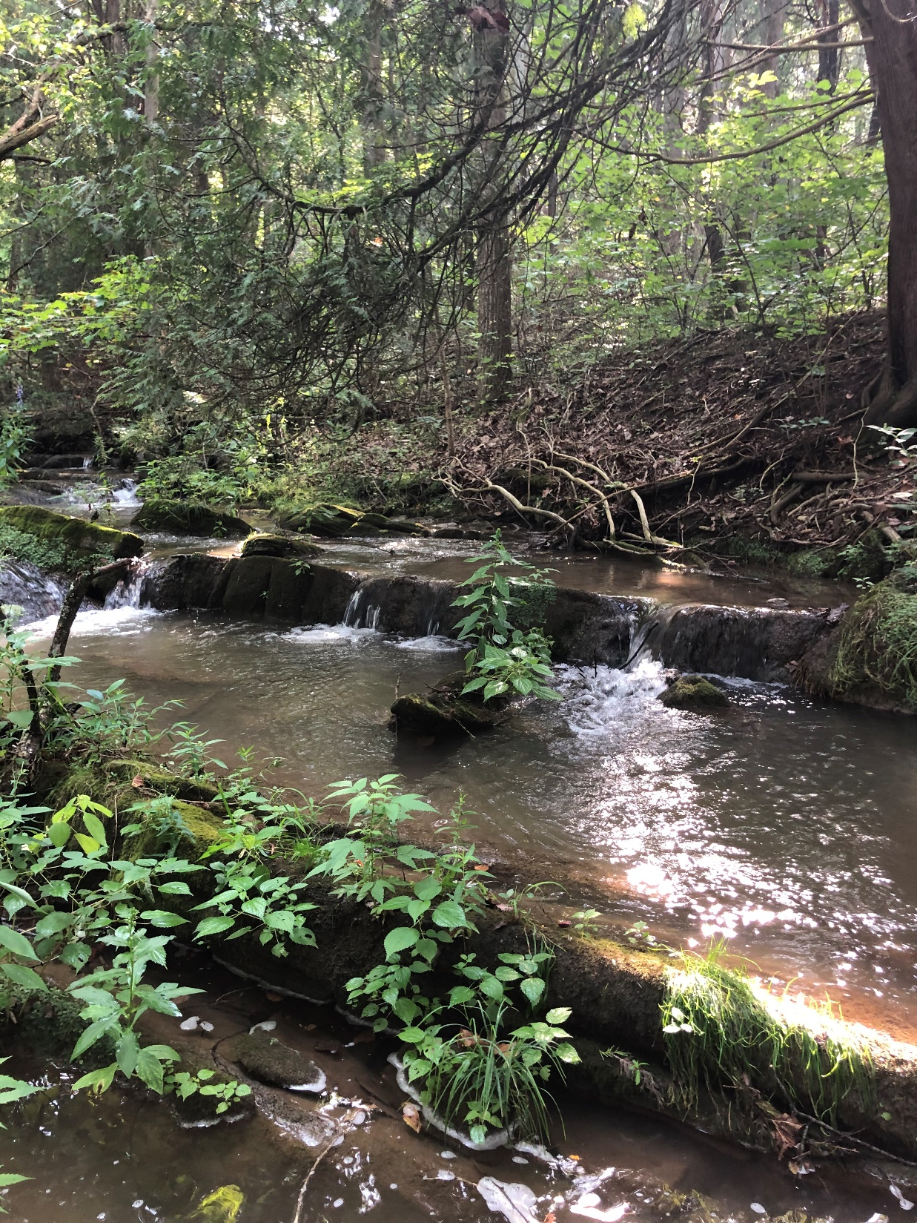
Moores and Mill Creek Clean Up Plan
Stakeholder Group Meeting
Nesha McRae
TMDL Coordinator, Valley Regional Office
November 17, 2022

Slide 2
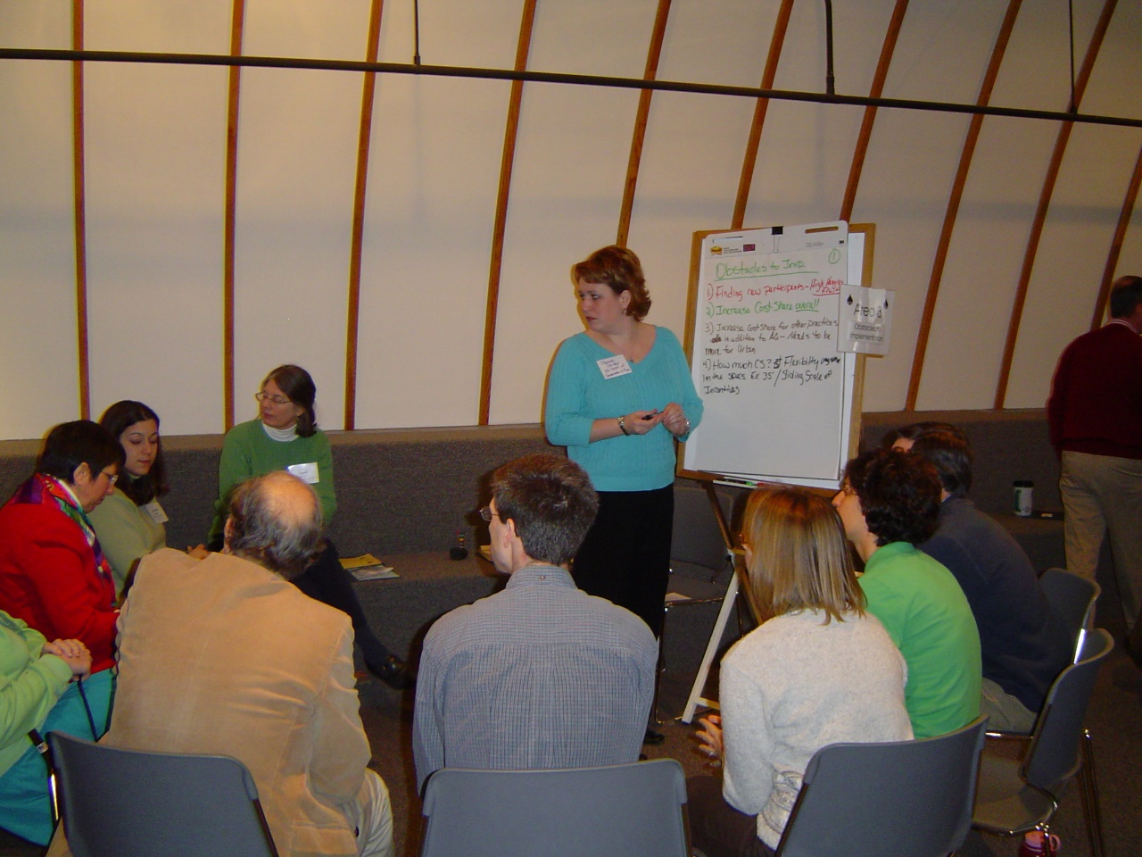
Role of the Stakeholder Group?
Provide a local perspective
Guide the development of the clean-up plan
Identify suitable Best Management Practices
Identify priority areas for implementation
Review costs
Establish a timeline
Develop outreach strategies
Identify key players in the community

Slide 3
Moores and Mill Creek Watersheds
3,830 acres
7,390 acres

Slide 4
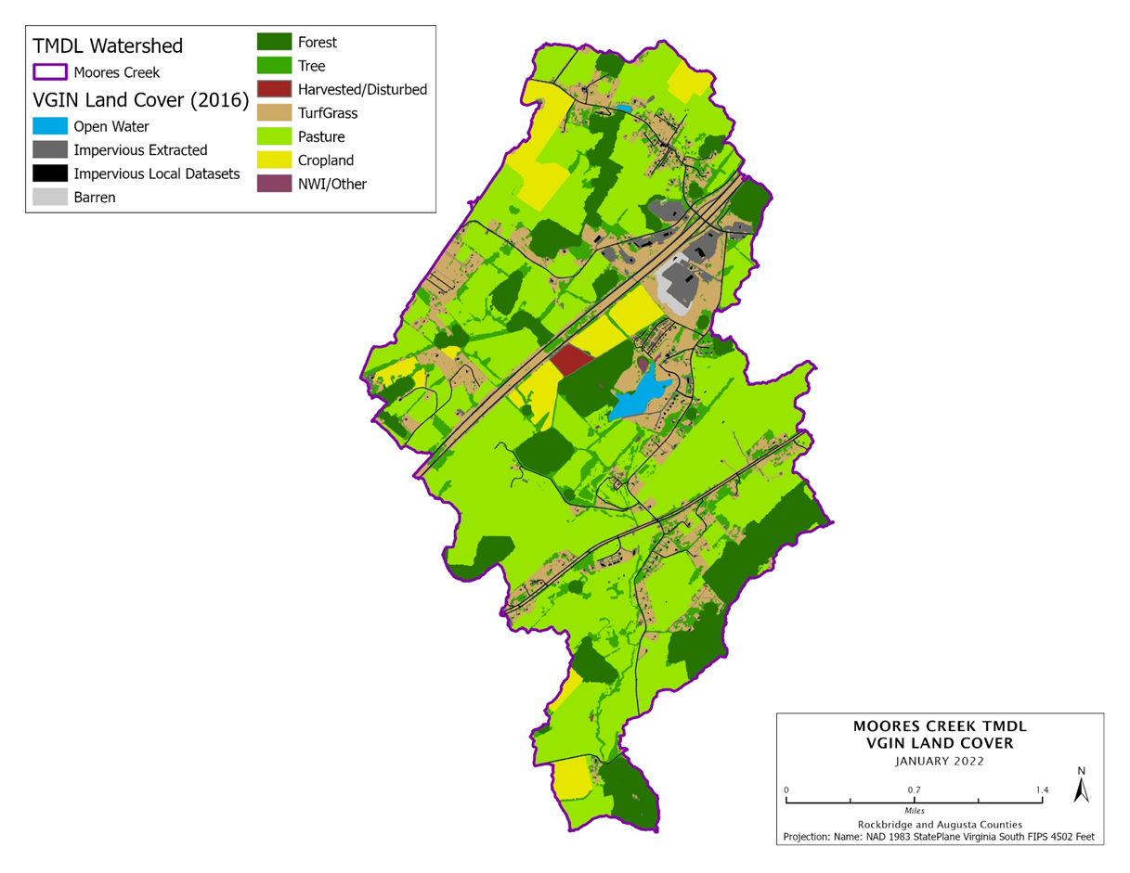
Moores Creek Land Use
1,775 acres of pasture/hay
240 acres of cropland
535 acres of turfgrass
200 acres developed
15 acres barren
7.1 miles of streambank

Slide 5
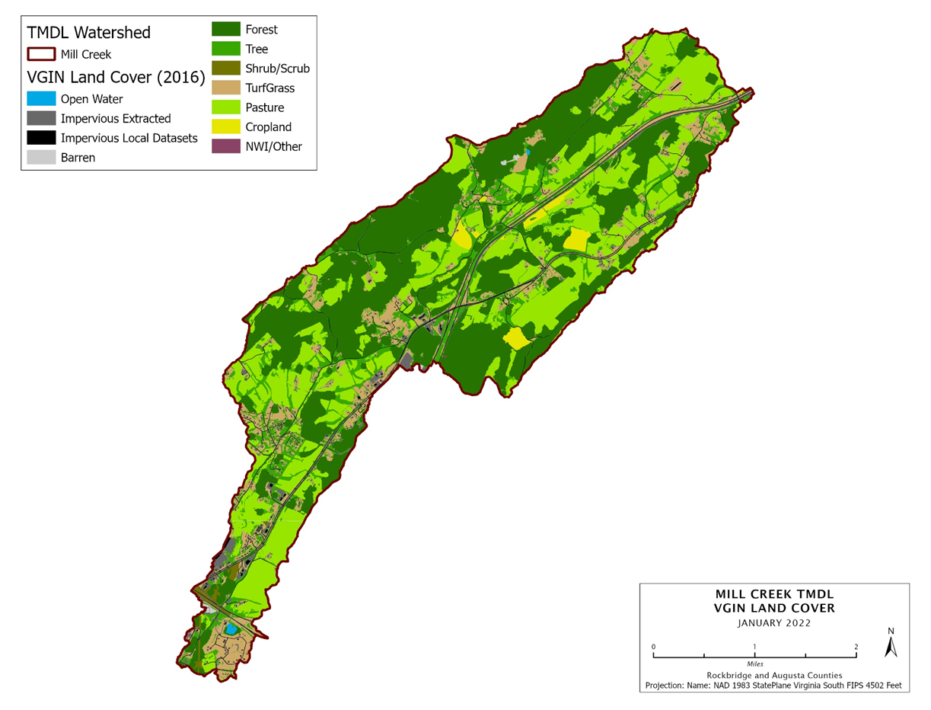
Mill Creek Land Use
2,190 acres of pasture/hay
105 acres of cropland
700 acres of turfgrass
450 acres developed
9 acres barren
12.8 miles of streambank

Slide 6
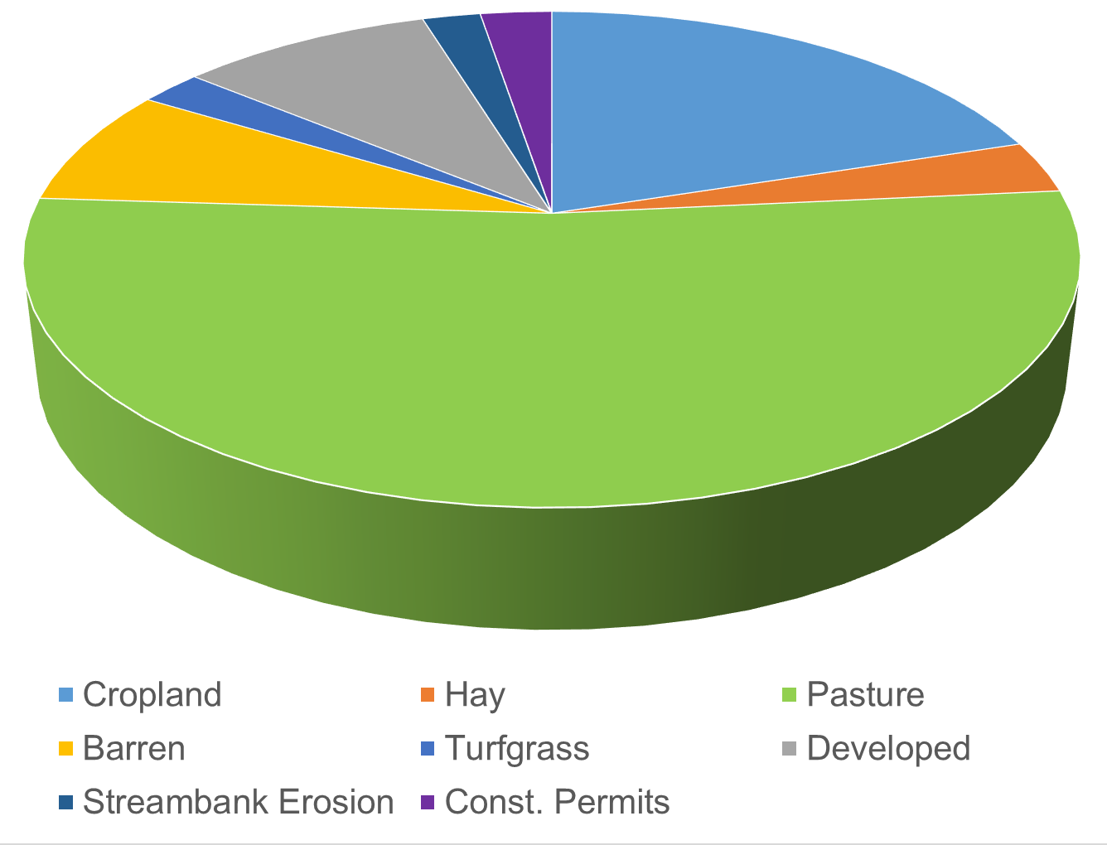
Sediment sources in Moores Creek
An estimated 17% reduction in sediment is needed to restore aquatic life in Moores Creek

Slide 7
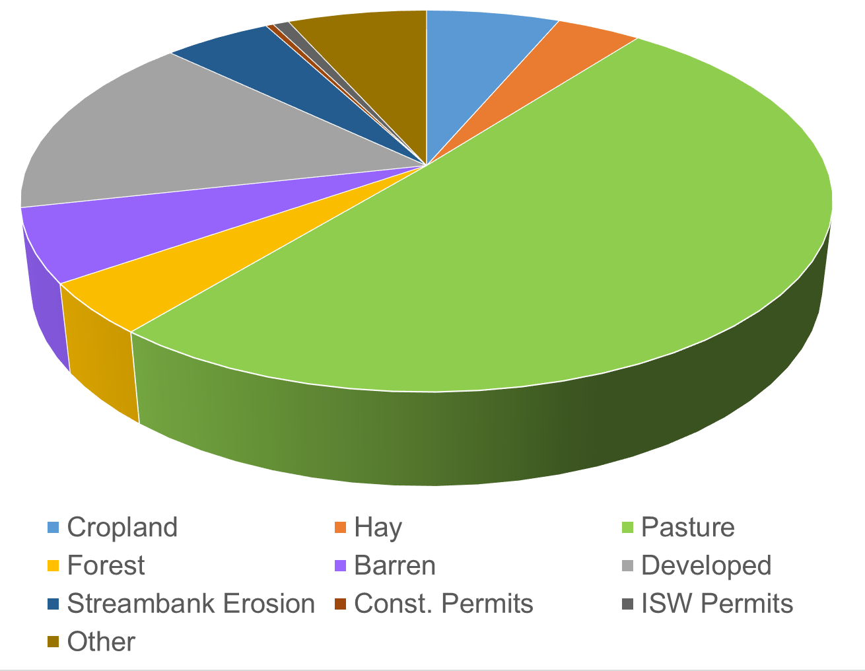
Sediment sources in Mill Creek
An estimated 18% reduction in sediment is needed to restore aquatic life in Mill Creek

Slide 8
Sediment reduction goals
Source | Moores Creek | Mill Creek
Cropland, Pasture, Hay | 23% | 25%
Streambank erosion | 23% | 25%
Developed land | 8.5% | 13.5%
Barren land | 8.5% | 13.5%
Turfgrass | 8.4% | 13.5%

Slide 9
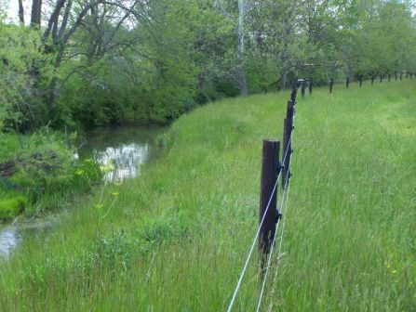
How to meet reduction goals?
Identify best management practices for agricultural, urban and residential land
Consider cost effectiveness
Evaluate likelihood of implementation
Identify priority areas for implementation with existing interest

Slide 10
Prioritizing practices: Agricultural
Practice type | Practice description | Sediment reduction | Priority
Livestock exclusion | Livestock exclusion with narrow buffer and grazing mgmt. | 40%
 | Livestock exclusion with wide buffer and grazing mgmt.
 | Livestock exclusion with buffer, no off-stream water
Pasture practices | Precision intensive rotational/prescribed grazing | 30%
 | Streamside buffer: grass and shrub | 40%
 | Streamside buffer: forested | 70%
 | Permanent vegetative cover on critical areas | 75%
 | Aforestation of erodible pasture | LU Change
Cropland practices | Long term vegetative cover on cropland | 75%
 | Continuous no-till | 70%
 | Cover crop | 20%

Slide 11
Other Agricultural Practices?
Practice type | Practice description | Priority

Slide 12
Prioritizing practices: Urban/Residential
Practice type | Practice description | Sediment reduction | Priority
Residential/Urban | Bioretention filters | 80%
 | Bioswales | 80%
 | Detention basin retrofit
 | Pervious pavement | 80%
 | Streamside buffer: grass/shrub | 50%
 | Streamside buffer: forested | 70%
Streambank stabilization |  | 50%

Slide 13
Other Urban/Residential Practices?
Practice type | Practice description | Priority

Slide 14
Focus areas for implementation?
Practice type | Practice description | Focus area description

Slide 15
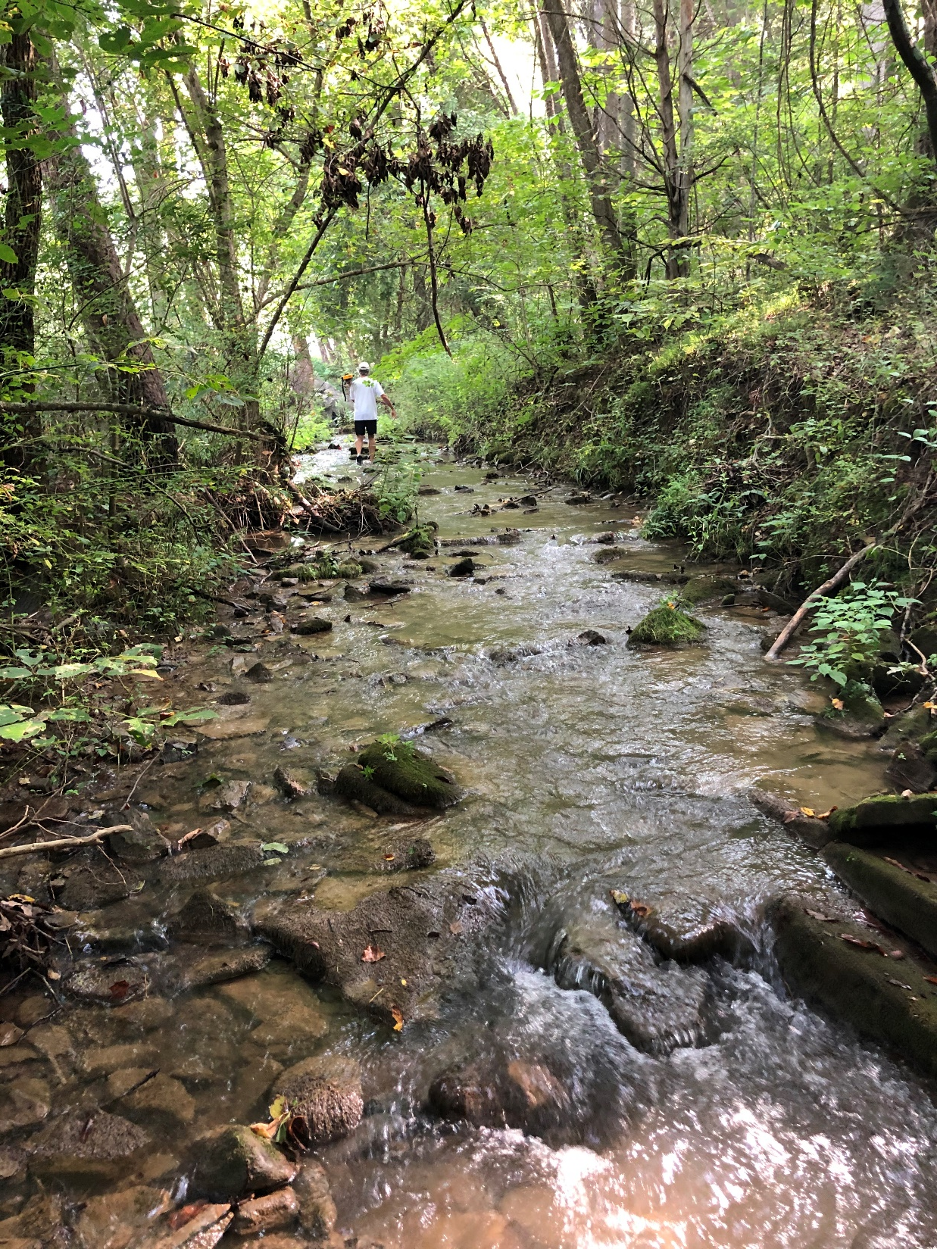
as
What’s Next?
2nd Stakeholder Group Meeting
Mid-February meeting
Discuss cost estimates for selected BMPs
Scope out pilot projects
Identify outreach strategies
Discuss timeline for implementation

