Slide 2
Yeocomico River Water Quality Improvement Plan
Final Public Meeting
August 30th, 2022
Ashley Wendt
Technical Reviewer
Madison Whitehurst
Nonpoint Source and Data Coordinator
Virginia Department of Environmental Quality

Slide 3
Agenda
Introductions
Watershed refresher
  what’s the issue and why do we need a water quality improvement plan?
Draft Plan- what’s in the plan?
Next steps
Questions and open discussion

Slide 4
Introductions
DEQ staff
Attendees

Slide 5
Why do we need a plan for clean water?
Virginia’s Continuous Planning Process:
Monitoring
Assessment
Reporting
Cleanup Studies
Cleanup Plans
Implementing Control Measures
Yeocomico River Watershed:
Why?
  High levels of bacteria (E. coli) in the watershed
Concerns:
  Recreational use impairment
    - Human health concern
  Shellfish harvesting restrictions
Clean Water
Notes:
The primary benefit of this implementation is cleaner water in the Bonum, Gardener, Jackson, Mill, Lodge Creeks and the West Yeocomico River/Hampton Hall Branch. The goal is to implement the IP so that fecal contamination may be reduced and allow for the removal of the condemnation of the shellfish growing areas. The benefit to the stakeholders (specifically the oyster growers) in these creeks would be that once the water quality is restored, they would no longer need to transport their floats to clean water to depurate oysters prior to consumption. Reducing fecal contamination levels in these creeks, from all anthropogenic sources will improve public health by reducing the risk of infection from fecal sources through contact with surface waters.
Also, satisfies WQMIRA. Written into state statute to develop a plan following a TMDL.

Slide 6
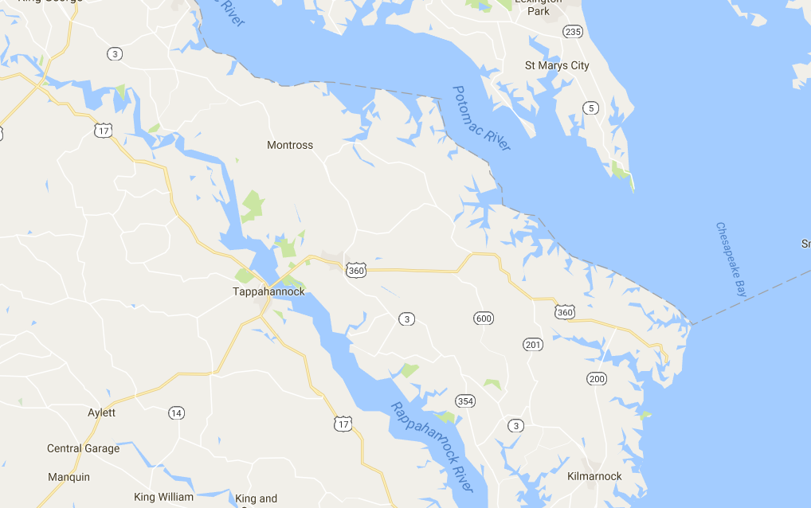
Implementation Plan Project Area

Slide 7
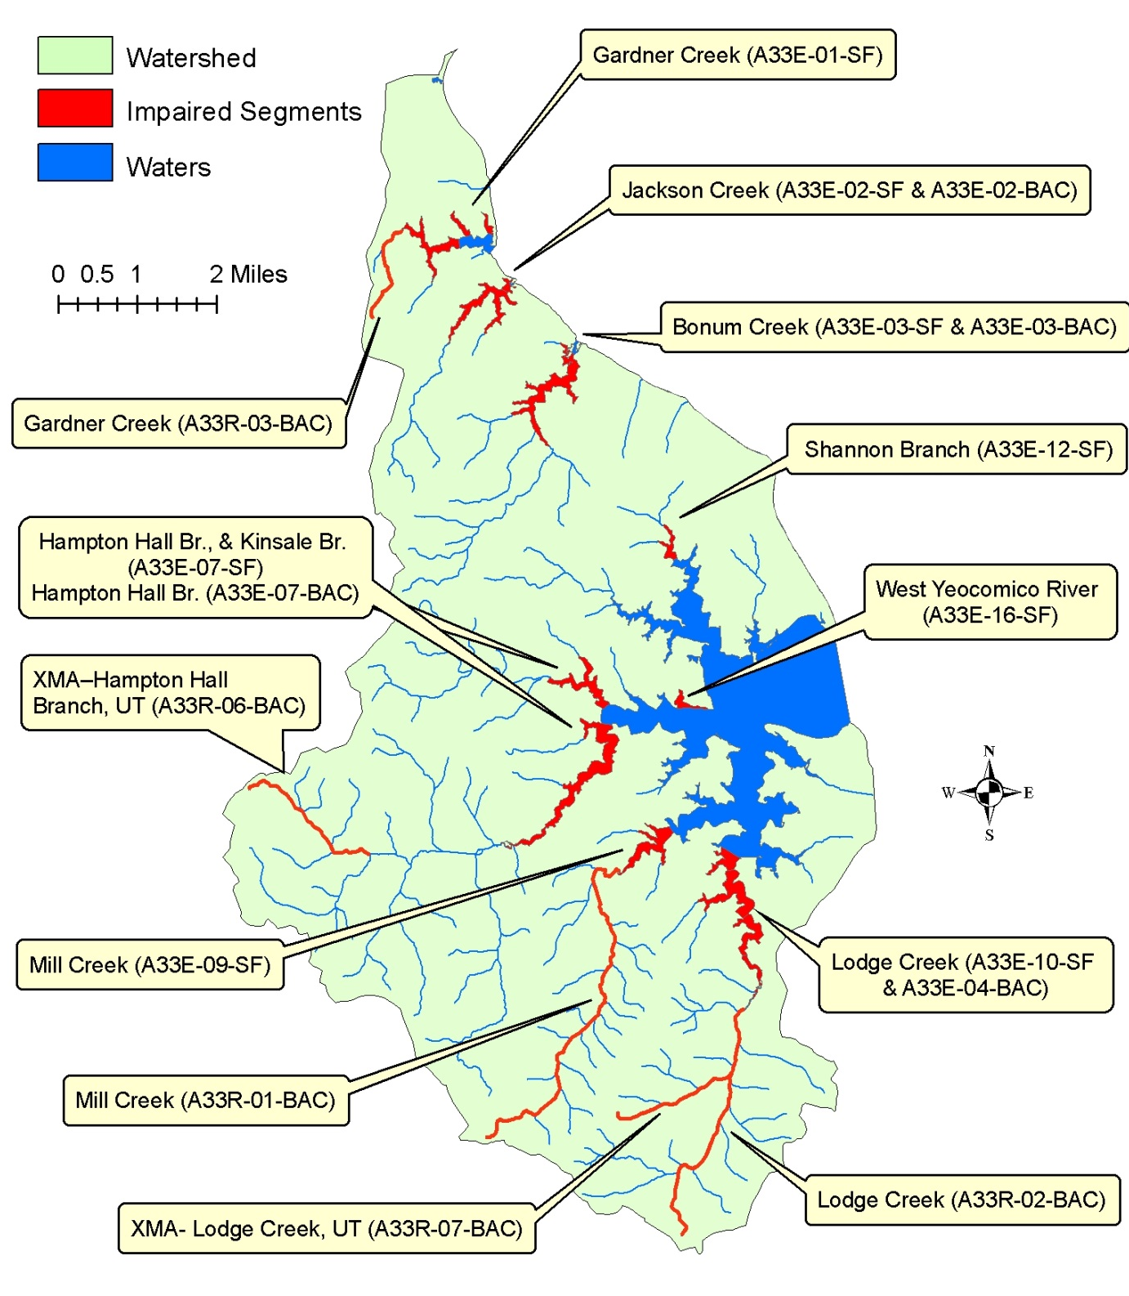

Slide 8
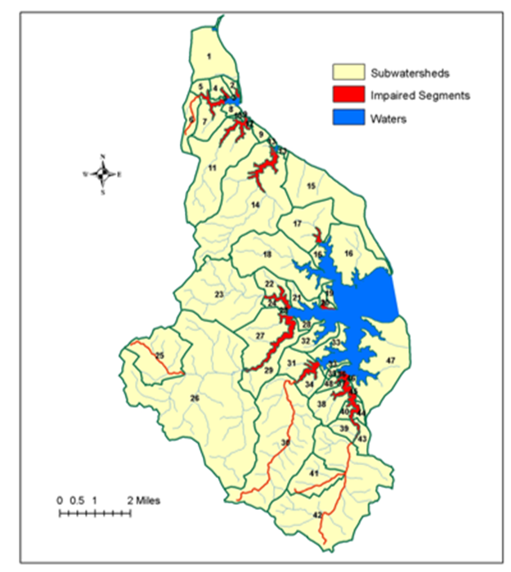
Yeocomico Watersheds
Water Name | Subwatershed ID
Gardner Creek-Tidal | 2, 4-7
Gardner Creek-Nontidal | 6
Jackson Creek | 10-12
Bonum Creek | 14
Shannon Branch | 17
West Yeocomico River | 20
Kinsale Branch | 22-24
Hampton Hall Branch | 25-27, 29
XMA – Hampton Hall Creek UT | 25
Mill Creek-Tidal | 30, 31, 34
Mill Creek-Nontidal | 30
Lodge Creek-Tidal | 36-46, 48
Lodge Creek-Nontidal | 41, 42
XMA - Lodge Creek, UT | 41

Slide 9
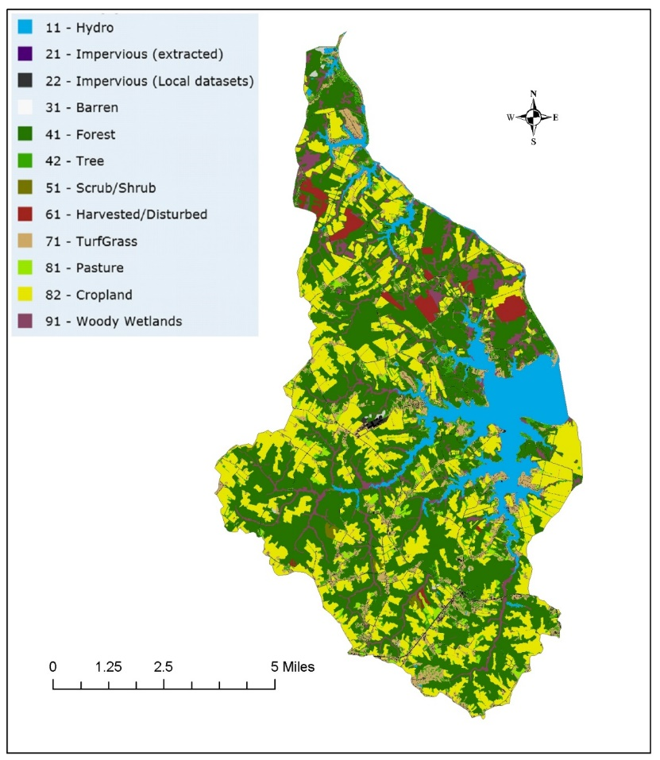
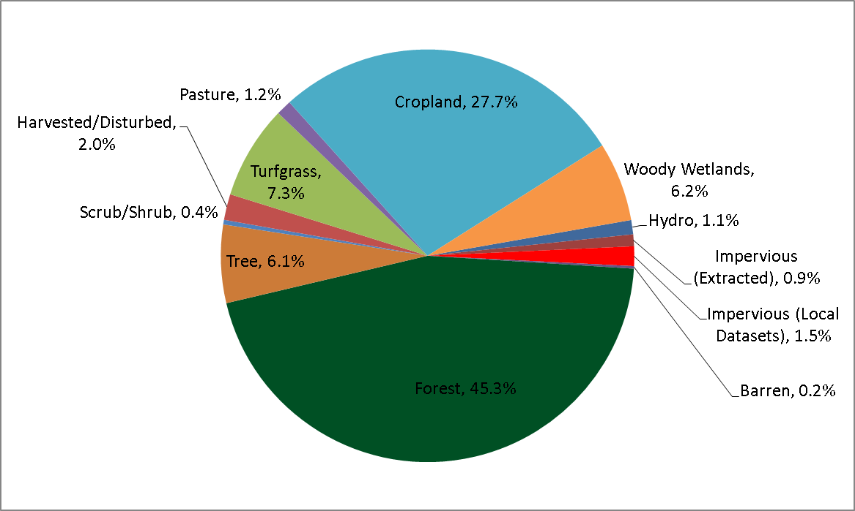
Project Area: Land Use and Pollutant Sources
The Project Area does not support Virginia’s bacteria standards for the production of edible and marketable seafood or for recreational use.
Notes:
This IP outlines a strategy for reducing anthropogenic loadings of bacteria to a level that complies with each TMDL. With completion of the IP, Virginia has identified a plan for meeting the water quality goals within the 5 creeks and a means to enhance local natural resources. Additionally, approval of the IP will enhance opportunities for funding during implementation.

Slide 10
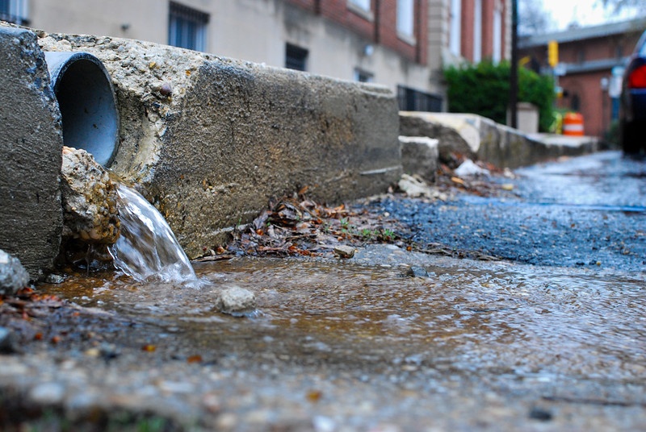
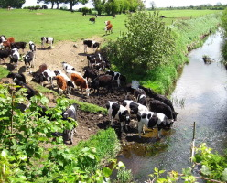
Potential Sources of Bacteria
Permitted Sources
  - Virginia Pollution Discharge Elimination Systems (VPDES)
Livestock
  - Direct deposit and runoff
Wildlife
  - Deer, turkey, geese, ducks, muskrats, raccoons, beavers
  - Direct to stream
Human
  - Straight pipes, failing septic systems
  - Residential runoff
Pets

Slide 11
What is in the cleanup plan?
Actions to improve water quality (BMPs)
Outreach strategies
Costs and benefits
Funding opportunities
Project timeline:
  - Implementation goals
  - Implementation milestones
Notes:
Also known as an Implementation Plan

Slide 12
Agricultural Best Management Practices
Notes:
Examples of the specific agricultural BMPs contained in the plan.

Slide 13
Residential and Pet Waste Best Management Practices

Slide 14
How long is it going to take?
10 year overall timeline
Phase 1 (First 5 years): Focus on the most cost effective BMPs and educational programs that reduce human, pet, and livestock sources of contamination.
Phase 2 (Second 5 years): This is when you go for the harder to reach goals.

Slide 15
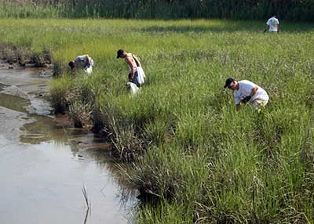
Education and Outreach
Target audiences identified for educational outreach programs:
  Recreational boaters: inform boaters about the availability of sanitary pump out facilities and the detrimental impact overboard discharge of human waste can have on water quality
  Aquaculture Education (“oyster gardening”): support educational efforts aimed to help homeowners set up their own system.
  Residential Education: address managing wildlife, pet waste, and proper care and maintenance of septic systems.

Slide 16
How much is it going to cost?

Slide 17
How are we going to pay for it?
USEPA 319 Funds (available through DEQ)
State Water Quality Improvement Fund
State Cost-Share Program and Tax Credits
USDA Programs – CRP/CREP/EQIP
State Housing and Urban Development Programs
Wildlife Habitat Incentives Program (WHIP)
Wetland Reserve Program (WRP)
National Fish and Wildlife Foundation
Southeast Rural Community Assistance Project, SERCAP
Northern Neck Planning District Commission

Slide 18
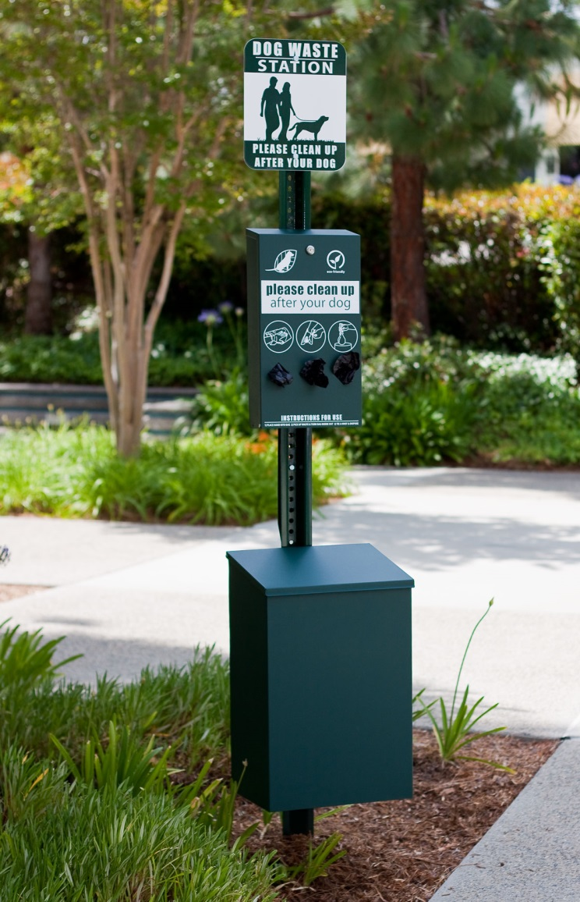
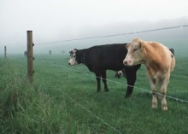
Implementing the plan…what’s next?
Pursue grant opportunities for residential BMP programs
Agricultural BMP implementation through Northern Neck SWCD and Natural Resource Conservation Service
Pursue partnerships with local schools and non-profits for education and outreach

Slide 19
Tracking Implementation Progress
BMP Reporting
  Grant funded BMPs are reported to DEQ, and input to DCR or DEQ databases.
  Biennial IP Progress reports (part of Annual NPS Program Report to EPA) capture all State-funded BMPs (most significantly VACS).
Water Quality Monitoring
  Improvements in water quality and implementation progress will ultimately be determined through monitoring conducted by DEQ’s monitoring programs and the VDH-DSS at bacteriological monitoring stations in accordance with its shellfish monitoring program

Slide 20
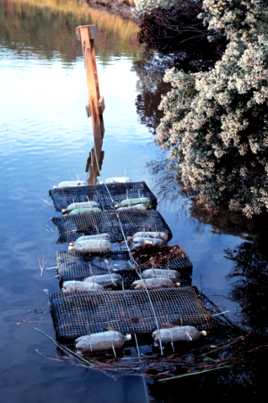
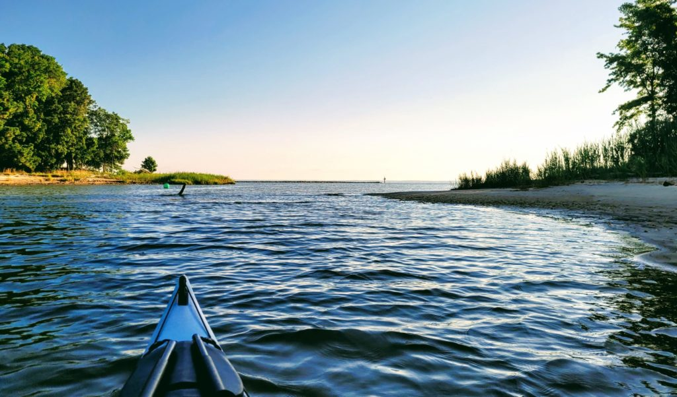
Why should you participate?
Economic benefits
  Agricultural producers
  Homeowners
  Local economy
Water quality benefits
  Environmental
  Human health

Slide 21
Next Steps
Public Comment Period for Draft IP: August 31, 2022 to October 1, 2022
  Submit written comments via traditional mail or e-mail by 11:59 PM on October 1, 2022
  Include name, address, and telephone number of the person submitting the comments
  Submit to: Ashley Wendt, DEQ – Central Office, 1111 E Main St. Suite 1400, Richmond VA 23219; ashley.wendt@deq.virginia.gov
Revisions based on public comment, DEQ will submit to EPA for their review/approval
EPA Approval of IP
  Once EPA approves, the IP watershed area will be eligible for Section 319 grants
Eligible to apply for DEQ 319 Funding:
  2024 Request for Applications will be open July-Aug 2023
  New Grant awards could start in Fall of 2024

Slide 22
Questions and open discussion

