Slide 1
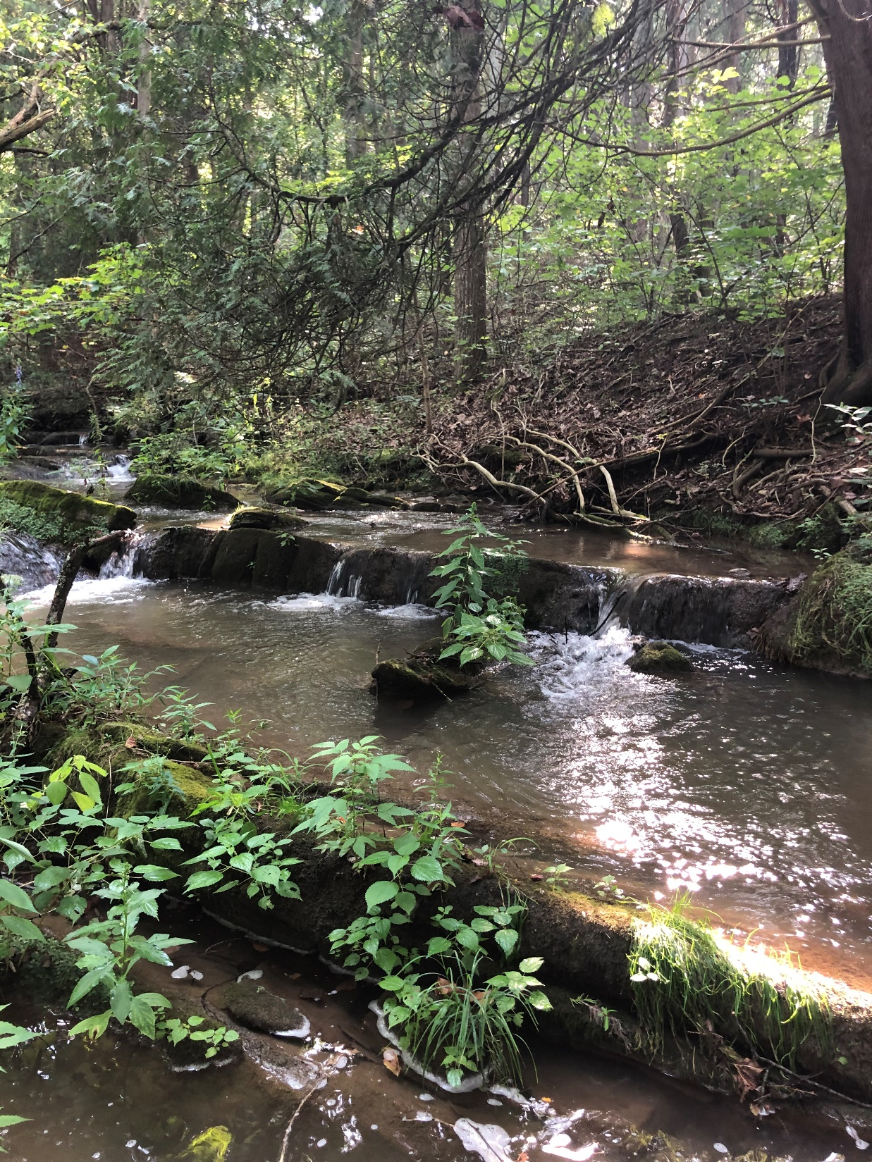
Hat and Black Creek Clean Up Study
Community Kick Off Meeting
Nesha McRae
TMDL Coordinator, Valley Regional Office
January 30, 2023

Slide 2
Goals for our meeting
Share what we know about Hat & Black Creek: Summarize monitoring data, discuss pollutants
Describe process we will use to identify and address pollution in the streams
Describe how you can get involved in this process
Answer your questions about this effort

Slide 3
Hat and Black Creek Watersheds

Slide 4
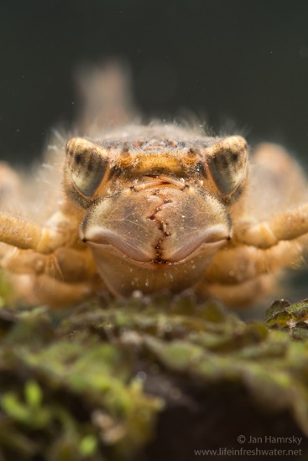
Why a study?
Photo: Jan Hamrsky: lifeinfreshwater.net
Aquatic life designated use
All waters should support “the propagation and growth of a balanced, indigenous population of aquatic life”
What does this mean?
Waters should be free of substances harmful to aquatic life
Monitor benthic macroinvertebrates (the bugs on the stream bottom) to determine if the standard is met

Slide 5
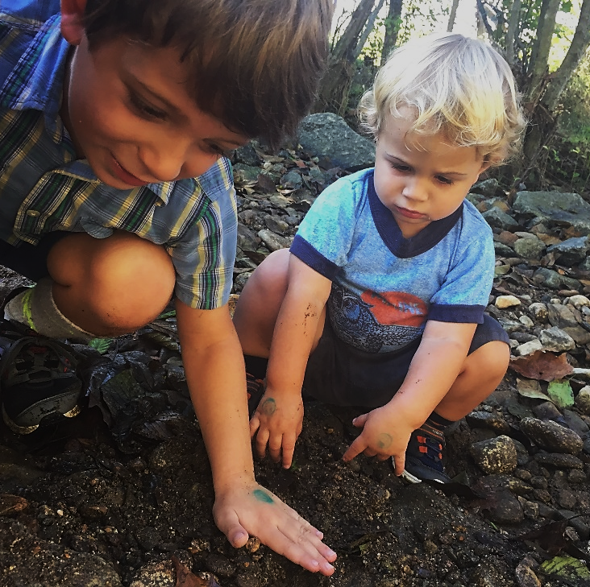
Why should we care about bugs?
Consume algae and organic matter → nutrient cycling
Aquatic food chain
Our “canary in the coal mine”
Chemical monitoring = a snapshot in time
Long lived
Relatively immobile

Slide 6
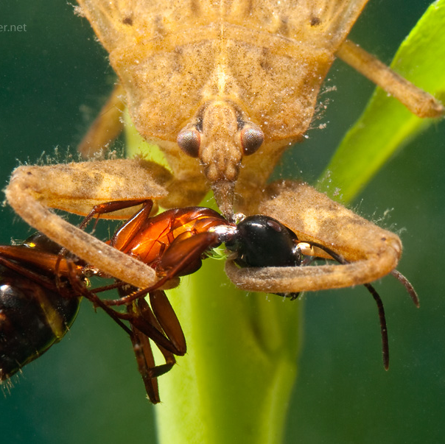
Determining a biological impairment
DEQ biological monitoring data (spring and fall)
VA Stream Condition Index is our barometer
Diversity, pollution tolerance, feeding group
Target score of ≥60

Slide 7
Sensitive to pollution: Stoneflies
Photo: Jan Hamrsky: lifeinfreshwater.net

Slide 8
Sensitive to pollution: Mayflies
Sensitive to pollution: Mayflies
Photo: Jan Hamrsky: lifeinfreshwater.net

Slide 9
Caddisflies
Sensitive to pollution: Caddisflies
Photo: Jan Hamrsky: lifeinfreshwater.net

Slide 10
Moderately Sensitive: Dragonflies
Photo: Jan Hamrsky: lifeinfreshwater.net

Slide 11
Insensitive to Pollution: Blackflies
Photo: Jan Hamrsky: lifeinfreshwater.net

Slide 12
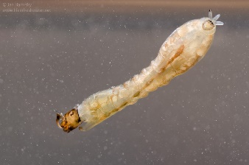
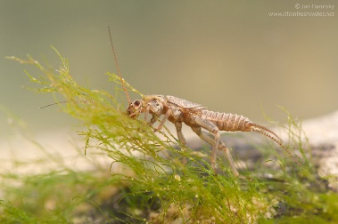
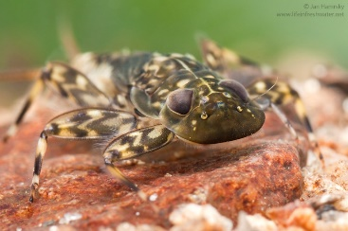
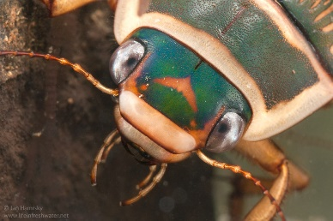
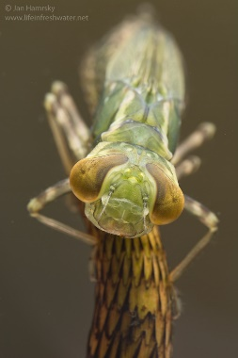
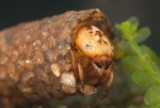
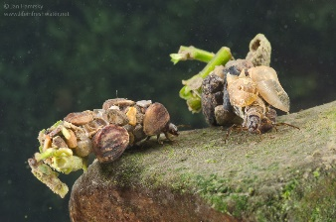
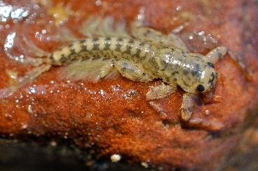
Virginia Stream Condition Index
60
40
20
Photos: Jan Hamrsky: lifeinfreshwater.net

Slide 13
DEQ Biological Monitoring Stations

Slide 14
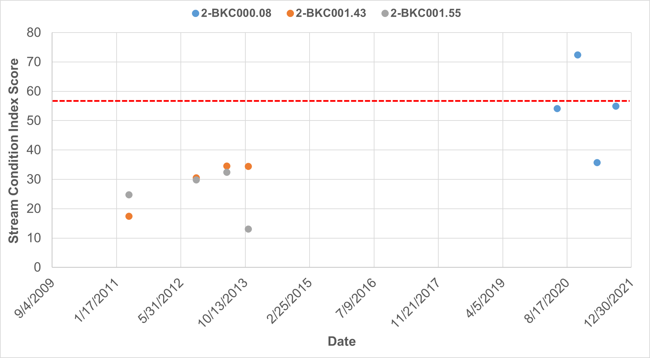
Black Creek Stream Condition Index Scores

Slide 15
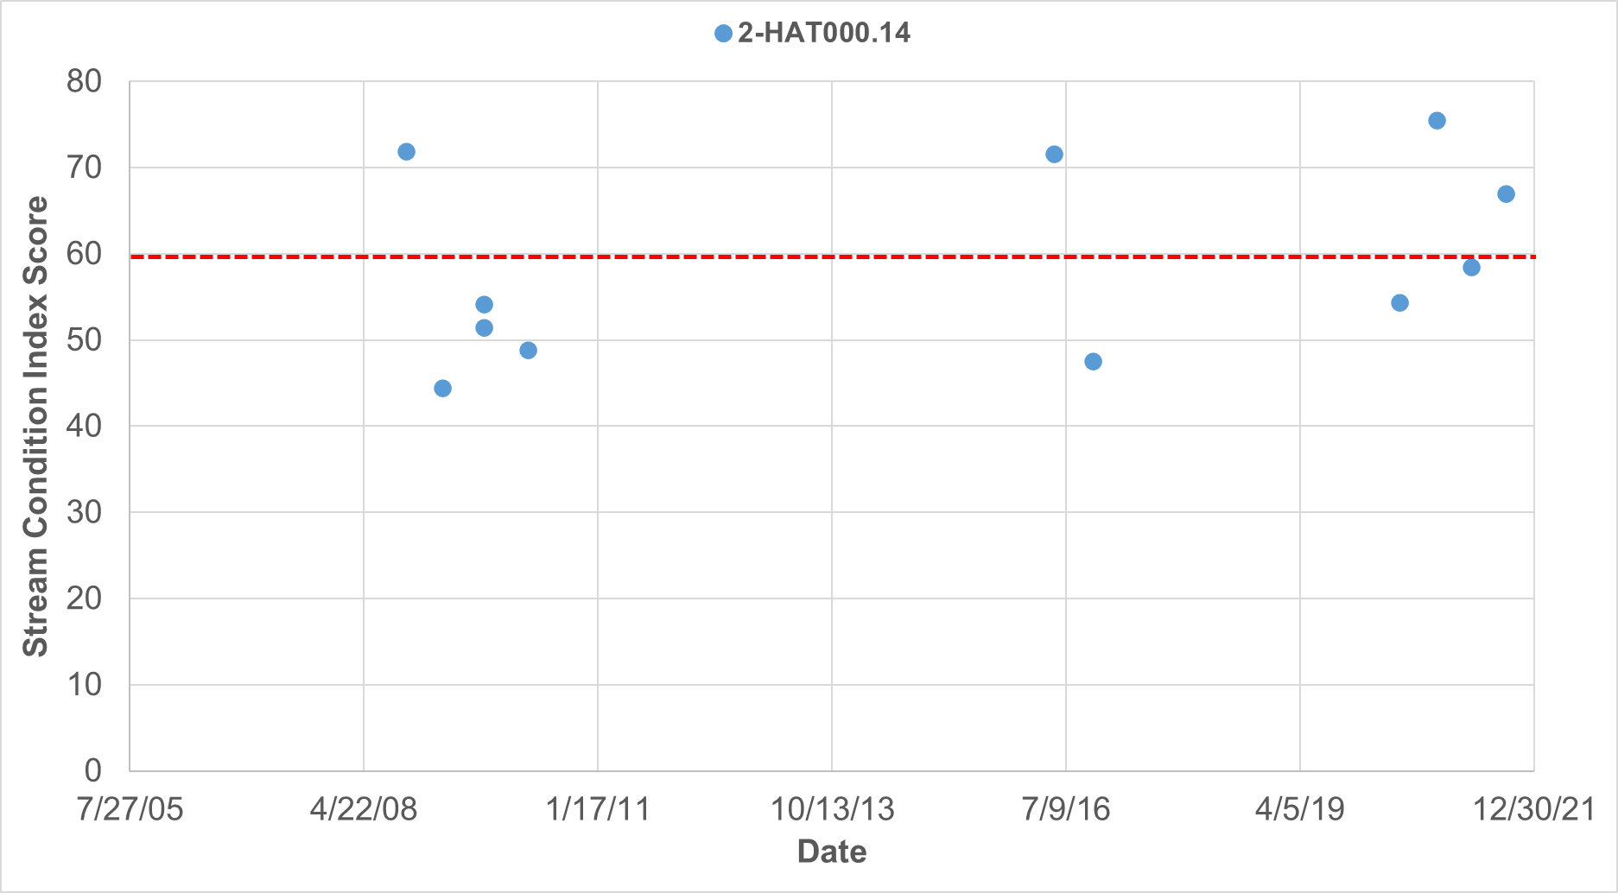
Hat Creek Stream Condition Index Scores

Slide 16
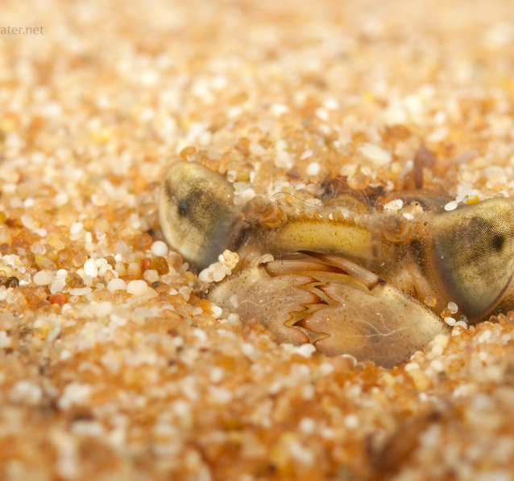
Biological Impairments Determining the cause…
Benthic stressor analysis
Evaluation of monitoring data
Comparison with healthy reference watershed data and stressor thresholds
Weight of evidence approach
Identification of most likely stressor(s)
Photo: Jan Hamsky; www.lifeinfreshwater.net

Slide 17
Candidate Stressors
Suspended solids
Deposited sediment
Dissolved oxygen
Phosphorus
Nitrogen
Ammonia
Total dissolved ions
Dissolved chloride
Dissolved sulfate
Dissolved sodium
Dissolved potassium
Dissolved metals
Temperature
Conductivity
pH
Organic matter
Sediment metals
Sediment toxics
Pesticides
Polycyclic Aromatic Hydrocarbons (PAHs)
Polychlorinated Biphenyls (PCBs)

Slide 18
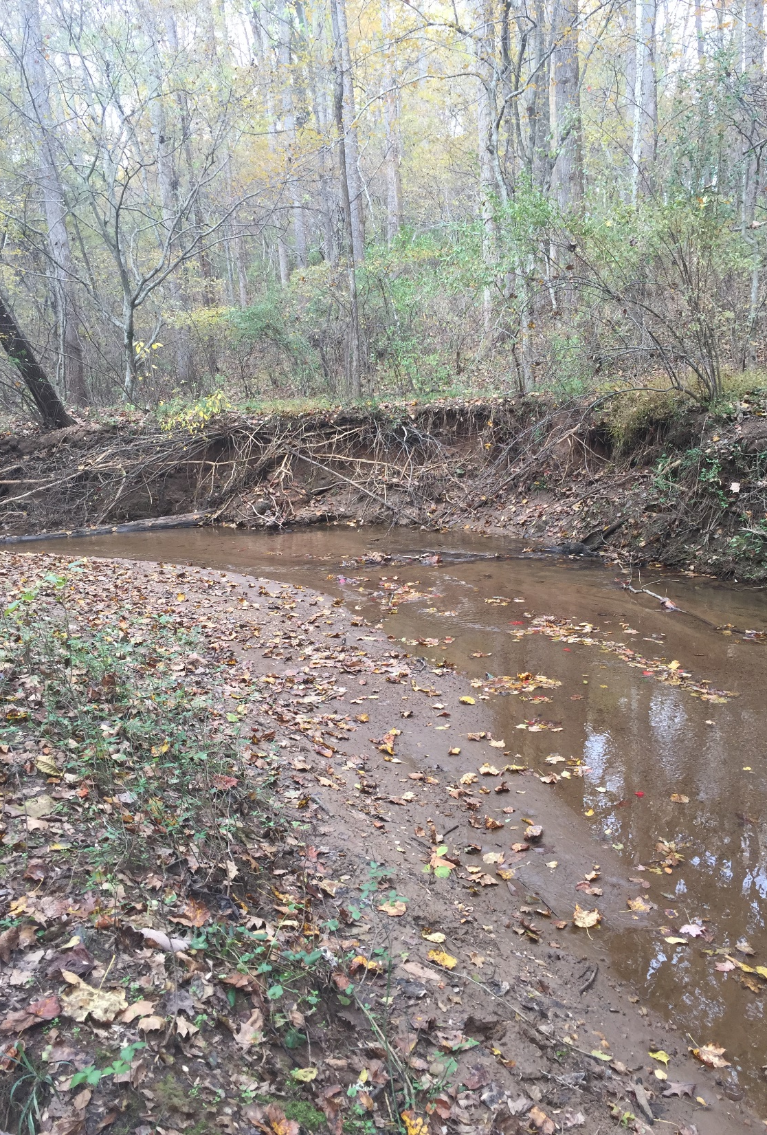
Weighing the Evidence: Sediment example
Eroding streambanks
Sediment deposits
Highly embedded
Intact streamside buffers

Slide 19
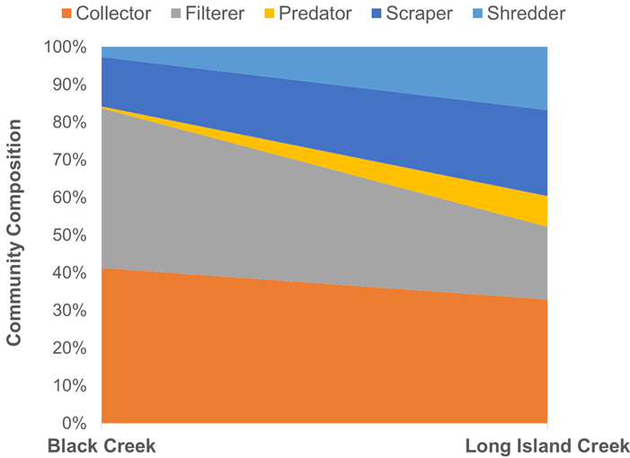
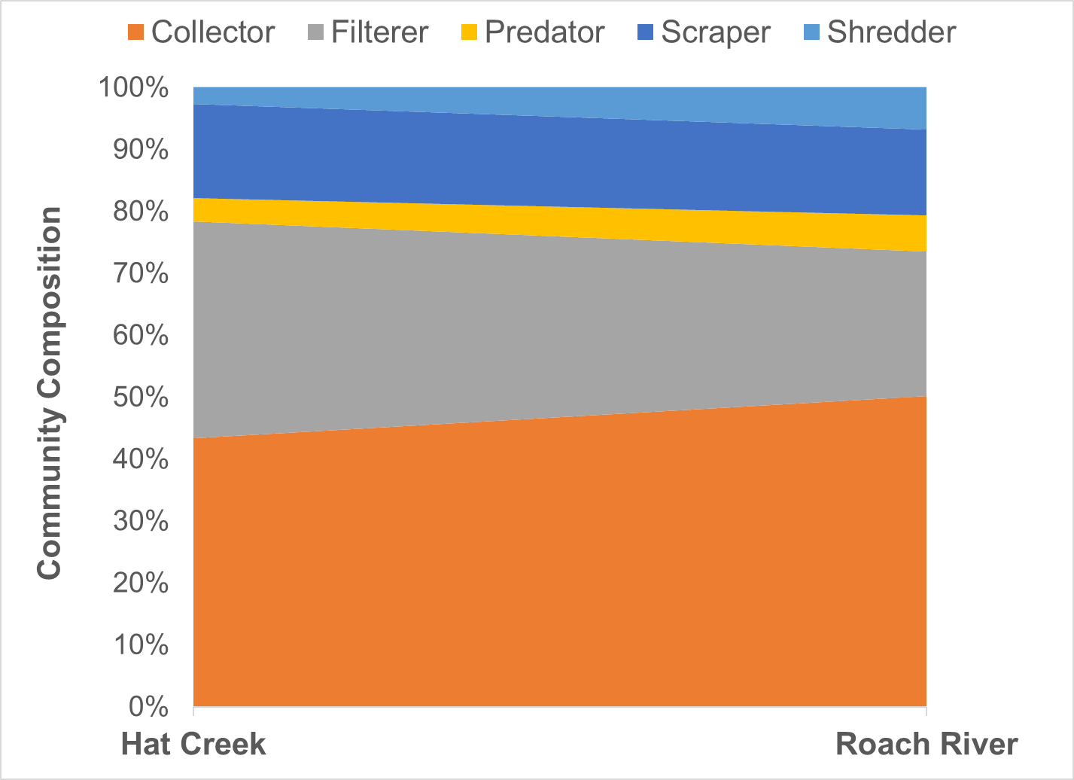
Evidence of sediment as a stressor?
Biological monitoring data
Filterers are predominant functional feeding groups, abundance of collections in Black Creek
Abundance of net spinning caddisflies

Slide 20
Net spinning caddisfly
Photo: Jan Hamrsky: lifeinfreshwater.net

Slide 21
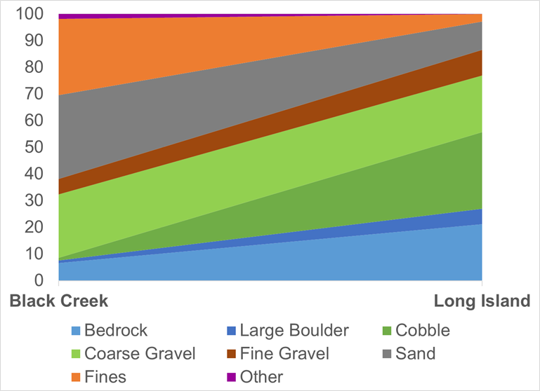
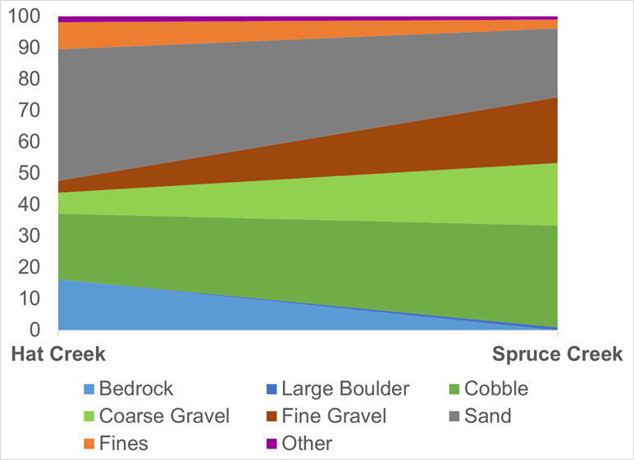
More evidence for sediment?
Stream bottom measurements
More sand and fines in both Hat and Black Creeks

Slide 22
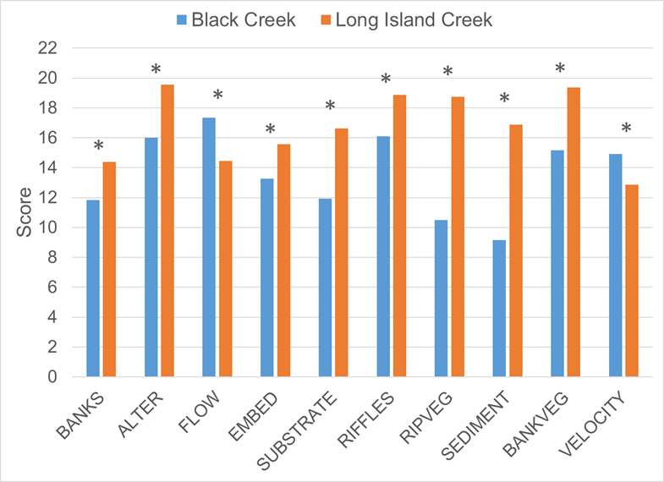
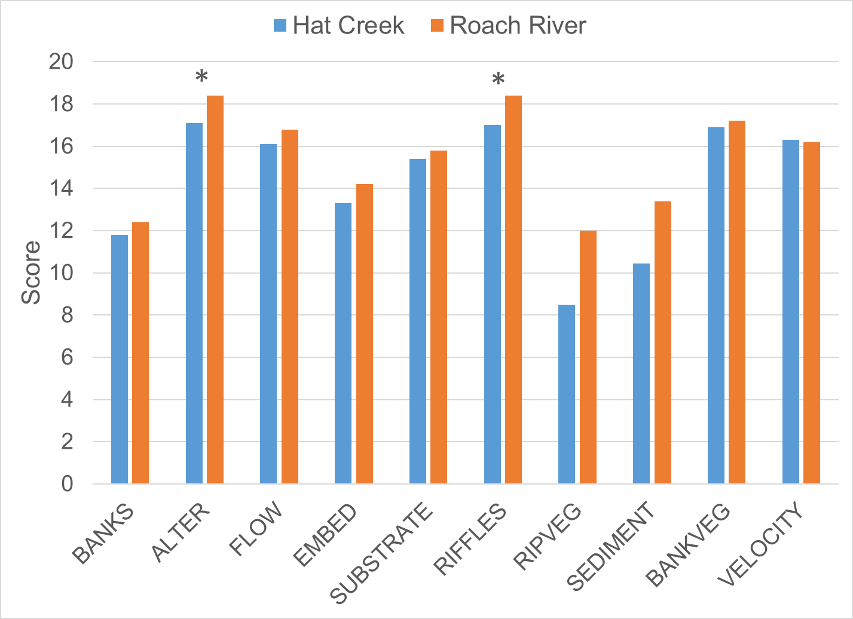
More evidence for sediment?
Habitat measurements
Both streams lack streamside vegetation (RIPVEG) and show evidence of sediment deposition (SEDIMENT)
Bank erosion & embeddedness in Black Creek

Slide 23
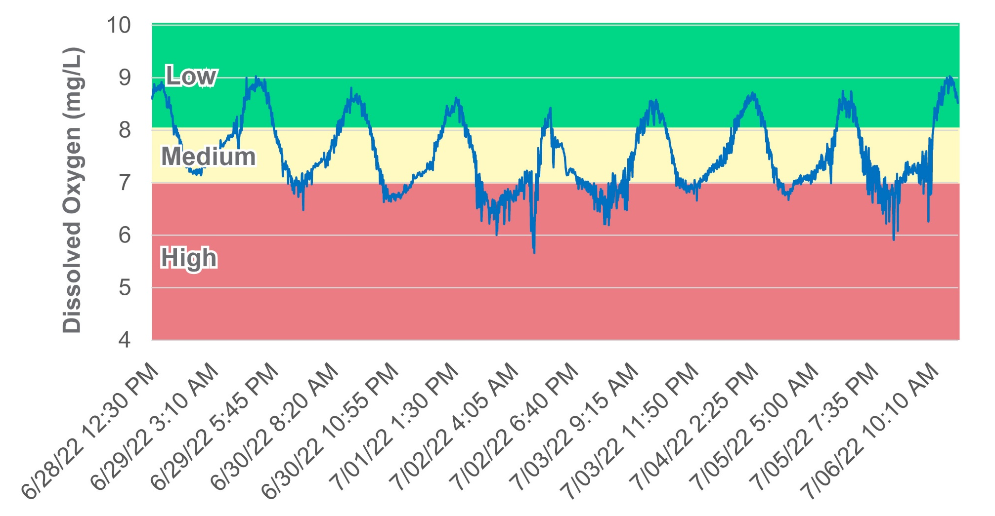
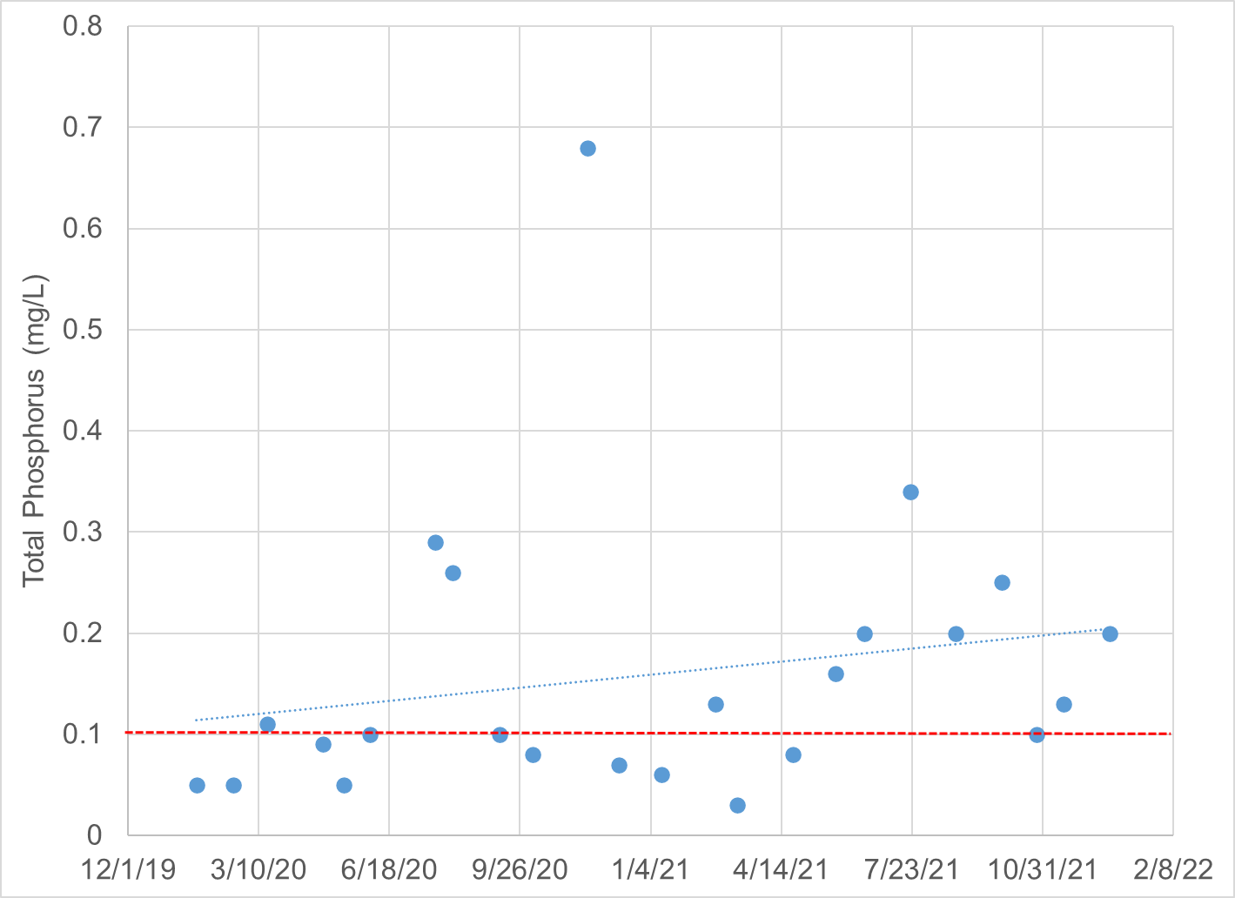
Phosphorus in Black Creek
High phosphorus concentrations
Low dissolved oxygen concentrations
Predominance of midge and black fly larvae (34%)

Slide 24
What is a TMDL?
A Total Maximum Daily Load is the maximum amount of a pollutant that a waterbody can receive and still meet water quality standards.

Slide 25
How do we develop a TMDL? What’s the magic number…
Identify sources of sediment and phosphorus
Model their path to the stream
Determine reductions needed from each source to restore aquatic life
Forest:
0% reduction
Forest:
1 ton/yr
Cropland:
30% reduction
Cropland:
10 tons/yr
Residential:
50% reduction
Residential:
4 tons/yr
Pasture: 12 tons/yr
Pasture: 40% reduction
Urban:
75% reduction
Urban:
8 tons/yr
Impaired stream
Sediment load = 37 tons/yr
TMDL
Sediment load = 19 tons/yr
Point sources:
2 tons/yr
Point sources:
0% reduction
Diagram: Adapted from the Center for TMDL and Watershed Studies at Virginia Tech

Slide 26
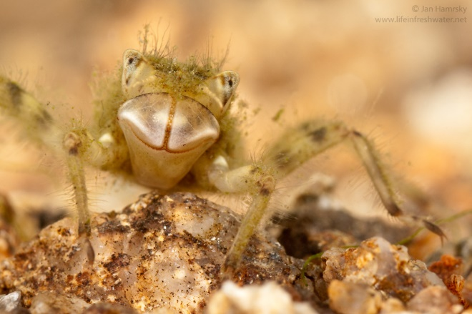
More than just a number?
Primary objective is to address pollution in our waterways
TMDL study is the first step
Followed by an implementation plan
Implementation through partnerships with local organizations
Photo: Jan Hamsky; www.lifeinfreshwater.net

Slide 27
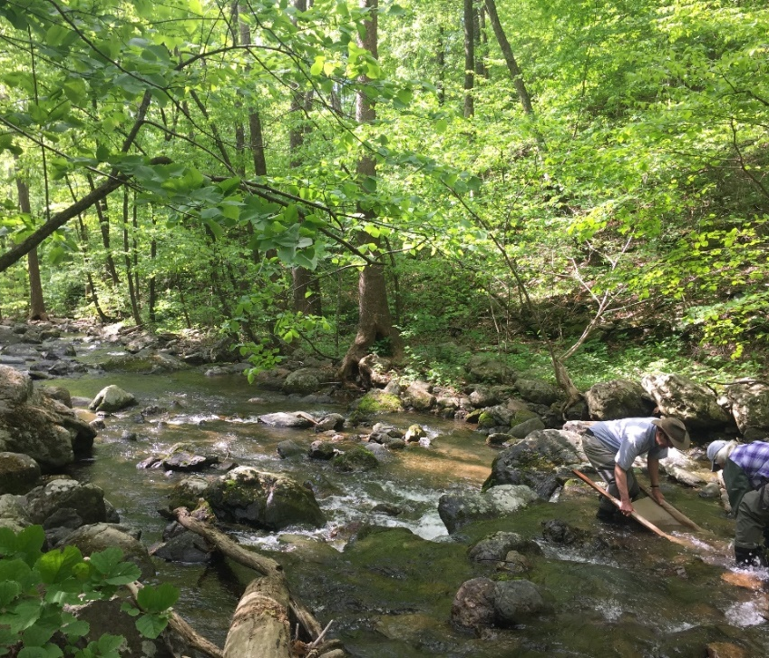
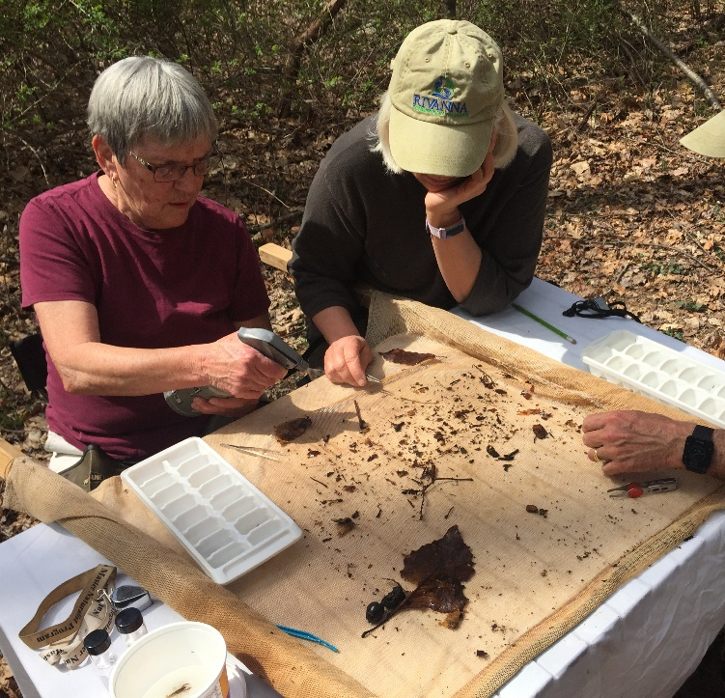
How can you get involved? We need to hear from you!!!
Join the Advisory Committee
Represents the local community
Provides feedback on
Stressors to the benthic community
Land use
Pollutant sources
Key stakeholders and community meetings

Slide 28
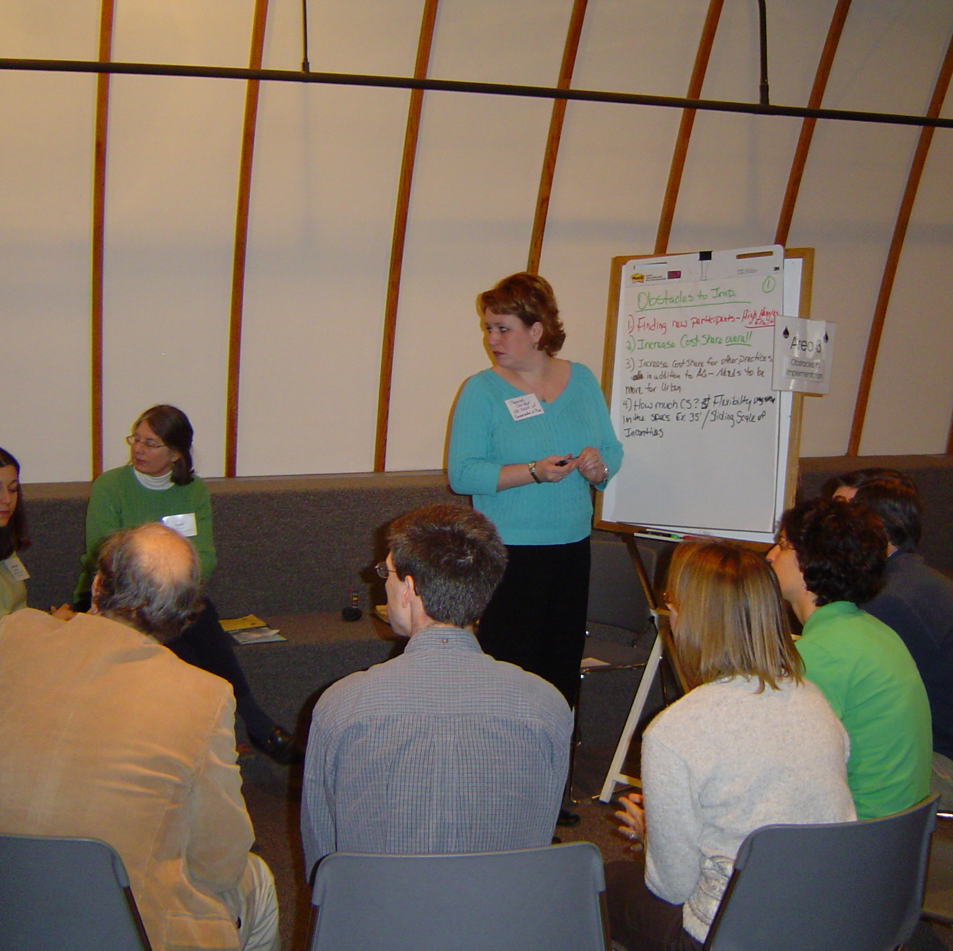
Join us for the first Stakeholder Meeting! Nelson Memorial Library March 1, 2023 2:00 p.m. – 4:00 p.m.
What’s Next?

Slide 29
Questions & Comments
30-day public comment period (Jan. 25, 2023 – Feb. 24, 2023)
Send comments to:
Nesha McRae
PO Box 3000
Harrisonburg, VA 22801
Nesha.mcrae@deq.virginia.gov

