Slide 2
Applications and Certificates
Voluntary Remediation Program Lunchtime Series
Meade Anderson – Manager April Ni’Mary – Business Analyst
James Thornhill
Partner - Wire Gill LLP
April 12, 2023

Slide 3
Today’s Presentation
Applications and Certificates
Tips and Pointers
Question and answer session at the end

Slide 4
Roles
Roles in Relationship to the Site
Participant and Owner
Representatives and Authorized Agents
Consultants and Counsel
Required Signatures
Applicant as “Participant”
Owner; if different from applicant
Authorized Agent; requires an authorized agent letter from the Participant
Signatures must be ink
Can be digitized for e-mailing
No policy in place at this time to accept or validate digital signatures for applications

Slide 5
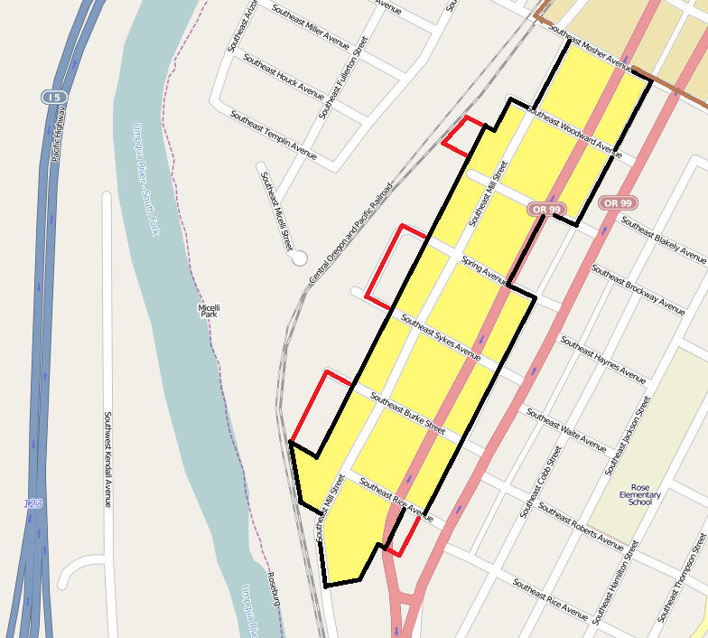
Map
Map clearly showing the location of the site
Site boundaries must be clearly delineated if a plat stamped by a licensed surveyor is not available at the time of application
Adding property after eligibility means a new application

Slide 6
Regulatory Jurisdiction
Do not leave blank
Do not reference Phase I/II reports
Do address all programs in the section:
CERCLA Investigations, CERCLA / NPL Listing, Petroleum or Oil Releases, RCRA, Present or Past Permits, Enforcement Action, Open Dump / Unpermitted Facility, Waste Generator, Immediate Risk, Impact to Drinking Water

Slide 7
Summarize Please
Nature and Extent of Known Contamination - Areas of Concern
We have limited input characters on our end. Please be brief and descriptive.
Expand details of contamination and AOCs on the map and/or in reports as applicable
Submit the Phase I and II ESAs (if available) for detailed information
Note: Staff are available for pre-application meetings

Slide 8
Poll Question 1
What information should be included with the check?
A: The DEQ assigned VRP number
B: The site name
C: The application
D: A photo copy of the check
E: A and B

Slide 9
Certificates - Starting Point
Start at the beginning, restrictions will be permanent.
All Voluntary Remediation Report components must be completed and accepted, and the final remedial action plan completed.
The boilerplate Certificate template must be used
Actual documents are the best examples
Plan for time to revise and refine for edits and comments
Start the entire VRP process with the Certificate in mind
Currently re-evaluating the Certificate and Restrictions for revisions

Slide 10
Certificate and Restrictions
Certification of Satisfactory Completion of Remediation
Declaration of Restrictive Covenants
Two separate documents which are cross-referenced
Legal documents
Certificate is the enforcement immunity
Restrictions are just that… the restrictions that are proffered which will limit the future use of the property

Slide 11
Draft Process
Drafting the Certificate is an iterative process between the participant, consultants and/or counsel and DEQ
The Participant develops the initial draft
DEQ will use track changes to note edits and comments
Remember to consider all parties to the land deed and encumbrances (as appropriate).

Slide 12
Draft Process continued
Restrictions will be repeated in three locations and should be consistent in wording
Conditions of Issuance, Relevant Information, and in the Restrictions
Use boiler plate restrictions for consistency
Restrictions must be protective yet allow for flexibility
DEQ review process includes three staff; project manager, legal review and manager review
Director of Office of Remediation Programs and notary will also review the documents

Slide 13
Relevant Information
Basic site history, acreage, address, and other information related to past, current and future usage
Briefly discuss the SCR
Investigation
Risk Assessment
Remedial actions taken
List reports which make up the Voluntary Remediation Report
Discuss and state Restrictions consistently
Public Notice
Discuss notice sent to local government and adjacent property owners
State the name of the paper the notice was published in
Statement regarding comments received

Slide 14
90 Days
The Certificate and Restrictions MUST be recorded within 90 days.
Since the Certificate has a self-terminating clause, if additional time is needed it must be requested before issuance.
Failure to record the certificate in the 90 day window will result in the certificate becoming invalid.
Extensions can be given when built into the draft certificate
Re-issuing the Certificate may result in an Administrative Fee of $2000

Slide 15
Certificate Issued
Final Certificate Signed by DEQ first, mailed to participant – 90 day clock starts
The Participant/Owner must not sign the document until after DEQ signs and that we are all in agreement on the final document
The Participant/Property Owner must:
Sign the original Certificate and Restrictions documents and have the signatures notarized.
Record the Certificate and Restrictions in the city or county land records where the site is located.*
Return a recorded copy with clerk’s stamp and instrument numbers back to DEQ.
*For unrestricted sites, recordation is not required but encouraged.

Slide 16
Post Certificate Monitoring Reports
PCMR allowed by the VRP Regulations
Allowed at the discretion of DEQ and must not be speculative
Reports must be submitted in a timely manner and have a timeframe for completion
Must be concise and clearly respond to requirements
Avoid violating restrictions or importing soil onto the site which does not meet risk goals of the site (such as residential)
A technical review after issuance of the Certificate (for example evaluating imported soil data) may initiate a Technical Amendment and associated fees

Slide 17
Site Plans/Plats & Legal Descriptions
A plat stamped by a licensed surveyor clearly depicting Site boundaries is preferred
A legal description is acceptable
Site plans depicting site features are encouraged as supplemental information
Areas within a site with restrictions such as excavation limitations must be surveyed
Alta surveys provide excellent site information however at times the Clerk may not accept the Alta as the sole document
Plats which are poor quality may not be accepted by the Clerk
Remember poor quality plans can significantly complicate future site actions

Slide 18
Clerk of the Court
Is the Queen or King…
The Clerk has the final say on recording the Certificate and Restrictions and plat and DEQ has no say
If they say no, you may be heading home without recorded documents
Remember some staff may not be familiar with Certificates and Restrictions so you may have to request them to double check with the Clerk
Be prepared to pay fees with checks
Do not wait until day 89

Slide 19
Amendments
Restrictions are for perpetuity
However, Restrictions may be modified or eliminated
Administrative ($2000) does not require a technical review
Technical ($4500) requires a technical review such as removal action reports, additional site investigations, revised risk assessments, etc.
Technical Amendments will likely require a Public Notice
Amendments not completed by November 1 of the following calendar year will require the Annual Maintenance Fee

Slide 20
Poll Question 2
DEQ has not accepted my 5 component Voluntary Remediation Report. Am I ready for my certificate?
A: No. DEQ must accept each of the components of the report first.
B: Yes. I am ready for my certificate once I’ve submitted all of my documentation.
C: What? I have to write reports?

Slide 21
EPA MOA
Memorandum of Agreement with the EPA developed in 2002 and revised in 2017:
https://www.epa.gov/sites/default/files/2017-03/documents/signed_va_vrp_moa_modification_march_2017.pdf
A site enrolled in VRP has a bar against EPA becoming involved
EPA has no interest in a site which has completed VRP

Slide 22
Annual Fees
Annual Phase III billing will be assessed on November 1 of each for sites enrolled the previous calendar year.
For sites near completion we recommend:
Public Notice be completed by July 15
Draft Certificate to DEQ by August 1
All outstanding fees must be paid before a Certificate is issued.

Slide 23
Poll Question 3
Will DEQ file the certificate in the land records with the locality?
A: No, that is the participant’s responsibility.
B: Yes, of course.
C: What’s a land record?

Slide 24
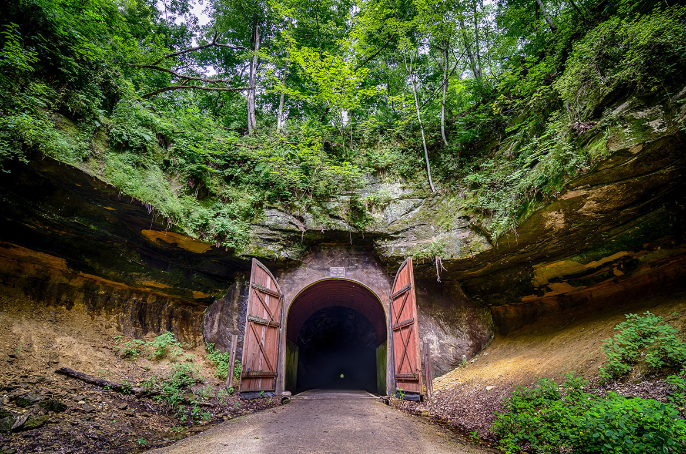
Recording the VRP Certificate and Declaration
Clerk’s Office
Jim Thornhill
Wire Gill LLP
804-288-8400
jthornhill@wiregill.com
Real Estate
VRP Conclusion

Slide 25
Pre-Issuance Checklist for Recording to
Meet the 90 Day Deadline
Signatories?
Participant, Landowner, Tenant, Lender, Others
Who is recording?
Title company, attorney, me?
Do I have a legal description or survey plat?
Is the VRP site less than an entire parcel?
Is there a restriction that will apply to less than the entire site?
Clerk’s Office Requirements?
Cover sheet jurisdiction?
Fees?
Notarized original signatures
Special requirements?
Margins
Plat size
Electronic, mailing, in person
Only blue or black ink.
Page numbering.
Self-addressed stamped envelop to return documents.
This Certificate is conditioned upon its being signed by the Participant and the Site Owner and its being recorded within 90 calendar days of its issuance, in the land records of Fairfax County, Virginia.

Slide 26
Signatures
Is the landowner the same as the participant or an unrelated entity?
If unrelated have them review and comment before issuance.
Is there a lender who will need to subordinate to the declaration?
If yes, a trustee will have to sign to release a deed of trust as the trustee holds title for benefit of the lender.
Trustees like to see the lender as signatory as well agreeing to the subordination.
Obtain lender sign off to format before issuance and arrange for how the documents will be executed.
Are there other parties like tenants or encumbrance holders who need to sign?

Slide 27
Who is recording?
Title Company?
Does the participant have an existing
relationship with a title company?
Can you get any title company to record?
Attorney?
Is she or he familiar with recording in
Virginia and the particular jurisdiction?
Can I record myself?

Slide 28
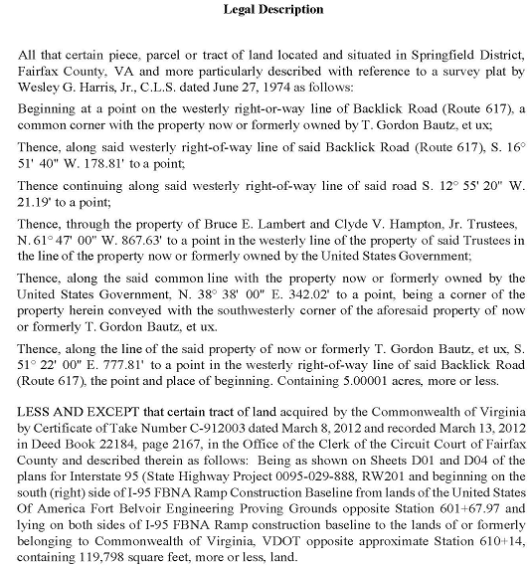
legal descriptions

Slide 29
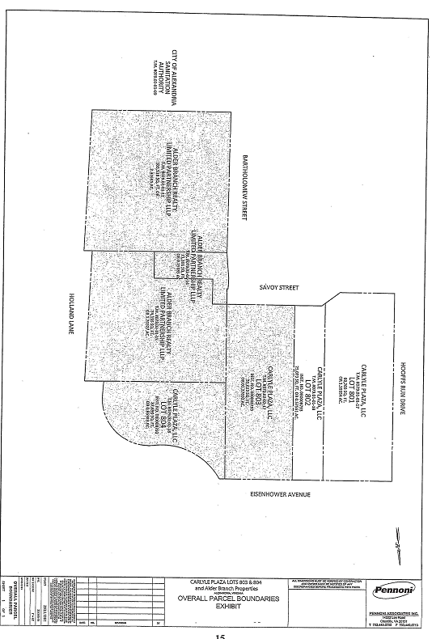
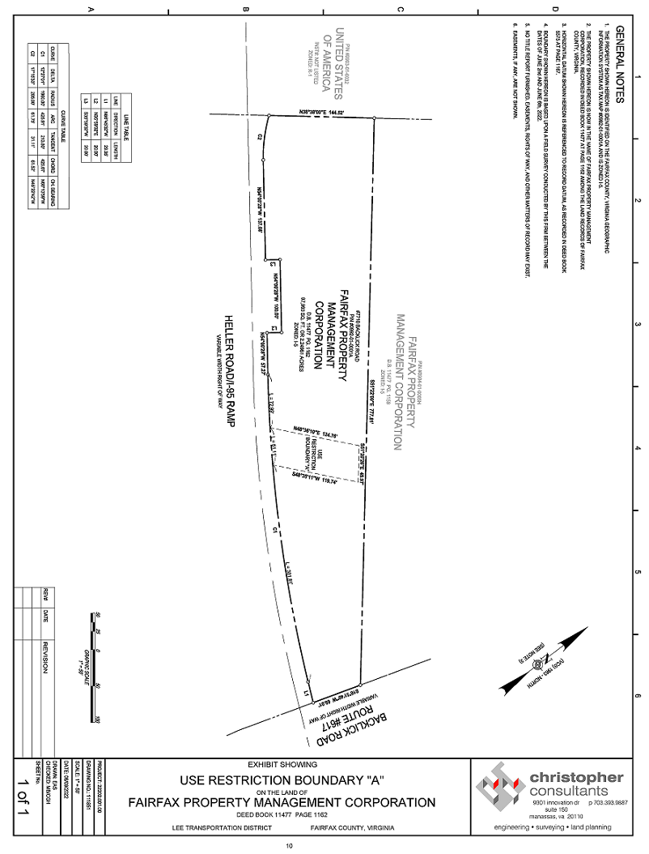
Survey Plats & figures

Slide 30
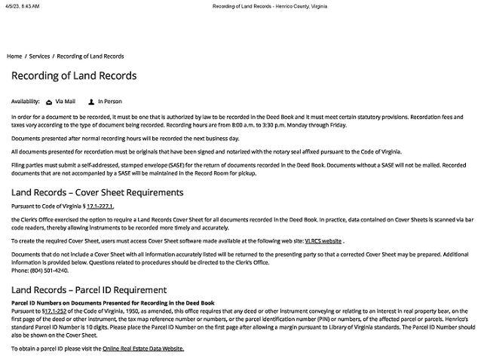
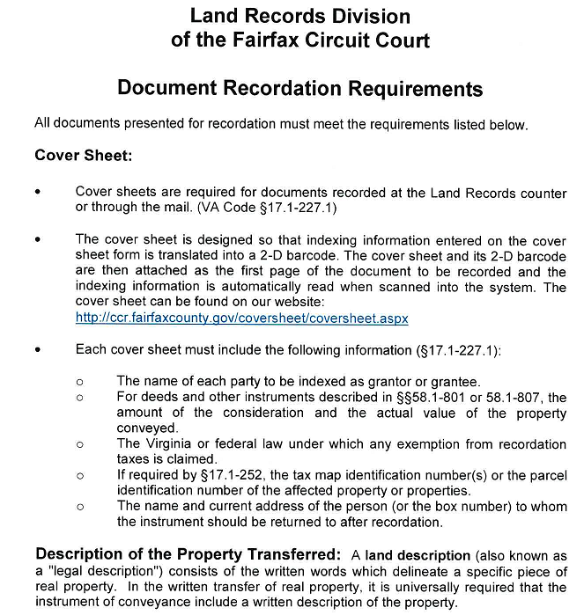
Circuit court Clerk’s Office requirements for recordation—go to circuit court’s website
Henrico County

Slide 31
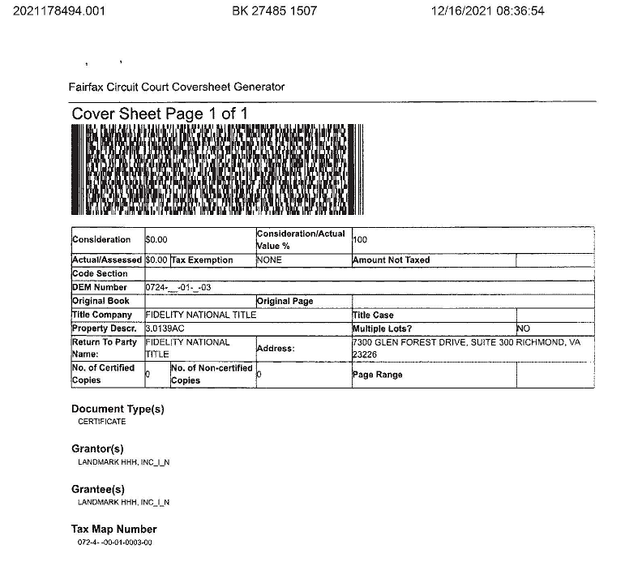
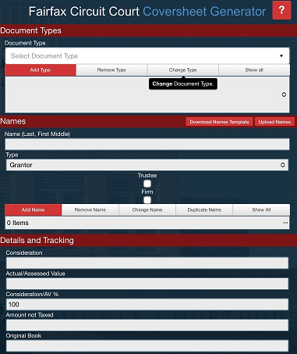
Cover Sheets

Slide 32
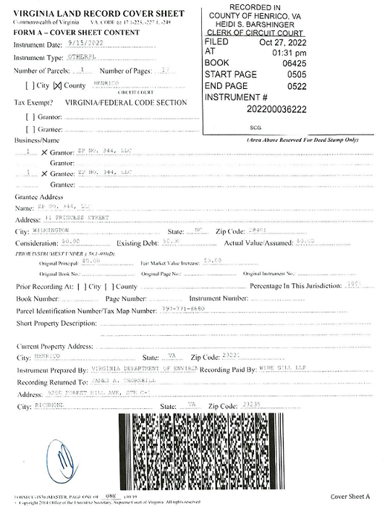
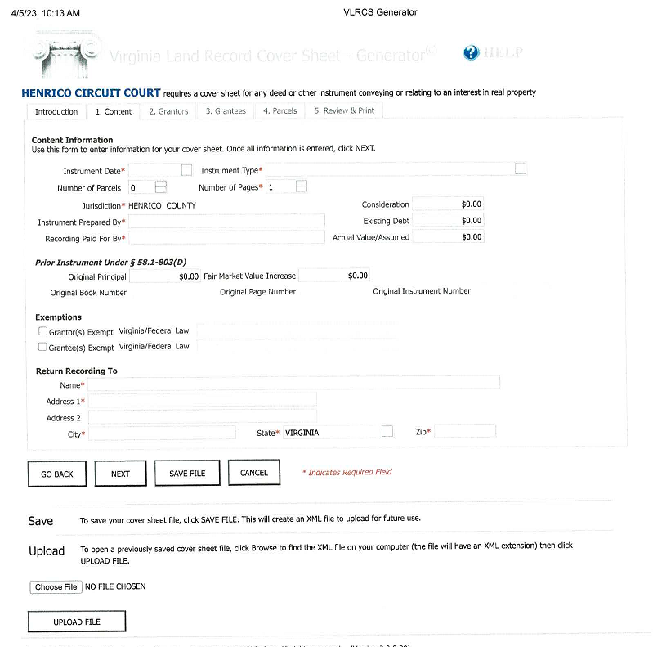
Cover sheets continued

Slide 33
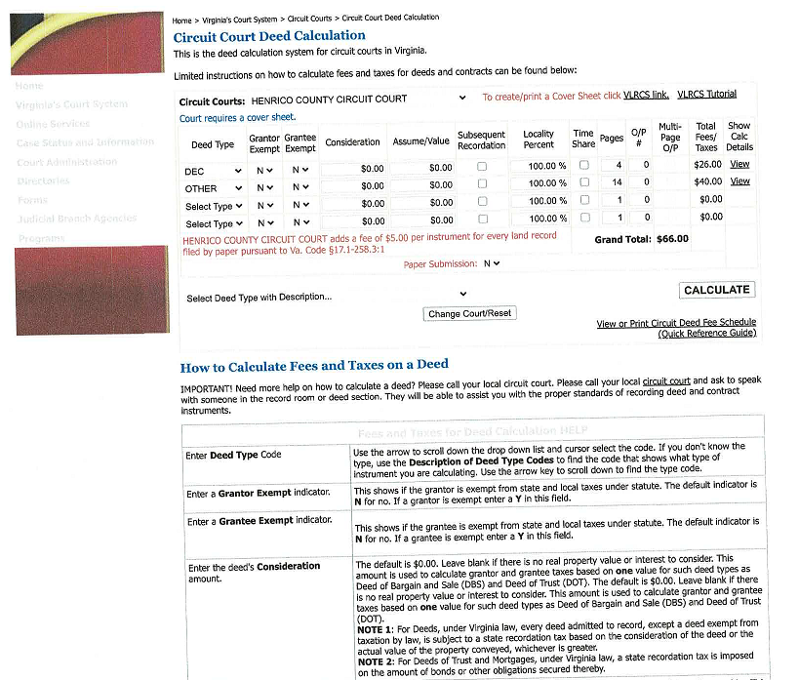
Fees
Circuit Court Deed Calculation System for Calculating Recording Fees for Documents
http://ccdeedcalc.courts.state.va.us/

Slide 34
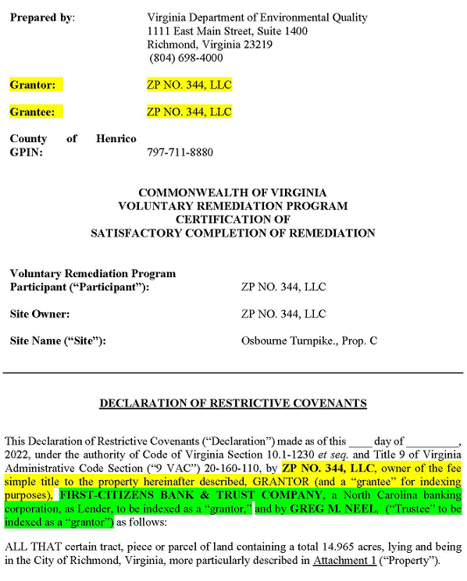
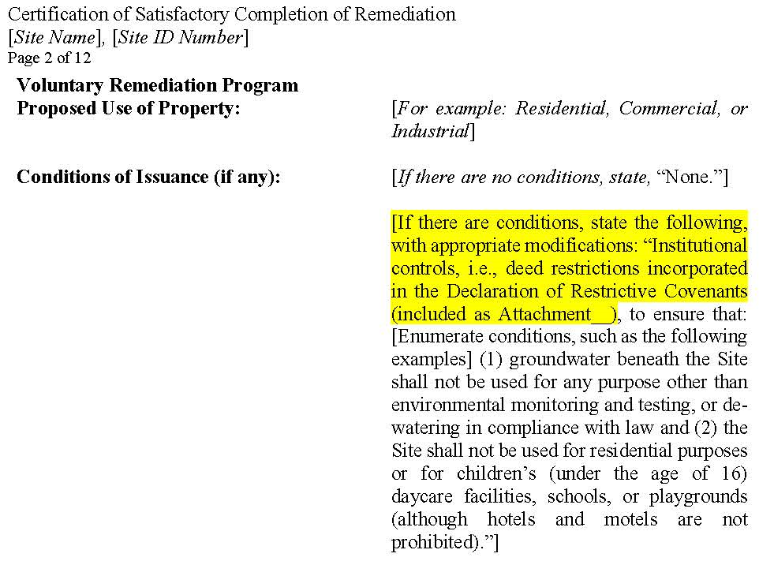
Sign declaration attached to the certificate or execute and record separately?

Slide 35
Fairfax County Common Recording Issues
Cover sheet is not submitted or is filled out incorrectly.
The document has been sent to Fairfax in error; the property is located in another
county or city.
Insufficient fees.
The names of the grantors and/or grantees on the cover sheet do not match the names
in the instrument.
Signatures are not original.
A clerk may refuse any document in which the name or names of the person under
which the document is to be indexed is not legible or not provided. (Va. Code § 55.1-604).
The deed book and page number are incorrect.
Instrument contains a social security number.
Use of red ink.

Slide 36
Questions?

Slide 37
Contact
For Contact Hours, a completion certificate will be included in a follow-up email for you to keep for your records.
After this class you will receive a survey, please take the time to let us know how we did and what other topics you’d like us to cover.
For further questions visit the VRP website:
https://www.deq.virginia.gov/land-waste/land-remediation/voluntary-remediation

