Slide 1
Chesterfield Energy Reliability Center Dominion Energy, Inc.
July 2023

Slide 2
Agenda
Introduction
Project Overview
Permitting Requirements
Class I Analysis
Next Steps
Questions

Slide 3
Chesterfield Energy Reliability Center Overview
Dominion Energy is proposing to construct and operate the Chesterfield Energy Reliability Center (CERC)
Simple-cycle peaking facility primarily firing natural gas with fuel oil and hydrogen blend capabilities
Co-located with the Chesterfield Power Station
Existing coal/fuel oil fired Units 5 and 6 at the Chesterfield Power Station permanently shut down (May 2023)

Slide 4
CERC Purpose
Provide reliable, dispatchable generation during high demand periods, seasonal peaks, and extreme temperature events.
Serve as backup generation when other resources (i.e. solar and wind facilities) are unavailable or insufficient to meet customer needs.
Resiliency: Fast responding and reliable generation with dual fuel capability including natural gas and fuel oil. Future potential to include a hydrogen fuel blend.

Slide 5
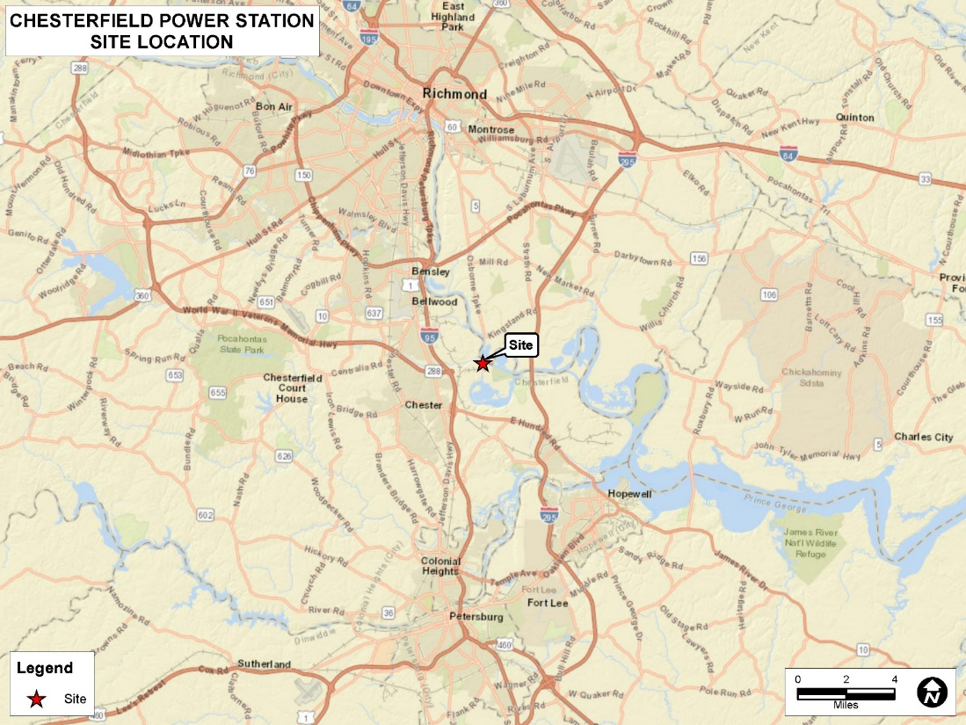
CERC Location
CERC will be located on 94-acre site within the James River Industrial Center adjacent to the existing Chesterfield Power Station.

Slide 6
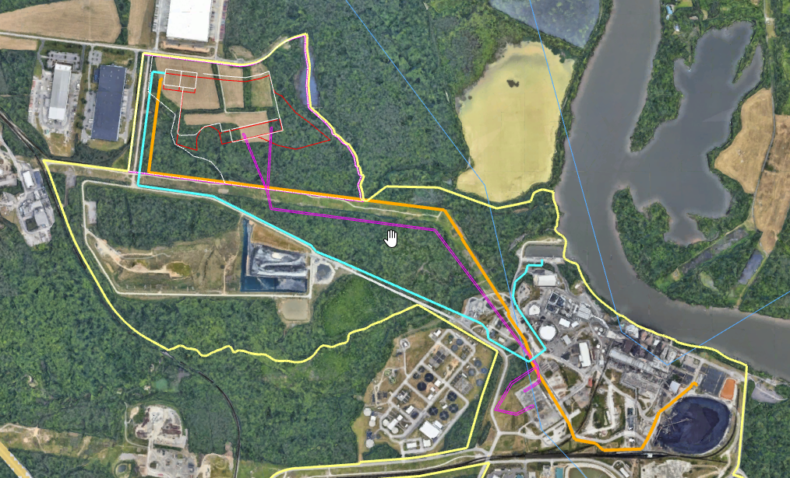
Facility Location
Preliminary Site Design and Routing
CERC
Legend
Property Boundary
Transmission Line
Nat. Gas Pipeline
No. 2 Fuel Oil Pipeline

Slide 7
CERC Project Details
Four (4) General Electric 7FA.05 simple-cycle combustion turbines with a net nominal generating capacity of approximately 1,000 MW.
Primary Fuel - Natural Gas
Secondary Fuel - No. 2 fuel oil with a maximum sulfur content of 15 ppm (fuel oil)
Alternative Fuel – Hydrogen blended with natural gas
Turbines will be equipped with SCR and Oxidation Catalyst
Operating Profile Each SCCT:
3,240 hours/yr with up to 750 hours/yr firing FO.
500 Startup/Shutdowns events/yr with up to 120 event/yr on FO

Slide 8
CERC Project Details (cont.)
Six (6) nominal 3,500 kWe (4,694 bhp) black start emergency generators
Additional Equipment
One (1) Fuel Gas Heater (nominal 18.8 MMBtu/hr each, natural gas-fired)
One (1) Diesel-fired fire water pump (nominal 190 bhp)
Secondary Emission Sources
Two (2) Fuel Gas Heaters owned and operated by the NG pipeline company (nominal 18.8 MMBtu/hr each, natural gas-fired)

Slide 9
PSD Permitting
Single source with existing station
Major Modification
Pollutant-specific applicability determination
Netting Analysis (e.g., Shutdown of coal-fired Units 5 & 6)
Technical Studies
Air quality impact assessment
Control Technology review
Public notice and review

Slide 10
PSD Applicability Analysis
Emission Source Description | NO_{x} (tpy) | CO (tpy) | VOC (tpy) | PM (tpy) | PM₁₀ (tpy) | PM_{2.5} (tpy) | H₂SO₄ (tpy) | GHG (CO₂e) (tpy)
Total project emissions | 386.60 | 783.72 | 137.24 | 80.21 | 151.42 | 151.42 | 17.92 | 2,212,947
Boiler 5 & 6 Shutdown | (453.55) | (165.28) | (19.29) | (277.75) | (221.96) | (43.99) | (427.97) | (1,700,338)
Pond Closure Project | N/A | N/A | N/A | 42.39 | 12.08 | 1.49 | N/A | N/A
Beneficial Use Proc. Equip. | 3.74 | 18.41 | 3.07 | 4.46 | 2.48 | 2.07 | 0.022 | 2,317
Gas Tech Pipeline Heater | 3.50 | 2.94 | 0.19 | 0.01 | 0.02 | 0.02 | 0.02 | 3,819
Net Emissions Increase | (60) | 640 | 121 | (151) | (56) | 111 | (410) | 518,745
PSD SER | 40 | 100 | 40 | 25 | 15 | 10 | 7 | 75,000
Project Exceeds SER? | No | Yes | Yes | No | No | Yes | No | Yes

Slide 11
Preliminary Short-Term Emission Rates (lb/hr)
Pollutant | Simple-Cycle Turbine Natural Gas (per turbine)* | Simple-Cycle Turbine ULSD (per turbine)* | Fuel Gas Heater (per heater) | Fire Water Pump | Black Start Emergency Generator (per generator)
NO_{x} | 23.30 | 47.90 | 0.21 | 0.88 | 62.39
PM₁₀/PM_{2.5}** | 19.70‡ | 45.00 | 0.13 | 0.06 | 0.41
SO₂ | 8.20‡ | 4.50 | 2.07E-02 | 3.90E-01 | 5.21E-02
H₂SO₄ | 5.60‡ | 3.00 | 2.44E-03 | 2.98E-02 | 3.99E-03
CO | 11.30 | 11.70 | 0.70 | 1.09 | 3.62
VOC | 3.20 | 6.70 | 0.09 | 0.38 | 0.41
* Maximum lb/hr across all operating scenarios.
** PM_{2.5} assumed to equal PM₁₀ for the sources presented.
‡ Based on 1.0 grains S/100 scf

Slide 12
Air Permit Requirements
PSD permitting required for CO, PM_{2.5}, VOC, and GHG
Minor NSR for NO_{x}, PM, PM₁₀, SO₂, and H₂SO₄
Air quality impact assessment for CO, PM_{2.5}, and Ozone
PSD BACT review for CO, PM_{2.5}, VOC, and GHG
State BACT review for NO_{x}, PM, PM₁₀, SO₂, and H₂SO₄

Slide 13
Air Quality Impact Analysis
Conduct Class II air impact analysis for CO and PM_{2.5}
Modeling Approach
AERMOD
Five (5) years of national weather service meteorological data
Conduct Class I Increment Analysis for PM_{2.5}
Consult with FLM on need for AQRV Analysis
Conduct Ozone analysis (MERPs)

Slide 14
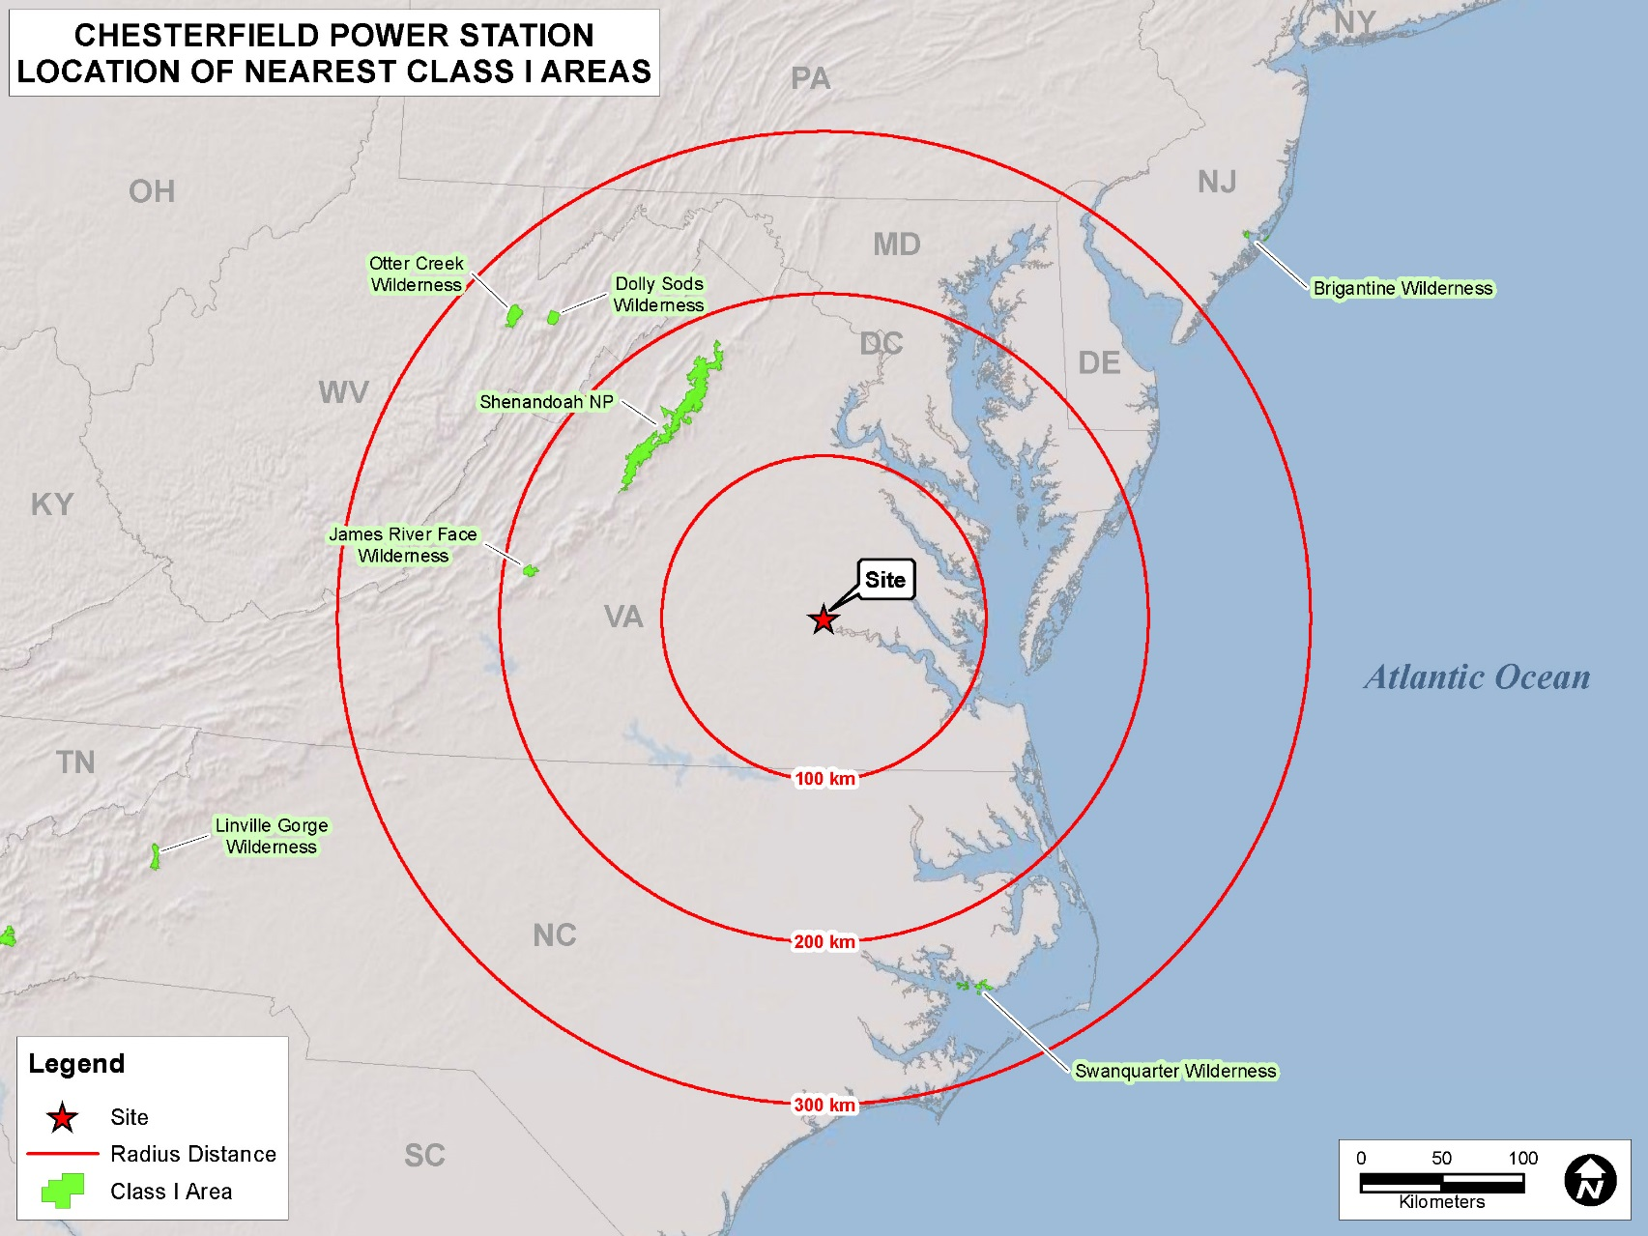
Relationship to Class I Areas

Slide 15
Class I areas within 300 km
Shenandoah National Park, 144 km
James River Face Wilderness, 178 km
Swanquarter Wilderness, 239 km
Dolly Sods Wilderness, 246 km
Otter Creek Wilderness, 262 km

Slide 16
Class I assessment
Q/D ratio – Natural Gas Scenario for SCCTs
Sum of the 24-hour emissions in tons/yr (assuming 24/7 operation) of NO_{x}, PM₁₀, SO₂, and H₂SO₄ divided by the distance (in kilometers) from the nearest boundary of the Class I Areas.
Pollutant | Simple-Cycle Turbine 1-4 lb/hr (per unit) | Fuel Gas Heater 1-3 lb/hr (per unit) |  | Emergency Generator 1 -6 lb/hr (per unit) | Fire Water Pump (lb/hr) | Total (TPY)
NO_{x} | 93.20 (23.30) | 0.63 (0.21) |  | 374.34 (62.39) | 0.88 | 2054
PM₁₀ | 78.80 (19.70) | 0.39 (0.13) |  | 2.46 (0.41) | 0.06 | 358
SO₂ | 32.80 (8.20) | 0.062 (2.07E-02) |  | 0.31 (5.21E-02) | 3.90E-01 | 147
H₂SO₄ | 22.40 (5.60) | 0.0.0073 (2.44E-03) |  | 0.024 (3.99E-03) | 2.98E-02 | 98
Total Emissions |  |  |  |  |  | 2658
Q/D Ratio |  |  | Shenandoah |  |  | 18.46
 |  |  | James River |  |  | 14.93
 |  |  | Swanquarter |  |  | 11.12
 |  |  | Dolly Sods |  |  | 10.80
 |  |  | Otter Creek |  |  | 10.14

Slide 17
Class I assessment (cont.)
Q/D ratio – Fuel Oil Scenario for SCCTs
Sum of the 24-hour emissions in tons/yr (assuming 24/7 operation) of NO_{x}, PM₁₀, SO₂, and H₂SO₄ divided by the distance (in kilometers) from the nearest boundary of the Class I Areas.
Pollutant | Simple-Cycle Turbine 1 - 4 lb/hr (per unit) | Fuel Gas Heater 1 - 3 lb/hr (per unit) |  | Emergency Generator 1- 6 lb/hr (per unit) | Fire Water Pump (lb/hr) | Total (TPY)
NO_{x} | 191.60 (47.90) | 0.63 (0.21) |  | 374.34 (62.39) | 0.88 | 2485
PM₁₀ | 180.00 (45.00) | 0.39 (0.13) |  | 2.46 (0.41) | 0.06 | 801
SO₂ | 18.00 (4.50) | 0.062 (2.07E-02) |  | 0.31 (5.21E-02) | 3.90E-01 | 82
H₂SO₄ | 12.00 (3.00) | 0.0.0073 (2.44E-03) |  | 0.024 (3.99E-03) | 2.98E-02 | 53
Total Emissions |  |  |  |  |  | 3422
Q/D Ratio |  |  | Shenandoah |  |  | 23.76
 |  |  | James River |  |  | 19.22
 |  |  | Swanquarter |  |  | 14.32
 |  |  | Dolly Sods |  |  | 13.91
 |  |  | Otter Creek |  |  | 13.06

Slide 18
Class I assessment (cont.)
Q/D ratio – Natural Gas Scenario for SCCTs
Sum of the 24-hour emissions in tons/yr (assuming 24/7 operation) of NO_{x}, PM₁₀, SO₂, and H₂SO₄ divided by the distance (in kilometers) from the nearest boundary of the Class I Areas (with contemporaneous emissions).
Pollutant | Simple-Cycle Turbine 1-4 lb/hr (per unit) | Fuel Gas Heater 1-3 lb/hr (per unit) |  | Emergency Generator 1 -6 lb/hr (per unit) | Fire Water Pump (lb/hr) | Contemporaneous Emission (TPY) | Total (TPY)
NO_{x} | 93.20 (23.30) | 0.63 (0.21) |  | 374.34 (62.39) | 0.88 | (446) | 1608
PM₁₀ | 78.80 (19.70) | 0.39 (0.13) |  | 2.46 (0.41) | 0.06 | (207) | 151
SO₂ | 32.80 (8.20) | 0.062 (2.07E-02) |  | 0.31 (5.21E-02) | 3.90E-01 | (652) | (505)
H₂SO₄ | 22.40 (5.60) | 0.0.0073 (2.44E-03) |  | 0.024 (3.99E-03) | 2.98E-02 | (428) | (330)
Total Emissions |  |  |  |  |  |  | 925
Q/D Ratio |  |  | Shenandoah |  |  |  | 6.42
 |  |  | James River |  |  |  | 5.20
 |  |  | Swanquarter |  |  |  | 3.87
 |  |  | Dolly Sods |  |  |  | 3.76
 |  |  | Otter Creek |  |  |  | 3.53

Slide 19
Class I assessment (cont.)
Q/D ratio – Fuel Oil Scenario for SCCTs
Sum of the 24-hour emissions in tons/yr (assuming 24/7 operation) of NO_{x}, PM₁₀, SO₂, and H₂SO₄ divided by the distance (in kilometers) from the nearest boundary of the Class I Areas (with contemporaneous emissions).
Pollutant | Simple-Cycle Turbine 1 - 4 lb/hr (per unit) | Fuel Gas Heater 1 - 3 lb/hr (per unit) |  | Emergency Generator 1- 6 lb/hr (per unit) | Fire Water Pump (lb/hr) | Contemporaneous Emission (TPY) | Total (TPY)
NO_{x} | 191.60 (47.90) | 0.63 (0.21) |  | 374.34 (62.39) | 0.88 | (446) | 2039
PM₁₀ | 180.00 (45.00) | 0.39 (0.13) |  | 2.46 (0.41) | 0.06 | (207) | 594
SO₂ | 18.00 (4.50) | 0.062 (2.07E-02) |  | 0.31 (5.21E-02) | 3.90E-01 | (652) | (570)
H₂SO₄ | 12.00 (3.00) | 0.0.0073 (2.44E-03) |  | 0.024 (3.99E-03) | 2.98E-02 | (428) | (375)
Total Emissions |  |  |  |  |  |  | 1689
Q/D Ratio |  |  | Shenandoah |  |  |  | 11.73
 |  |  | James River |  |  |  | 9.49
 |  |  | Swanquarter |  |  |  | 7.07
 |  |  | Dolly Sods |  |  |  | 6.86
 |  |  | Otter Creek |  |  |  | 6.45

Slide 20
Class I assessment (cont.) Projected Allowable Emissions (tons/yr)
Natural Gas with Fuel Oil
Pollutant | Simple-Cycle Turbine 1-4 tpy (per unit) | Fuel Gas Heater 1-3 tpy (per unit) |  | Emergency Generator 1-6 tpy (per unit) | Fire Water Pump** tpy | Total (TPY)
NO_{x} | 291.88 (72.97) | 2.72 (0.91) | 2.04 (0.68) | 93.60 (15.60) | 0.22 | 388
PM₁₀ | 177.08 (44.27) | 1.73 (0.58) | 1.26 (0.42) | 0.60 (0.10) | 0.02 | 179
SO₂ | 51.12 (12.78) | 0.27 (9.06E-02) | 0.20 (6.71E-02) | 0.078 (1.30E-02) | 9.75E-02 | 52
H₂SO₄ | 33.76 (8.44) | 0.032 (1.07E-02) | 0.0024 (7.91E-03) | 0.0060 (9.98E-04) | 7.45E-03 | 34
Total Emissions |  |  |  |  |  | 653
Q/D Ratio |  |  | Shenandoah |  |  | 4.54
 |  |  | James River |  |  | 3.67
 |  |  | Swanquarter |  |  | 2.73
 |  |  | Dolly Sods |  |  | 2.66
 |  |  | Otter Creek |  |  | 2.49
Based on a total annual operation of 3,240 hours with no more than 750 hours of fuel oil use. Includes up to 500 startups and shutdowns per year per SCCT. PM₁₀, SO₂ and H₂SO₄ from Natural Gas operation conservatively based on 1.0 grains S/100 scf.
** Based on annual operation of 500 hours.

Slide 21
Class I assessment (cont.) Projected Allowable Emissions (tons/yr)
Natural Gas with Fuel Oil – with contemporaneous emissions
Pollutant | Simple-Cycle Turbine 1-4 tpy (per unit) | Fuel Gas Heater 1-3 tpy (per unit) |  | Emergency Generator 1-6 tpy (per unit) | Fire Water Pump** tpy | Contemporaneous Emission (TPY) | Total (TPY)
NO_{x} | 291.88 (72.97) | 2.72 (0.91) | 2.04 (0.68) | 93.60 (15.60) | 0.22 | (446) | (58)
PM₁₀ | 177.08 (44.27) | 1.73 (0.58) | 1.26 (0.42) | 0.60 (0.10) | 0.02 | (207) | (28)
SO₂ | 51.12 (12.78) | 0.27 (9.06E-02) | 0.20 (6.71E-02) | 0.078 (1.30E-02) | 9.75E-02 | (652) | (600)
H₂SO₄ | 33.76 (8.44) | 0.032 (1.07E-02) | 0.0024 (7.91E-03) | 0.0060 (9.98E-04) | 7.45E-03 | (428) | (394)
Total Emissions |  |  |  |  |  |  | (1080)
Q/D Ratio |  |  | Shenandoah |  |  |  | NA
 |  |  | James River |  |  |  | NA
 |  |  | Swanquarter |  |  |  | NA
 |  |  | Dolly Sods |  |  |  | NA
 |  |  | Otter Creek |  |  |  | NA
Based on a total annual operation of 3,240 hours with no more than 750 hours of fuel oil use. Includes up to 500 startups and shutdowns per year per SCCT. PM₁₀, SO₂ and H₂SO₄ from Natural Gas operation conservatively based on 1.0 grains S/100 scf.
** Based on annual operation of 500 hours.

Slide 22
Preliminary Simple-Cycle Controls
Pollutant | Control Technology
CO | Good Combustion Practices and Oxidation Catalyst
NO_{x} | Dry Low NO_{x} Burners/Water Injection (during fuel oil use) and SCR
PM₁₀/PM_{2.5} | Inlet air filter, Good Combustion Practices, Low Sulfur Fuels
VOC | Good Combustion Practices Oxidation Catalyst
SO₂/H₂SO₄ | Pipeline Quality Natural Gas (.4 gr/100 scf) and Fuel Oil (15 ppm sulfur)
GHG | Use of High-Efficiency Combustion Turbine Technology; Good Combustion Practices

Slide 23
Permitting Timeline
Submit revised air permit application – July 2023
Informational Briefing – Anticipated 4th Quarter 2023
Public comment period and hearing – Anticipated 3rd Quarter or 4th Quarter 2024
Permit Issuance – Anticipated 1st Quarter 2025

Slide 24
Contact
Dominion Energy
T.R. Andrake
120 Tredegar Street
Richmond, Virginia 23219
(804) 839-2760
Thomas.R.Andrake@dominionenergy.com
ECT
Thomas Pritcher
7208 Falls of Neuse Road, Suite 102
Raleigh, NC 27615
Phone: (919) 861-8888
Cell: (919) 631-1537
tpritcher@ectinc.com

