Slide 1
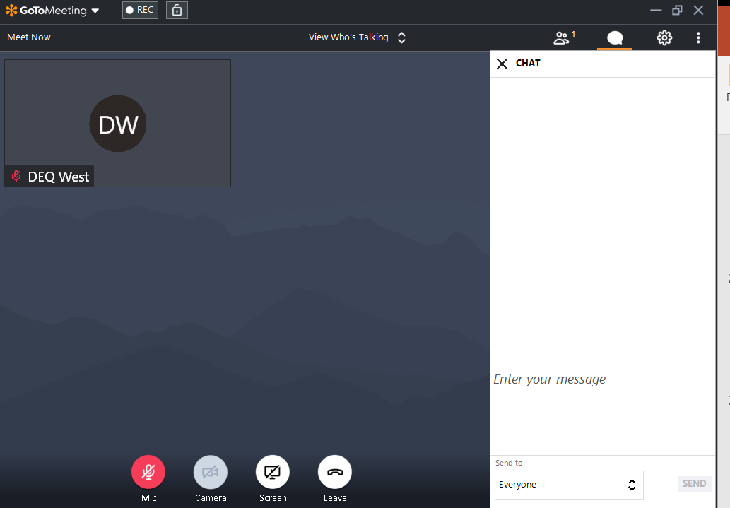
Getting Familiar with GoToMeeting
For technical support 703-583-3906

Slide 2
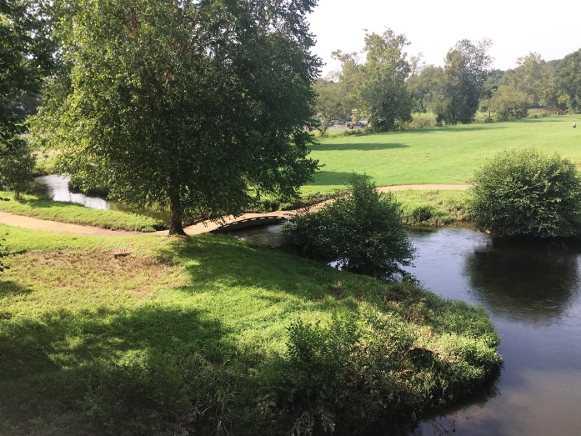
Mountain Run PCB Study:
First Technical Advisory Committee Meeting
Mark Richards & Rebecca Shoemaker
January 12, 2021
For technical support 703-583-3906

Slide 3

Agenda
Welcome and Introductions
  Meeting Objectives
Overview of Water Quality Planning
PCB Background Information
Water Quality Impairment of Mountain Run
Overview of the Mountain Run PCB TMDL
Next Steps

Slide 4
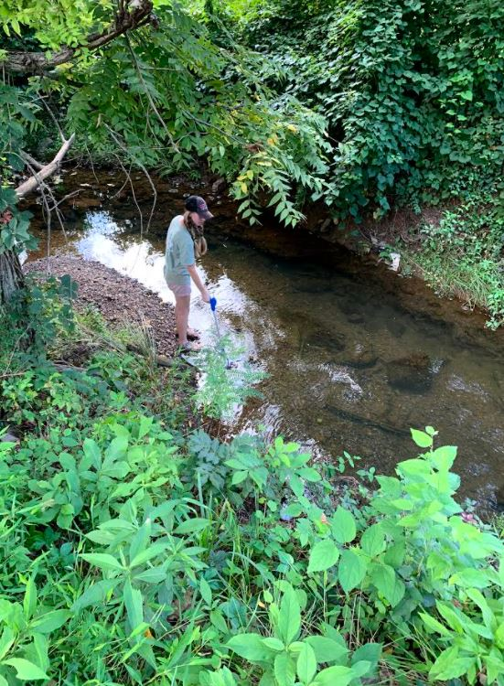
Polling Question
What best describes your interest in this project?
I represent a facility in the watershed with permitted outfall(s).
I am part of a local government organization.
I am concerned about the impact of PCBs on Mountain Run.
I like to fish and consume my catch.
Photo: October Greenfield, Friends of the Rappahannock

Slide 5
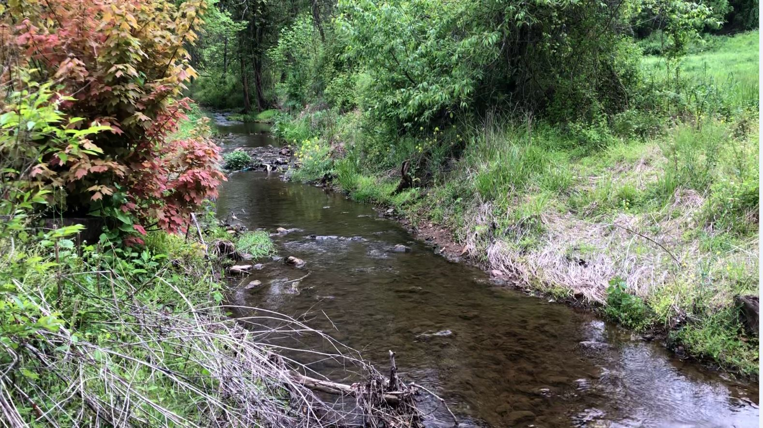
What does the Technical Advisory Committee do?
Represents the watershed community
Shares information on:
  Historic and current land use
  Key stakeholder groups and contacts
Reviews data related to:
  Pollutant sources
  Site Specific TMDL Endpoint
  Pollutant reduction scenarios
Photo: Friends of the Rappahannock

Slide 6
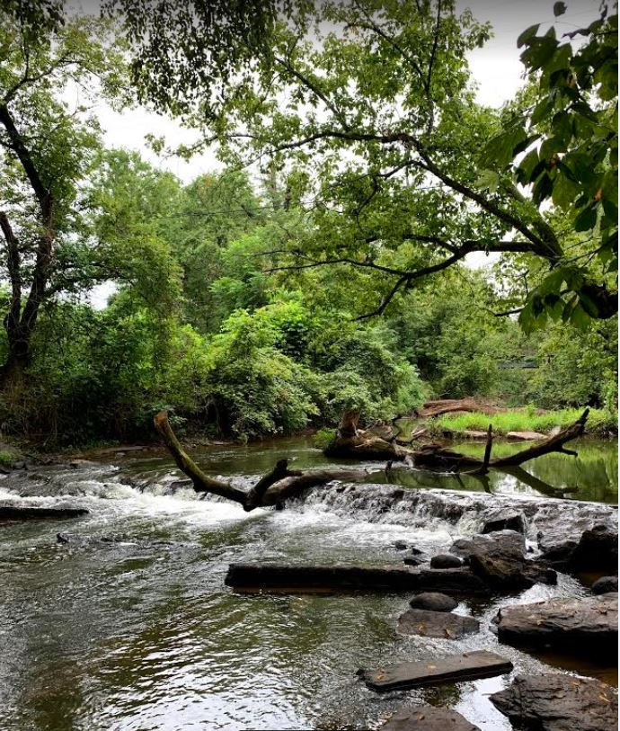
Our goals for today…
Share with you
  Background information on PCBs and fish tissue contamination
  DEQ’s on-going PCB source assessment study for Mountain Run
You share your thoughts on the study results and knowledge or insight on prospective sources
While this meeting is virtual, it is not intended to be a monologue
(i.e. WE NEED TO HEAR FROM YOU)
Photo: October Greenfield, Friends of the Rappahannock

Slide 7
Overview of Water Quality Planning

Slide 8
Water Quality Standards
Designated Uses
  All waters are designated for recreation, aquatic life, fish consumption, and wildlife
  Other uses applied locally as applicable (shellfish [tidal], public water supply, Chesapeake Bay, etc.)
Criteria
  To protect and maintain designated uses
  Numeric or narrative
Anti-degradation
  Protects and maintains existing water quality from being degraded

Slide 9
Continuous Planning Process
Monitoring
VPDES Permit Limits
Water
Quality Standards
Assessment
Implementation Plan
Integrated Report
Public
Participation
TMDLs
EPA
Public
Participation

Slide 10
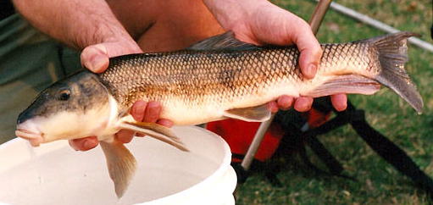
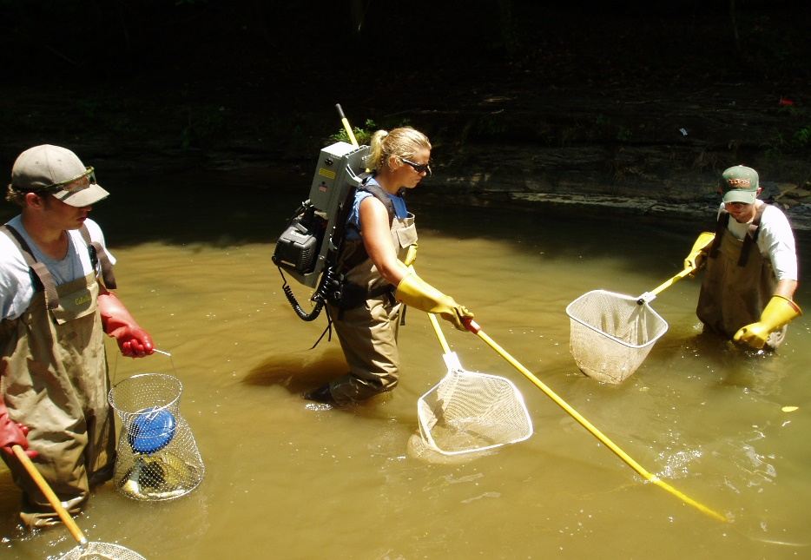
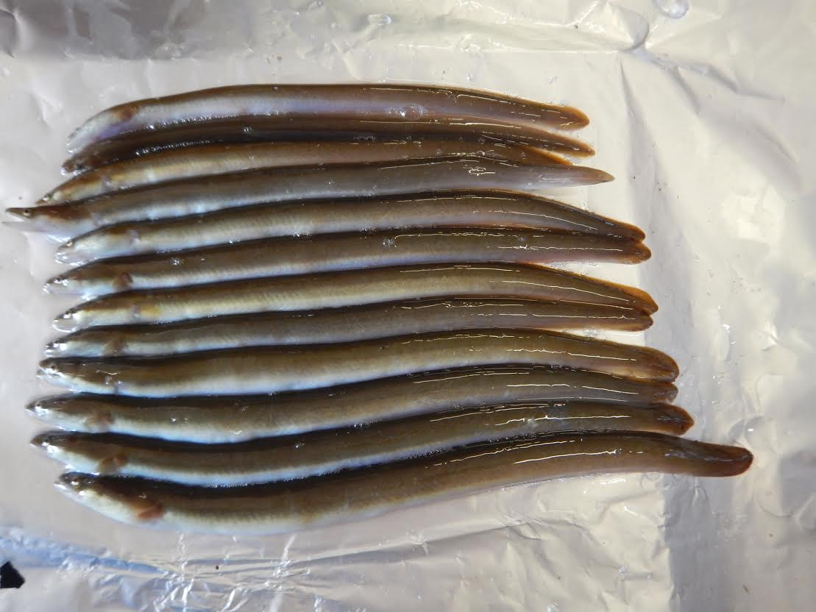
DEQ Fish Tissue Monitoring
Monitor to assess the “Fishable” Goal of the Clean Water Act - 305(b)
Target lipophilic or “fat loving” contaminants that accumulate in tissue
    PCBs, Pesticides, etc.
Compare to trigger values (protect human health)
    Listed on “dirty waters” report if exceeds - 303(d)

Slide 11
VA Water Quality Criterion – Total PCBs
Agency | Fish Tissue Threshold (ppb) | WQC (pg/L)
VDH | 100 (Fish Consumption Advisory) | - -
DEQ | 18 (Screening Value) | 640
DEQ’s Water Quality Assessment (Integrated Report)
  VDH: Consumption Advisory = impairment
  DEQ: If two or more fish samples exceed screening value at a site or two water samples exceed criterion at a site = impairment
  From: DEQ’s 2020 Water Quality Assessment Guidance Manual

Slide 12
Total Maximum Daily Load (TMDL)
Pollution Budget
Addresses different pollution categories
PCB TMDL - Multi-media approach
  Air, Land, Water
Goal = Reduce existing PCB load to restore the fish consumption use
TMDL End Point
Pollutant Load
TMDL = WLA + LA + MOS
Where:
WLA = Waste Load Allocation
LA = Load Allocation
MOS = Margin of Safety
Margin of Safety
Load Allocations (WLA + LA)
TMDL
Existing Load
Allocated Load
To be restored the waterbody must meet two thresholds: 1) Numeric WQC [or site specific value] and 2) fish tissue threshold

Slide 13


The TMDL Process
Fish Consumption Advisory
Identify Problem
Low Level PCB
Analysis
In Process
Source Assessment
Identify sources
Estimate source loading
To be Completed
Link Sources to Targets
Assess linkages
Estimate total loading capacity
TMDL Allocations
Reduce loads from point sources
Divide remaining loads among
sources
To be Completed
TMDL = Sum of WLA + Sum of LA + MOS
Notes:
These components are not necessarily sequential steps, but are a guide and framework for TMDL development.
(1) Problem Identification: define key factors and background information for a listed waterbody that describe the nature and impairment. This is the guiding factor in development of the TMDL.
(2) Develop Numeric Targets: measurable indicators and target values that can be used to evaluate attainment of water quality standards in the listed waterbody.
(3) Source Assessment: identify sources of loading for bacteria
(4) Link Targets and Sources: this is necessary in order to develop the TMDL since the linkage defines the cause-and-effect relationship between the pollutant sources and the in-stream pollutant response and allows for an estimation of loading capacity. This relationship can vary seasonally, especially for nonpoint sources that are highly dependent on precipitation.
(5) Load Allocations: pollutant loadings that will not exceed the loading capacity and will lead to attainment of the water quality standard can be determined based on the target/source linkage. The loadings may be distributed or allocated among the significant sources.
(6) Follow-up Monitoring: An ongoing monitoring plan should be included to determine whether the TMDL has resulted in attaining water quality standards and to support any required revisions to the TMDL.

Slide 14
PCB Background Information

Slide 15

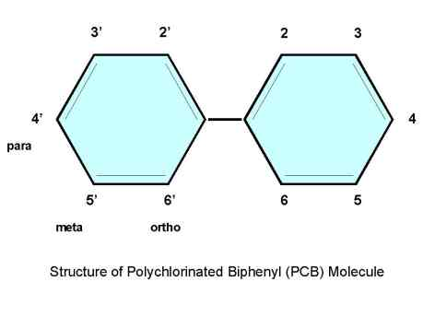
Background: PCBs
Biphenyl molecule (1-10 chlorine atoms)
209 distinct PCB Compounds
Regulated by DEQ as Total PCB (tPCB) = 209 compounds summed
Referred to as PCB Aroclors (Monsanto tradename) = mixture of PCB compounds
  Examples 1248, 1254, 1260

Slide 16
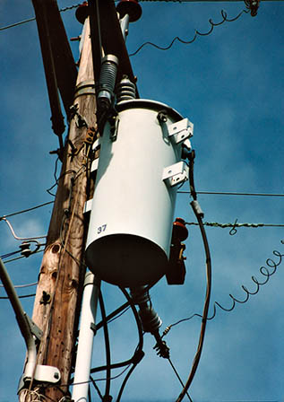
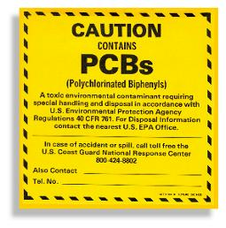
Background: PCBs
Legacy Contaminant
  Estimated that > 1.5 Billion lbs. manufactured in the U.S. until 1977
Characteristics
  Very stable and heat resistant
  Persistent in the environment
Common uses:
  Transformers, capacitors, hydraulic fluids, circuit breakers, PVC Products, carbonless copy paper, caulking material, paints, and more!

Slide 17
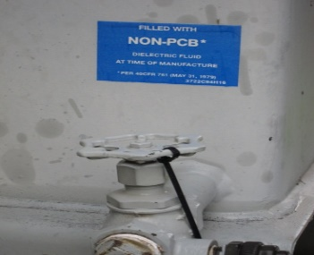
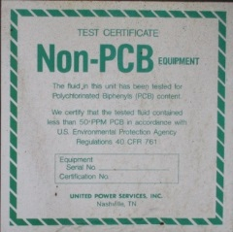
Toxics Substances Control Act (TSCA)
1976 Law regulates PCBs
  Bans the manufacture, processing, use and distribution in commerce
  Non-PCB Transformer defined as containing < 50 ppm PCB
  Inadvertent manufacture of PCBs – products up to 50 ppm allowed to leave site as long as annual average is < 25 ppm
    Unintentional by-products of manufacturing processes
50 ppm compared to DEQ’s WQC - 6.4 X 10⁻⁷ ppm (0.00000064)
Notes:
Banned in 1979
PCB Regulations: Part 761 in Title 40 of the Code of Federal Regulations
https://www.epa.gov/pcbs/learn-about-polychlorinated-biphenyls-pcbs
Has list of federal notices
6 Sept 2012: changes made so that PCB regs matched RCRA regs (40 CFR 262, 263, 264)
TSCA Cleanup level of 1 ppm
9VAC20-81-630: wastes containing PCBs (effective 2011)

Slide 18



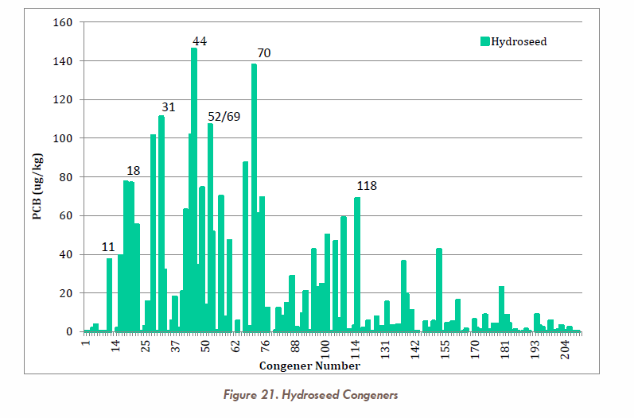
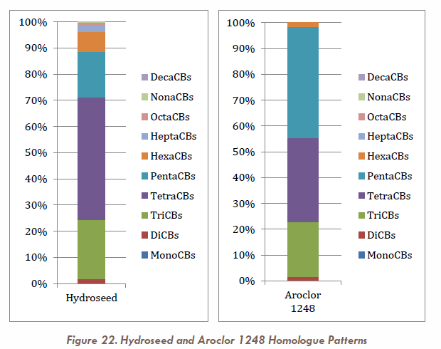
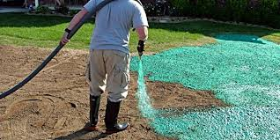
PCBs in Municipal Products
March 2015
Examples of other products tested
  Pennzoil SAE5W-30
  Valvoline Full Synthetic
  Road paint

Slide 19
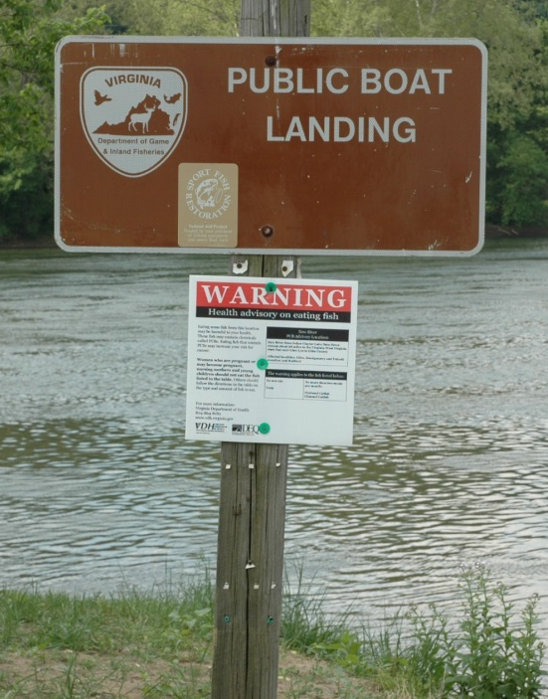
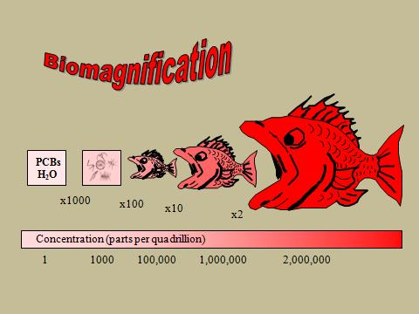
Why PCBs Continue to be an Issue
Fish impairments based on human health concerns
  Fish consumption significant exposure pathway
    Suspected carcinogen (EPA)
      Recognized as a carcinogen by the International Agency on Research for Cancer (IARC)
    Immunotoxicity, reproduction and
    development, hepatotoxicity (liver), etc.
Persistent, bioaccumulates at a low conc. (pg/L) & biomagnifies
Confirmed on-going releases

Slide 20
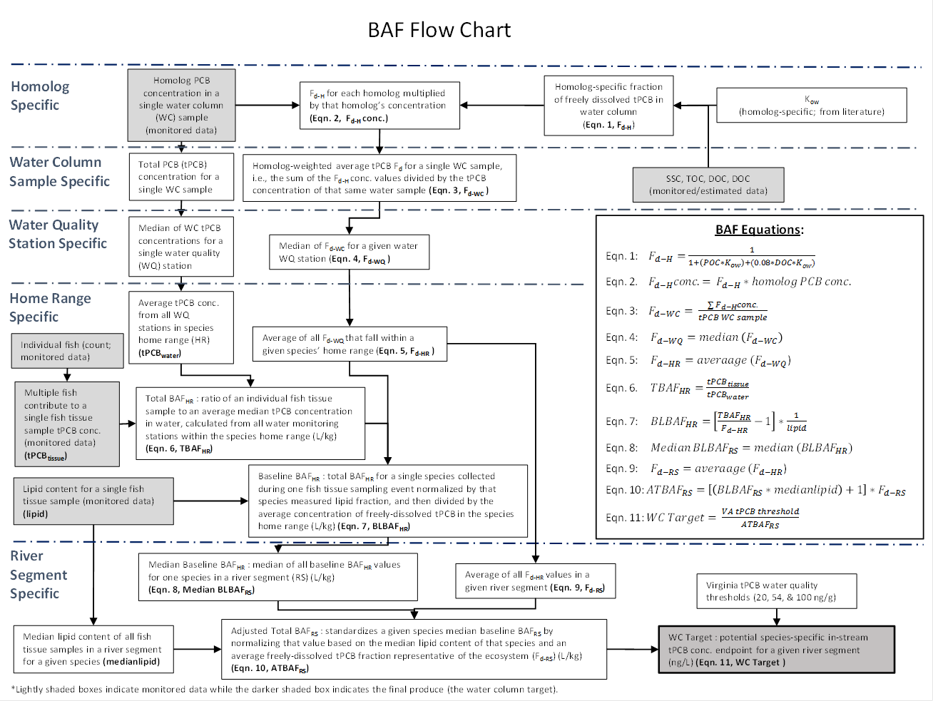
Site Specific PCB Endpoint
Explore the use of a site specific Bioaccumulation Factor (BAF) for multiple exposure pathways
  Used in other VA PCB TMDLs - Potomac River, Roanoke River, New River and Levisa Fork
Numeric water based value and fish tissue concentration must be met for successful restoration
  Narrative WQS (i.e., control of toxic substances including those that bioaccumulate)
Existing WQC only considers a single exposure pathway for PCBs (through fish gills)
  Other pathways include sediment ingestion and Biomagnification
EPA Method (EPA-822-03-030, 2003)

Slide 21
Water Quality Impairment in Mountain Run

Slide 22
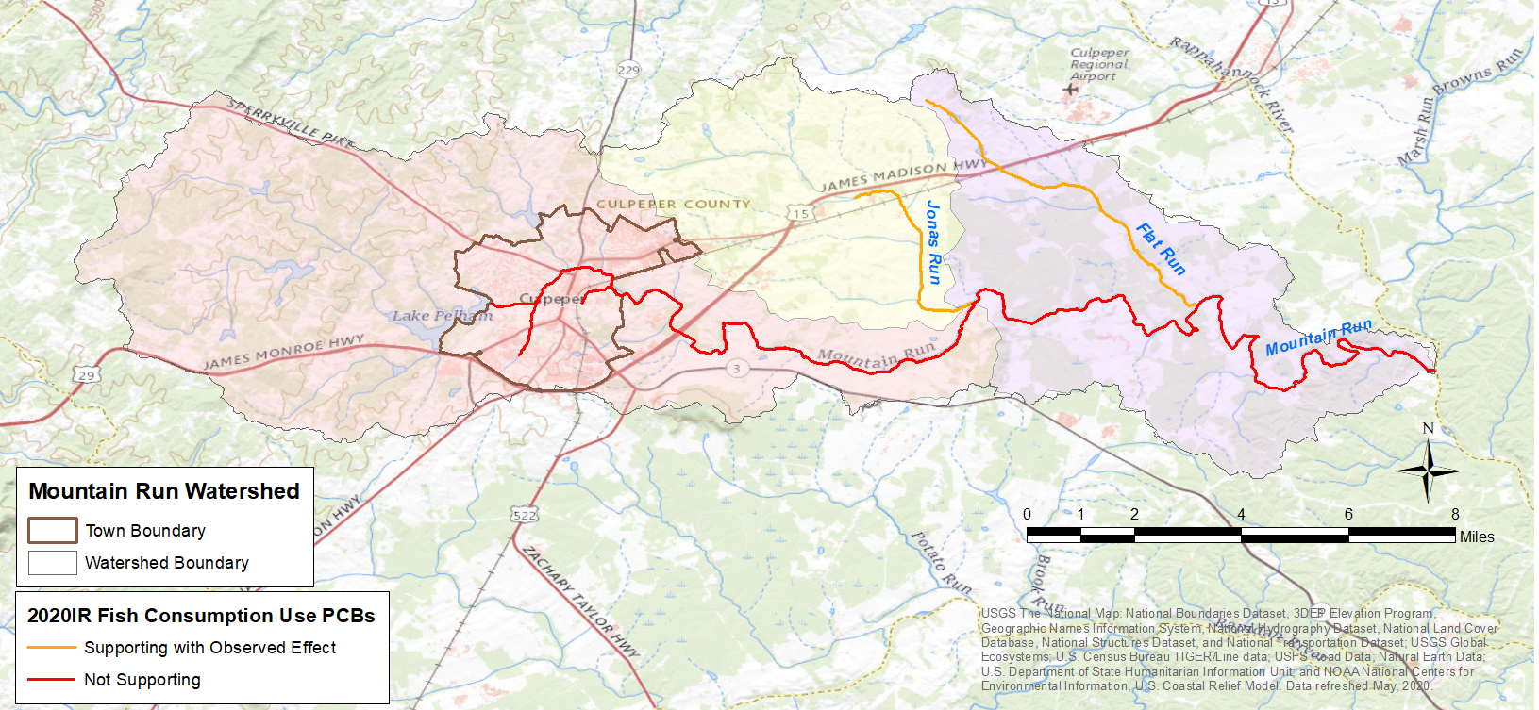
Mountain Run Watershed

Slide 23
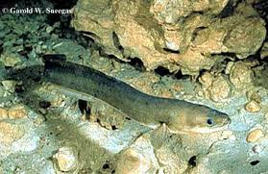
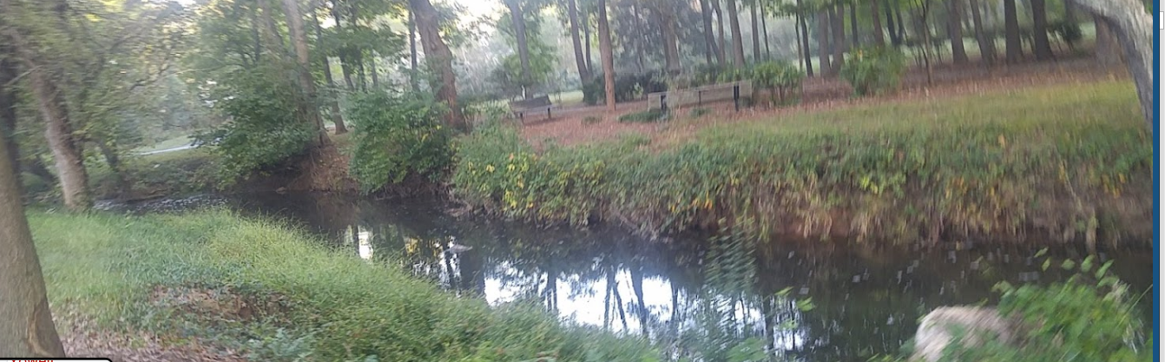
Mountain Run PCB Impairment Timeline
1999 & 2001: DEQ monitors fish tissue
2004: VA Department of Health issues fish consumption advisory for the American Eel (≤ 2 meals/month)
2006: 19.9-mile segment placed on VA’s impaired waters list
2006 & 2013: DEQ completes additional fish tissue monitoring
2013-2018: DEQ completes water and sediment monitoring to prepare for PCB study
2020: Impaired segment increased to 24.53-miles
Photo: https://www.cfr.msstate.edu/wildlife/fisheries/pdf/AmericanEel.pdf
Photo: https://www.google.com/maps/place/Yowell+Meadow+Park/@38.4756743,-77.9990059

Slide 24
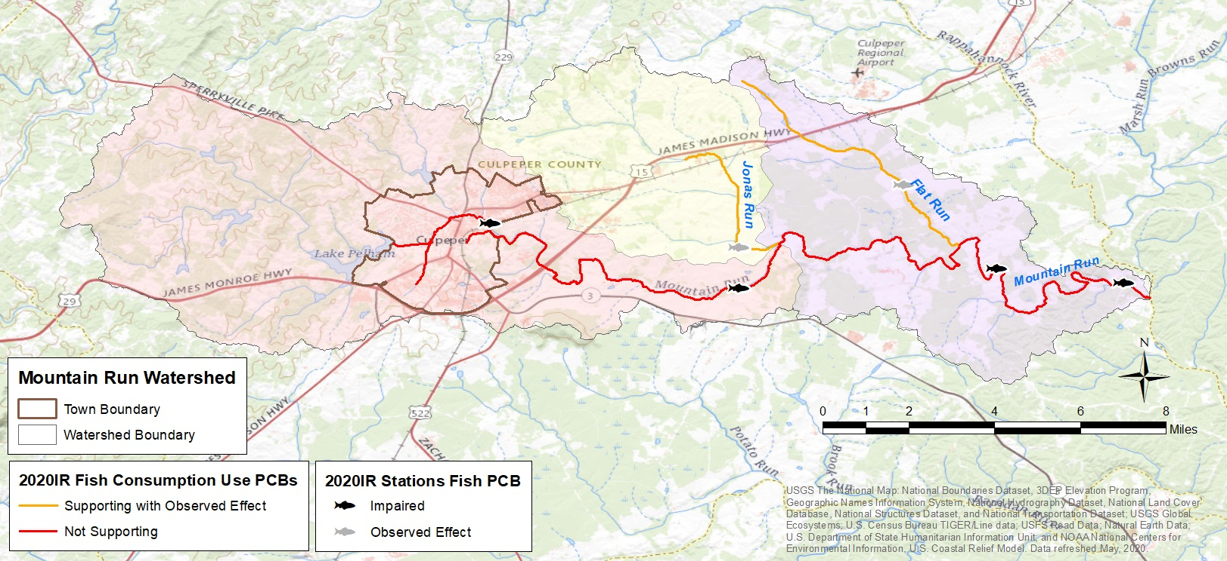
Problem Identification
VDH Fish Consumption Advisory
River basin | Waterbody | Section | Locality | Contaminants | Fish species | Advisory description
Rappahannock | Mountain Run | From rt. 15/29 bridge 19 miles to confluence with Rappahannock River | Culpeper | PCBs | American Eel | ≤ 2 meals/month
Does not affect swimming
Photo: Rick Browder, VADEQ
http://www.vdh.virginia.gov/environmental-health/public-health-toxicology/fish-consumption-advisory/

Slide 25
Arithmetic Mean tPCB Concentrations (ng/g) for Mountain Run Fish Tissue by Species, Year (1999-2013) and Rivermile

Slide 26
Arithmetic Mean of tPCB Concentrations in Mountain Run Fish
DEQ Screening Value

Slide 27
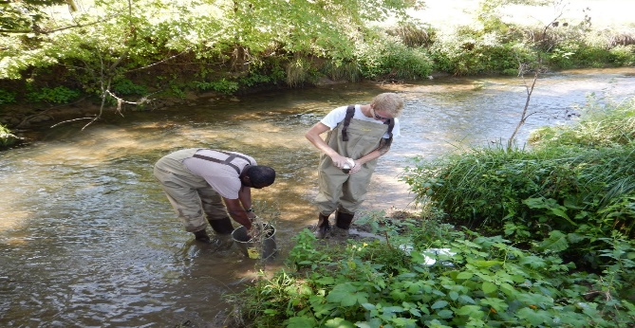
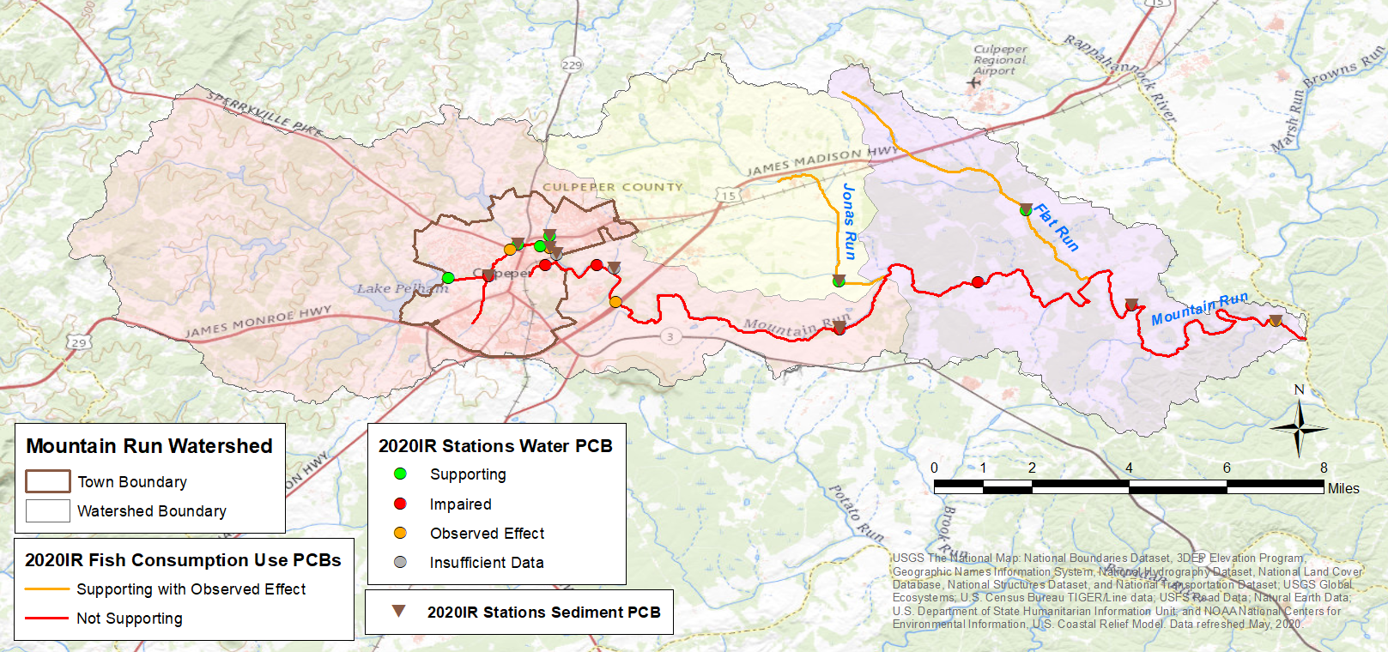
DEQ TMDL Sampling Approach
2013 – 2015, 2018
Source identification
TMDL model support
    Calibration/validation
2013 – 2018 water column, sediment
    Water column grab samples: High and Base Flow (n = 63)
    Sediment samples as needed

Slide 28
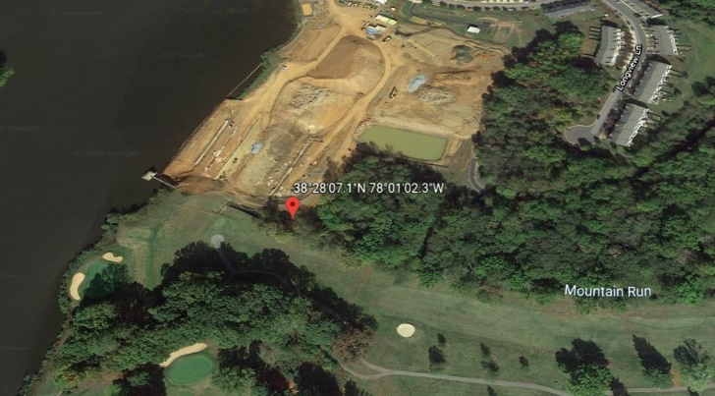
Water Column Arithmetic Mean Total PCB (tPCB) Concentrations (pg/L) by River Mile for Mountain Run (2013-2018)
DEQ’s WQC

Slide 29
Water Column PCB Mean Concentration by Rivermile for Mountain Run
Unnamed Trib. (Spring St)
Flat Run
Balds Run
Hidens Branch
Jonas Run
Unnamed Trib. (Yancey St)
DEQ’s WQC

Slide 30
Arithmetic Mean of Total PCB (pg/L) Water Concentrations in Mountain Run During Wet and Dry Flow Conditions
Mainstem Site Location (Rivermile) | Location Description | Sample Size (n) | Percent (%) Exceedence
23.88 | Spillway Below Lake Pelham | 4 | 0
22.49 | Rt 522 | 2 | 50
22.2 | Upstream of Old Brandy Rd | 2 | 0
22.01 | Old Brandy Rd | 5 | 40
21.75 | Upstream of RR Tracks | 1 | 0
21.11 | Rt 699 | 4 | 50
19.75 | Rt 29 (near By-pass) | 2 | 50
14.88 | Rt 633 (Stevensburg Rd) | 8 | 38
10.98 | Rt 669 | 2 | 100
5.79 | Rt 672 (Stones Mill Rd) | 7 | 29
0.59 | Rt 620 (Edward Shops Rd) | 6 | 17

Slide 31
Total PCBs - Sediment
Sediment Site Location (Rivermile) | Location Description
Lake Pelham (24.05) | Lake Pelham above Spillway
UT to Mtn Run (0.06) | End of Spring Street
Balds Run (0.08) | Colonel Jamerson Rd
Hidens Branch (0.22) | Rt 29 (Business)
Mountain Run (22.01) | Old Brandy Rd
UT to Mtn Run (0.10) | Rt. 667 (Nalles Mill Rd)
Mountain Run (14.88) | Rt 633 (Stevensburg Rd)
Mountain Run (0.59) | Rt 620 (Edward Shops Rd)

Slide 32
Mountain Run PCB TMDL

Slide 33
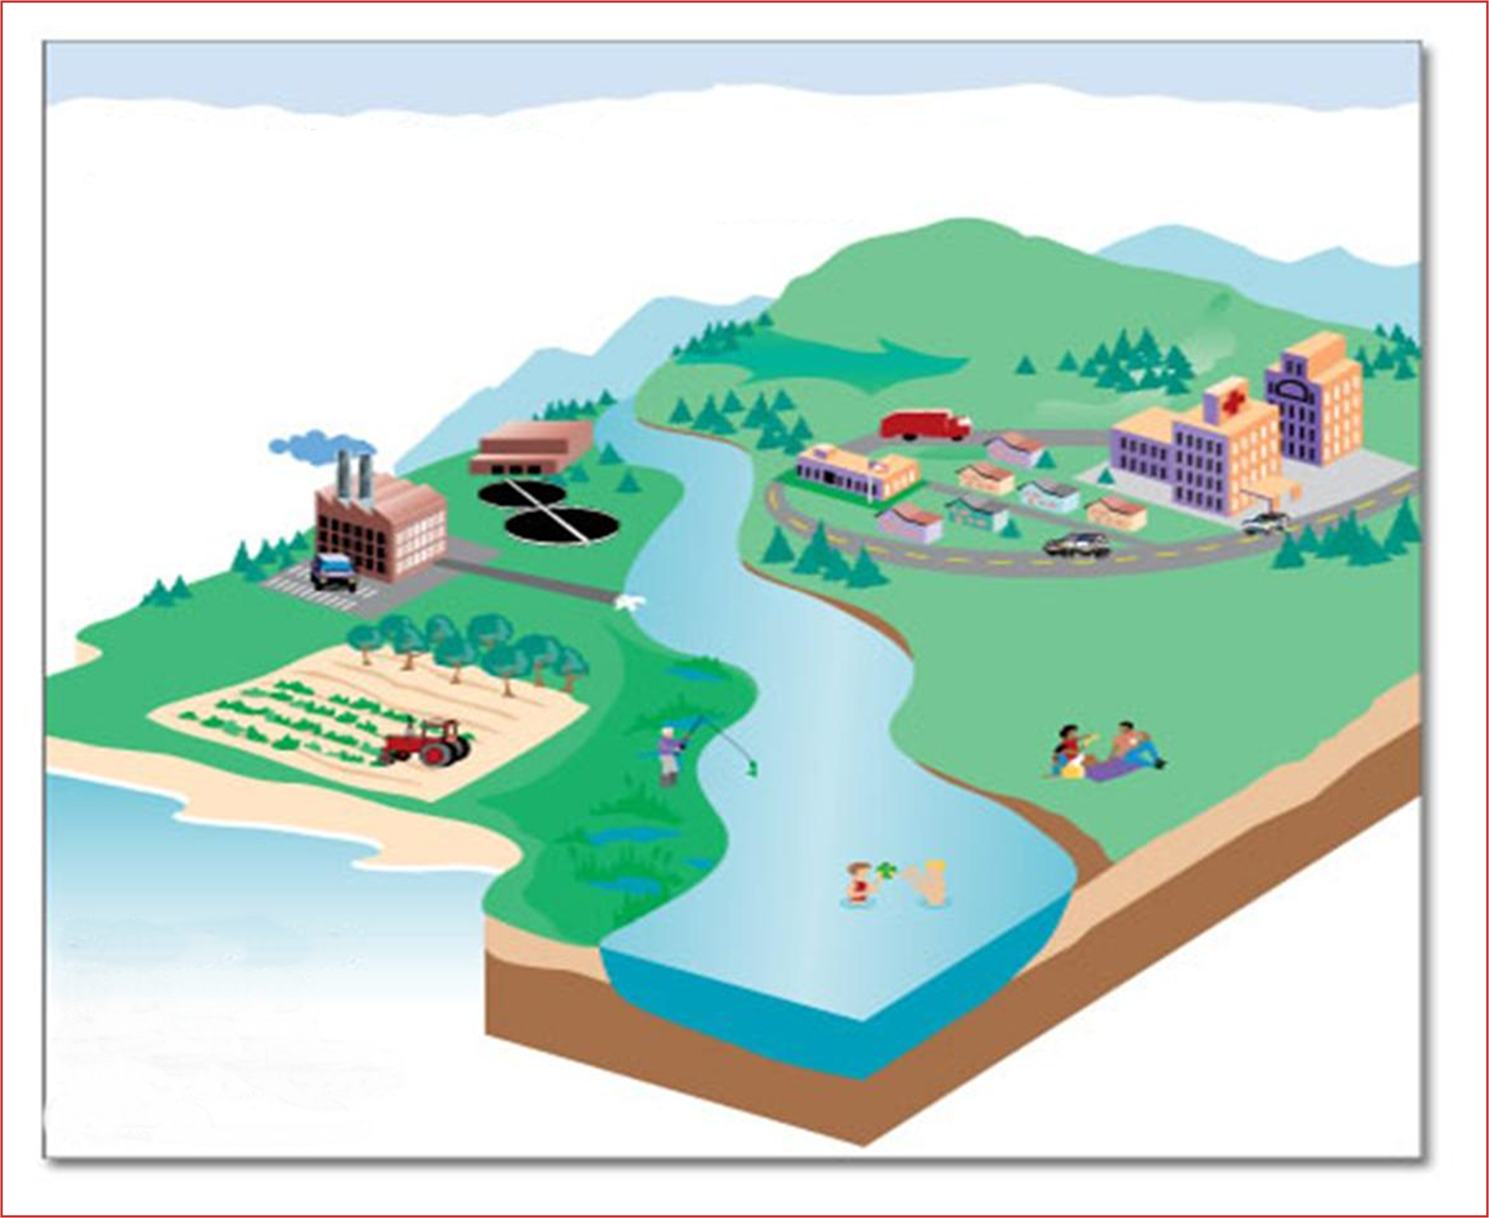

Sources considered in PCB TMDL
Wet Deposition
2
Dry Deposition
Air Emissions
Non-point source
Runoff
4
1
3
MS4 SW Runoff
Point Source Effluent
Contaminated Sites
PCB
PCB
5
Non-point source
Runoff
Requires Multi-Media Approach
(land, water, air)
PCB
6
PCB Contaminated
Sediment
PCB
PCB

Slide 34
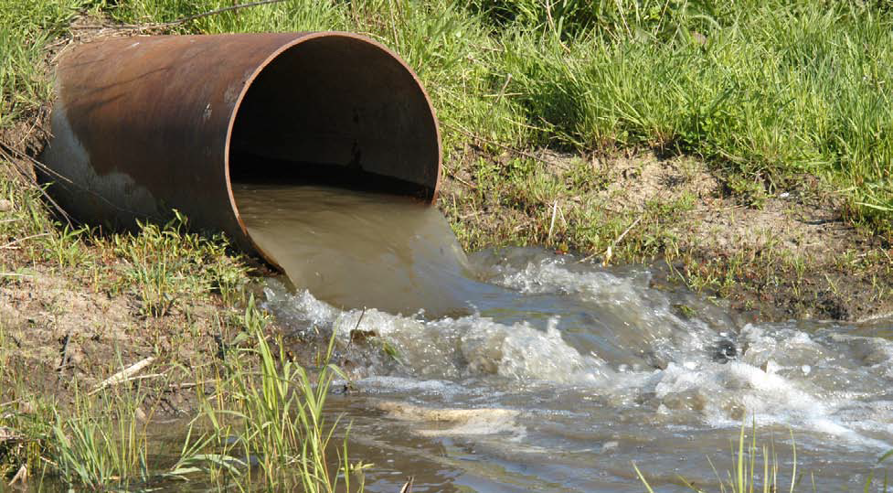
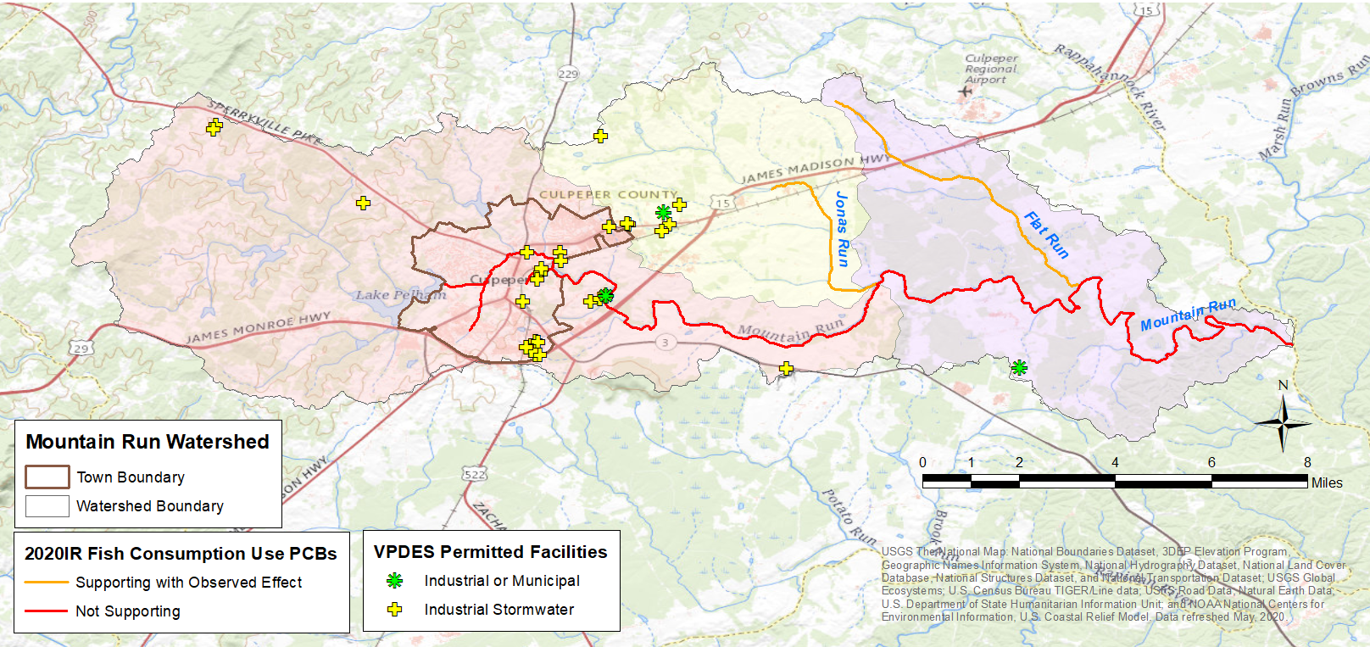
TMDL Source Category – Point Sources
VPDES Permitted facilities
  Municipal WWTP
  Industrial sources
    Selected based on Standard Industrial Classification (SIC)
      Individual Industrial Facilities
      Industrial Storm Water General Permitted Facilities
  Municipal Separate Storm Sewer System (MS4)

Slide 35
TMDL Source Category - VPDES Permitted Facilities
Facility Type | PCB Impaired Waterbody | Facility Name | Permit ID
Municipal WWTP
 | Mountain Run | Town of Culpeper WWTP | VA061590
Industrial Stormwater
 | Mountain Run. UT | TE Connectivity - Culpeper Plant | VAR050855
 | Mountain Run. UT | Bingham and Taylor Corp | VAR050900
 | Mountain Run. UT | Culpeper Municipal Power Plant | VAR051573
 | Mountain Run | Wise Services and Recycling LLC | VAR051878
 | Jonas Run, UT | Culpeper Recycling | VAR051928
 | Mountain Run | Culpeper Towing and Salvage Incorporated | VAR051952
 | Jonas Run, UT | AMRF Incorporated | VAR052293
Industrial Individual Permit
 |  | Not Applicable

Slide 36
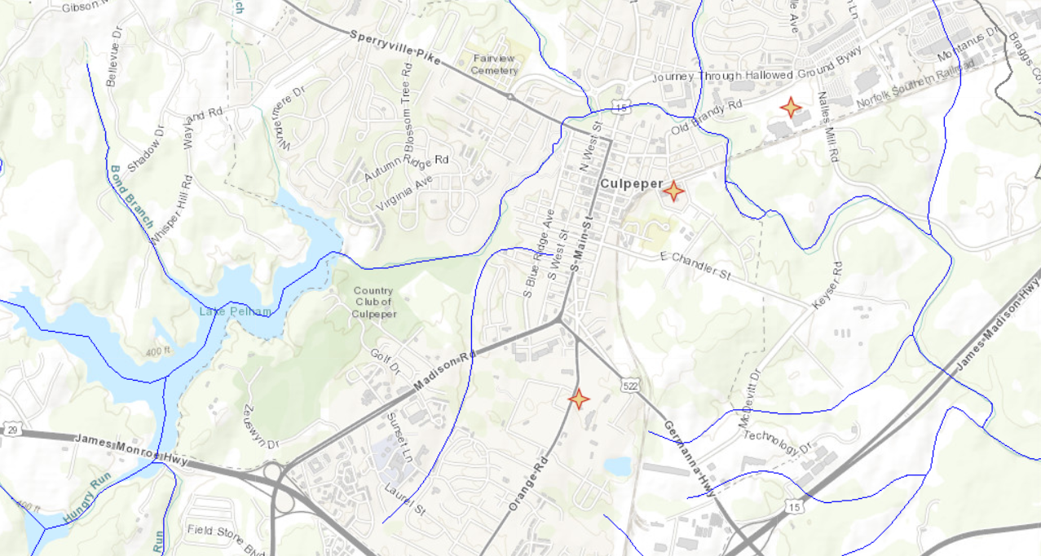
TMDL Source Category - Contaminated Sites
TSCA (PCB Clean-up Sites)
RCRA Corrective Action Facilities*, CERCLA
  Former Manufacturing Facilities (EPA Emergency Response)
Voluntary Remediation Sites*
Landfills
Rail Yards/Spurs*
Miscellaneous spill sites*
Electric Utility Transformer Pads*

Slide 37
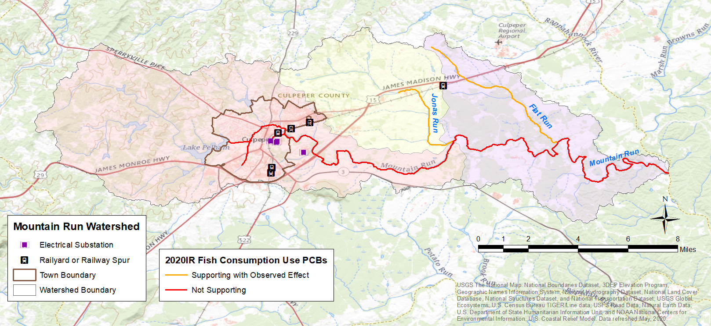
Railyards/Railway Spurs & Electrical Substations

Slide 38
TMDL Source Categories
Atmospheric Deposition (example)
Contaminated Sediment
Modes of Deposition
Wet = 4.5 – 12% of total
Rodenburg (Totten), L. A. et al., 2007. Rutgers University
For technical support 703-583-3906

Slide 39
Mountain Run PCB TMDL
PCB Fate and Transport Modeling

Slide 40
Implementation Process
Implementation Process
Point sources
WLA---- PMP
Nonpoint sources
Source “Fingerprinting”
Detect “uncharacterized sources”
Investigation
of Hotspots
Deliberate Monitoring
Funding

Slide 41
VPDES Point Sources
Pollutant Minimization Plan
If existing (baseline) condition > WLA
Pollutant Minimization Plan
Submitted and Approved
Backtrack/Source ID
Adaptive Implementation
Re-evaluate baseline load
Remediation
/BMPs

Slide 42
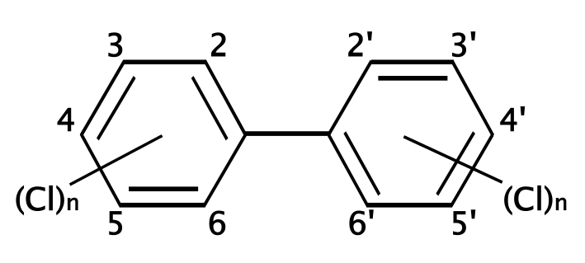


Point Source/Nonpoint Source:
“Fingerprinting”
Objective: To identify a specific pattern or “fingerprint” of congeners that could be indicative of a pollution source
1. # of fingerprints in the system
2. Chemical composition in each fingerprint
3. contribution of each fingerprint in each sample

Slide 43
Example “Fingerprint” for River Water

Slide 44
Example “Fingerprint” for Sediment

Slide 45
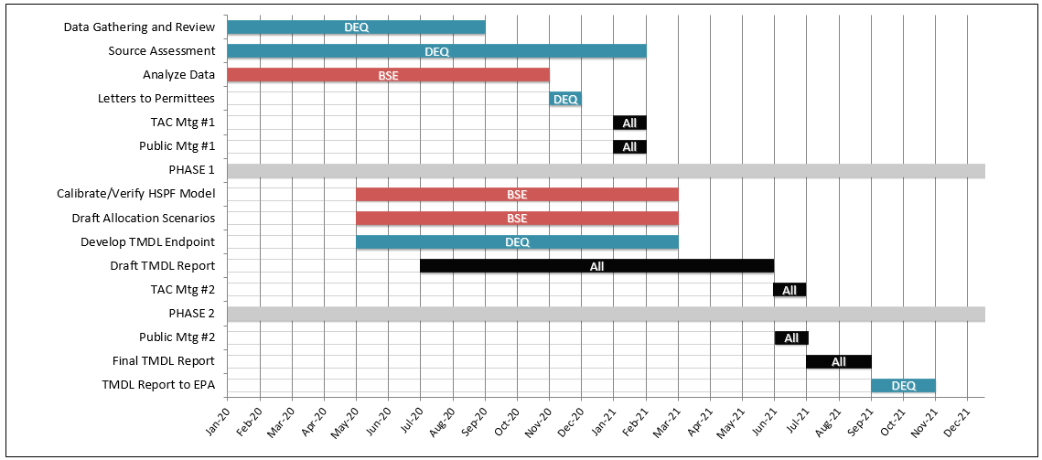
Mountain Run PCB TMDL Project Timeline

Slide 46

Next Steps
First Public meeting (1/13/2021)
  Comment period 1/14/2021 – 2/16/2021
Anticipate 1-2 more Technical Advisory Committee meetings
  Other stakeholders that should be at the “table”?
Final public meeting
Mark.Richards@deq.virginia.gov
Rebecca.Shoemaker@deq.virginia.gov

Slide 47
Extra Slides

Slide 48


VDH Threshold
In 2012 increased fish tissue PCB threshold from 50 ppb to 100 ppb
  Designed to protect public health when contamination has been identified.
  Risk Assessment calc. designed for known contamination in a finite geographical area (e.g., Superfund site).
VDH Changes -
- Increased body weight from 70 kg to 80 kg (176 lbs)
Changed life expectancy inc. from 70 yrs to 78 yrs & from 30 yrs
to 32 yrs a person would live in the same residence
- Decreased from four meals/month to two
Note: VDH is not required to go through administrative regulatory process to change threshold(s)

