Slide 2
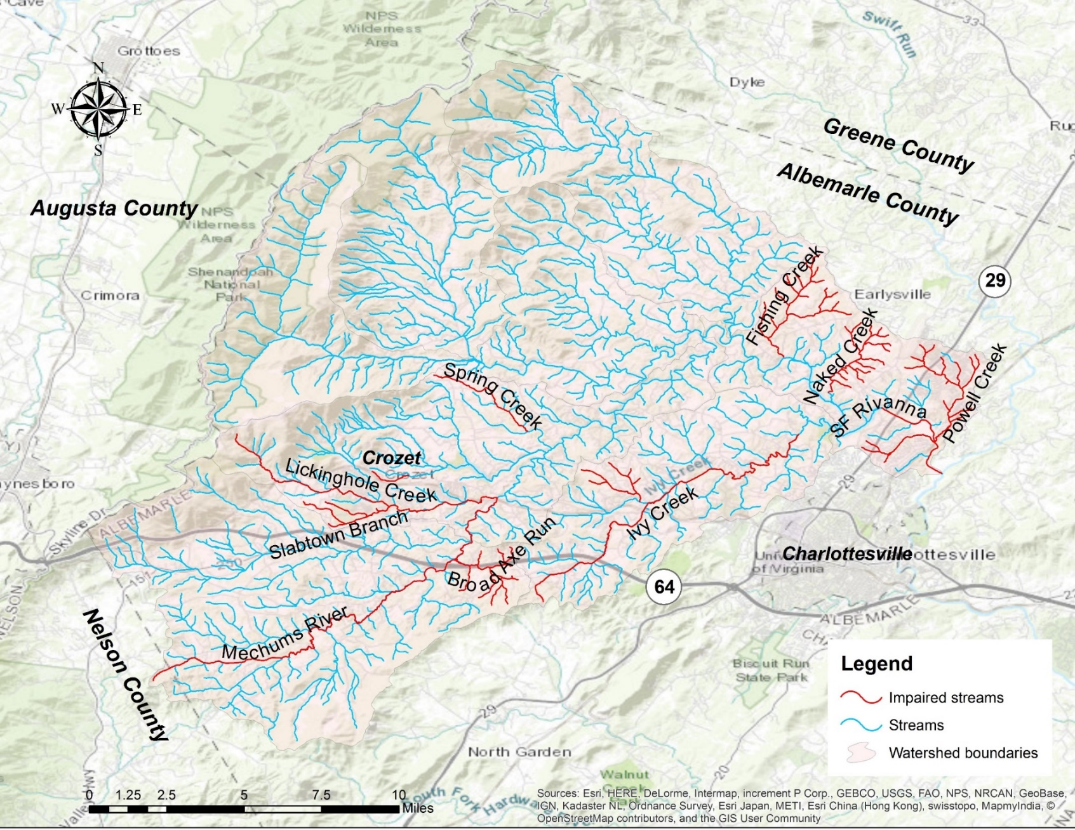
Introductions
Welcome to the 2nd Advisory Committee Meeting for the South Fork Rivanna River Stream Health Study!
Please type into the ‘chat’ box a brief introduction
Name
Organization/affiliation
Watershed of interest
Any general interests or concerns for the watershed?
If you are having technical difficulties, please call: 540-574-7872.

Slide 3
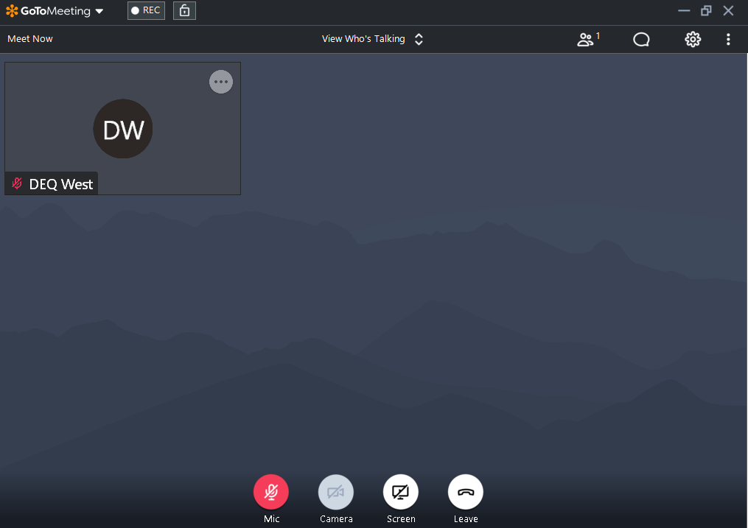
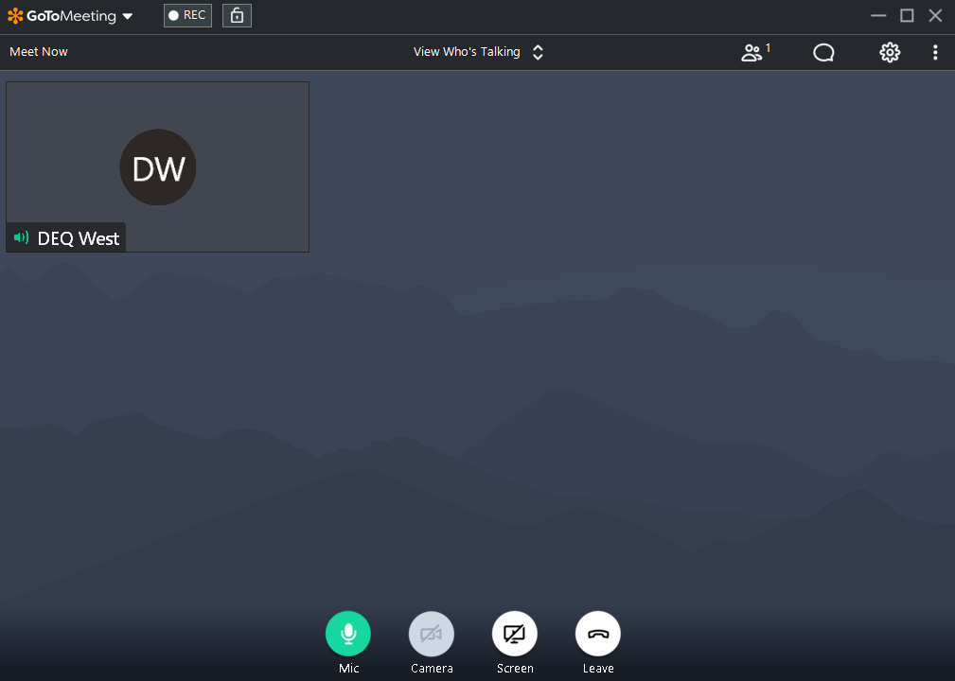
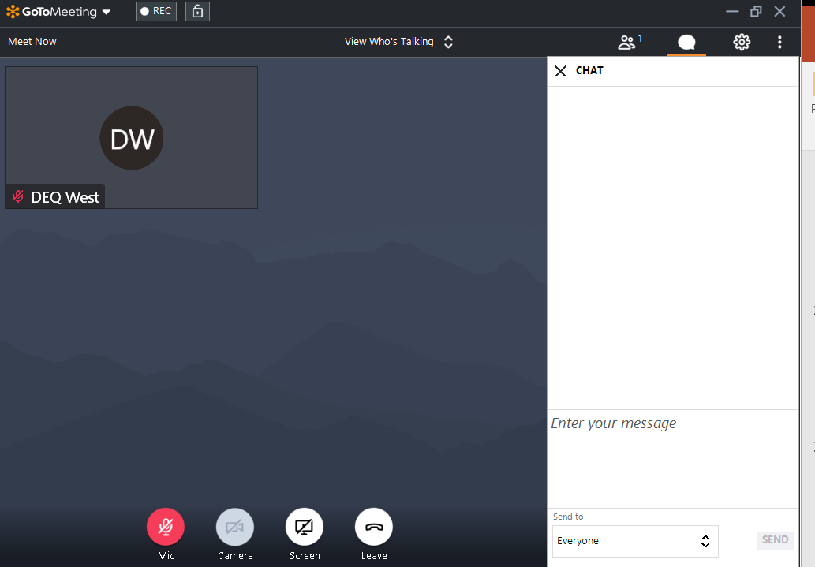
Getting Familiar with GoToMeeting
For technical support issues call Sara Bottenfield: 540-574-7872

Slide 4
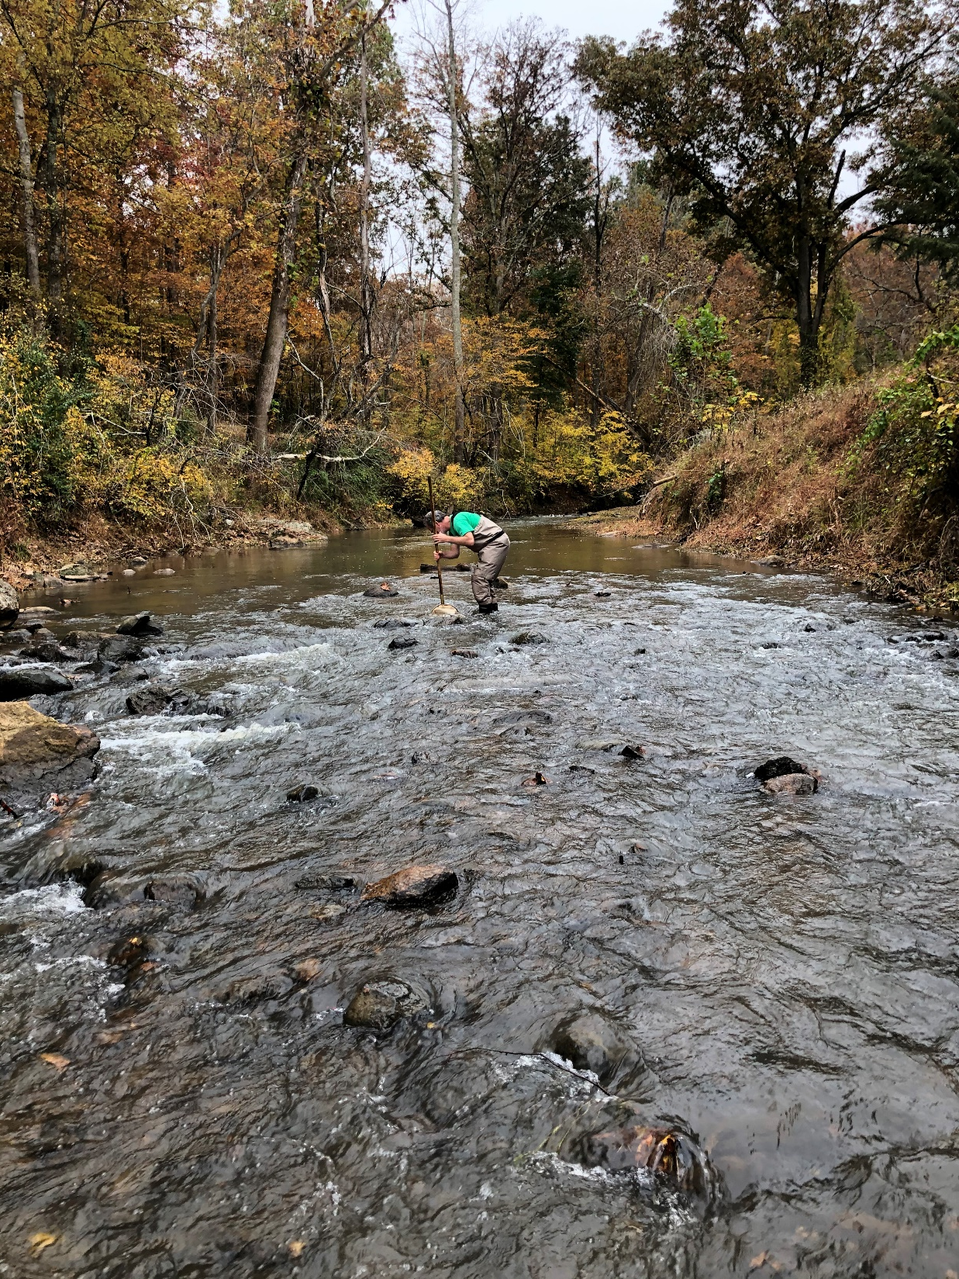
South Fork Rivanna River Stream Health Study
Technical Advisory
Committee Meeting #2
February 23, 2021
Katie Shoemaker
Senior Engineer
Wetland Studies and Solutions, Inc.
Nesha McRae
TMDL Coordinator, Valley Regional Office
Virginia Department of Environmental Quality

Slide 5
Goals for today
Blue: what we will share, Green: what we need from you
Explain the process of developing a watershed model
  Get your input on the appropriate model
Explain how we set goals for reducing pollutants
  Get your input on selecting reference watersheds
Share land cover estimates for each subwatershed
  Get your input on current land cover acreages
Share data on permitted sources of pollutants in the watersheds
Share estimates of acres under construction in the watersheds
  Get your input on the management of these sites
Explain next steps

Slide 6
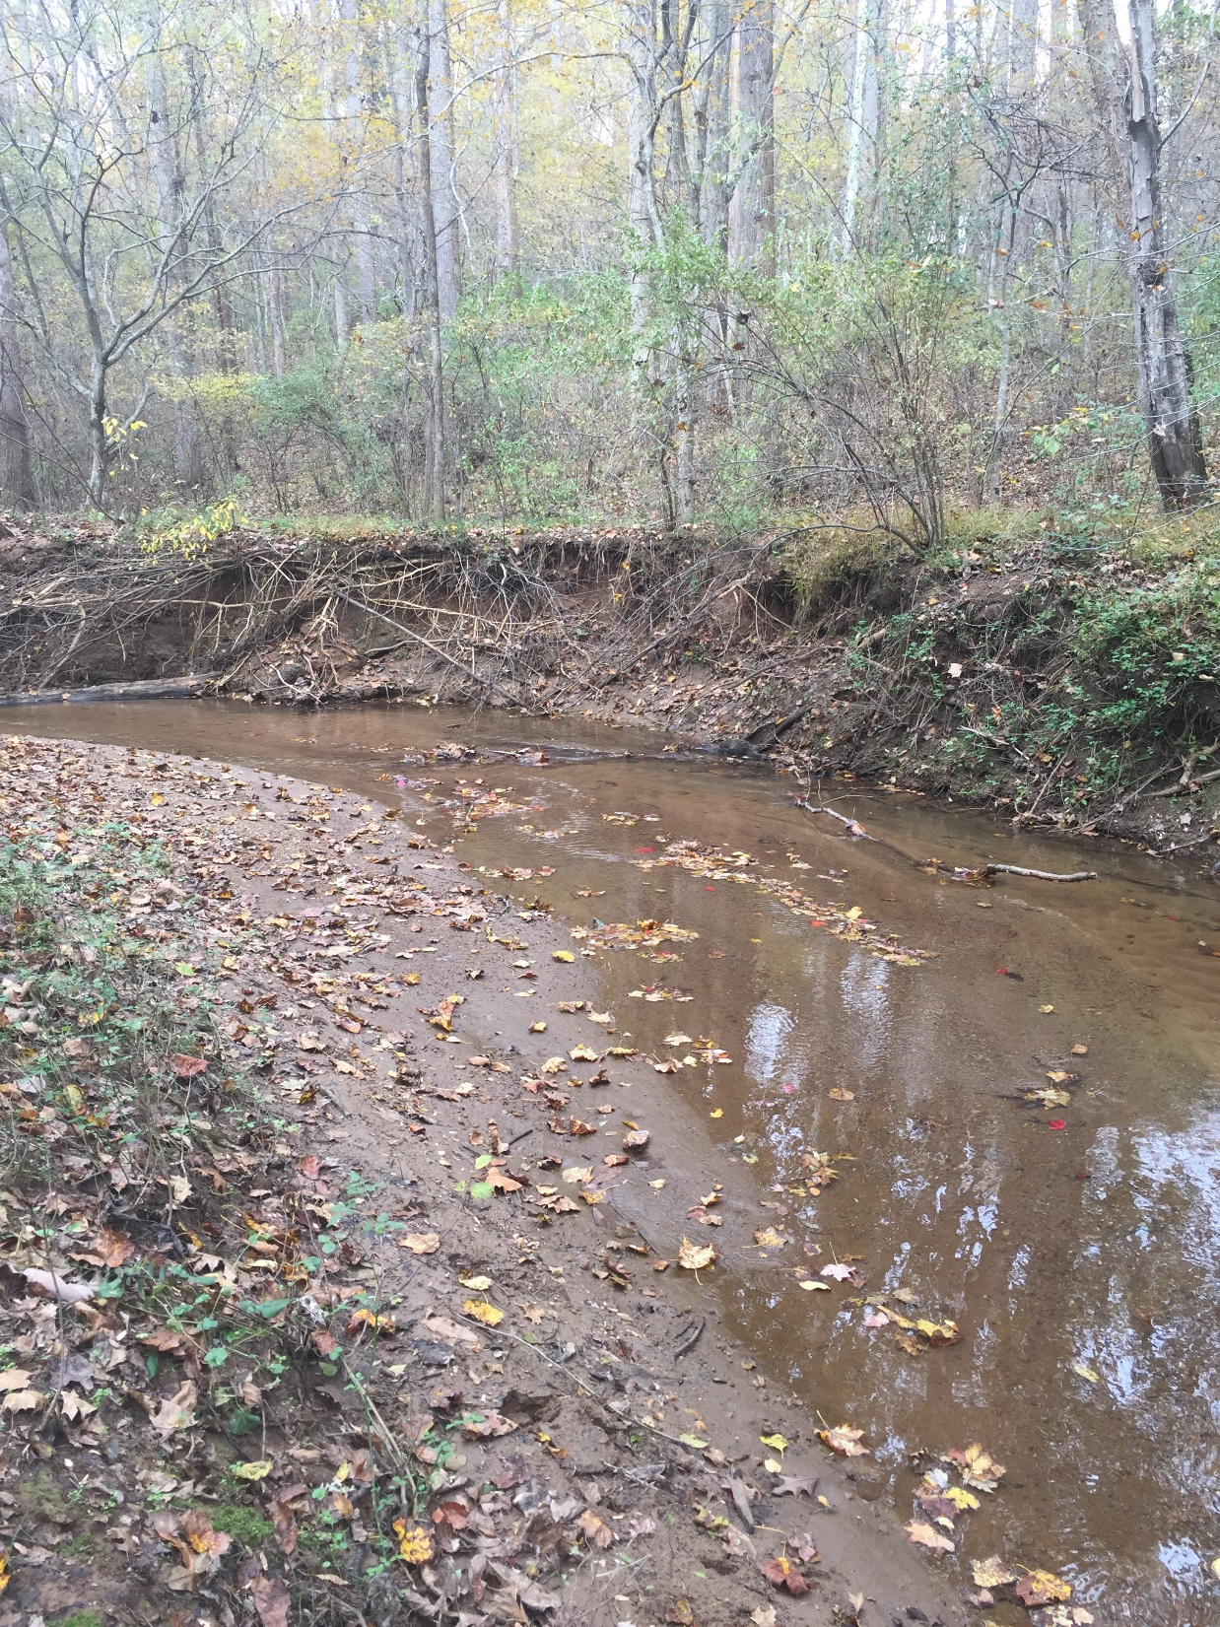
What is bugging the bugs?
Recap of benthic stressor analysis
Photo: Jan Hamrsky: lifeinfreshwater.net
Stream | Probable Stressors | TMDL Targets
Broad Axe Run | Sediment | Sediment
Fishing Creek | Sediment | Sediment
Ivy Creek | Sediment | Sediment
Lickinghole Creek | Sediment | Sediment
Little Ivy X-Trib | Sediment | Sediment
Mechums River | Sediment | Sediment
Naked Creek | Sediment | Sediment
Parrot Branch X-Trib | Sediment, Nitrogen | Sediment, Total Nitrogen
Powell Creek | Sediment | Sediment
Slabtown Branch | Sediment | Sediment
South Fork Rivanna River | Sediment, Phosphorus, Dissolved Oxygen | Sediment, Total Phosphorus
SF Rivanna River X-Trib | Sediment | Sediment
Spring Creek | Sediment | Sediment
If you are having technical difficulties, please call: 540-574-7872.

Slide 7
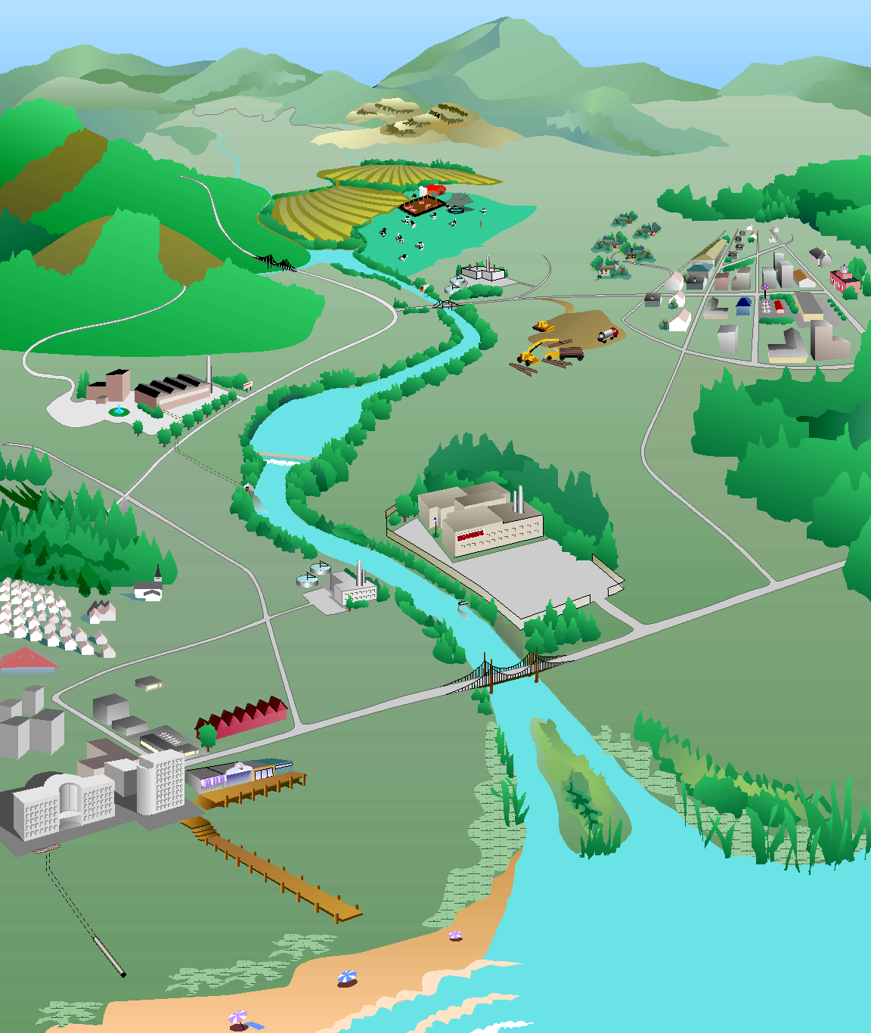
How do we develop a TMDL?
What’s the magic number…
If you are having technical difficulties, please call: 540-574-7872.
Identify sources of the pollutant
Model their path to the stream
Determine reductions needed from each source to meet standard
Forest:
1 ton/yr
Forest:
0% reduction
Cropland:
30% reduction
Cropland:
10 tons/yr
Residential:
50% reduction
Residential:
4 tons/yr
Pasture:
12 tons/yr
Pasture:
40% reduction
Urban:
75% reduction
Urban:
8 tons/yr
Impaired stream
Sediment load = 37 tons/yr
TMDL
Sediment load = 19 tons/yr
Point sources:
2 tons/yr
Point sources:
0% reduction
Diagram: Adapted from the Center for TMDL and Watershed Studies at Virginia Tech

Slide 8

Computer Watershed Model Selection
Computer model used to:
Estimate existing pollutant loads
Develop target pollutant load
Evaluate scenarios to meet target load
There are no perfect models!
Too little detail: hard to have confidence in results
Too much detail: may not have adequate return on investment
8
If you are having technical difficulties, please call: 540-574-7872.

Slide 9


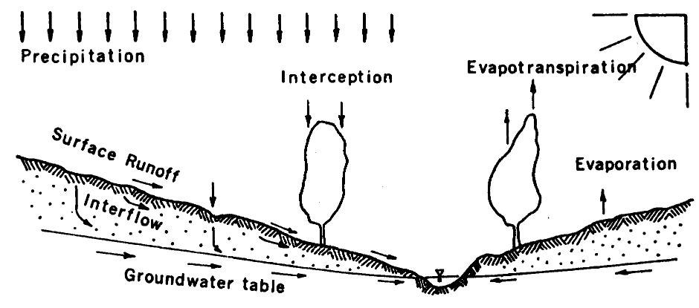
Watershed Computer Model Selection
HSPF (Hydrologic Simulation Program – FORTRAN)
Continuous simulation
Nonpoint and Point Sources
Simulates stream network
BATHTUB
Specific for reservoirs and lakes
Nutrient balance and eutrophication
For the South Fork Rivanna River Reservoir
9
If you are having technical difficulties, please call: 540-574-7872.

Slide 10
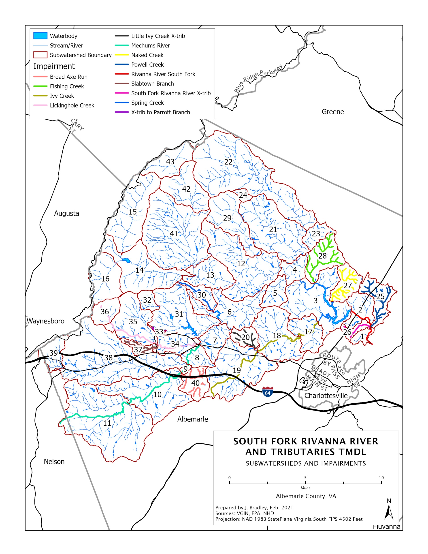
Subwatersheds
If you are having technical difficulties, please call: 540-574-7872.
10

Slide 11
TMDL Equation
WLA
LA
MOS
TMDL
WLA= Wasteload Allocation
  Permitted/Point Source
  Future Growth
LA= Load Allocation
  Nonpoint Source
MOS= Margin of Safety
  Extra load to account for uncertainty
If you are having technical difficulties, please call: 540-574-7872.
Notes:
Permitted sources in lynch Creek= zero, Reed Creek= has 1 permit (dischargers)
Implicit vs explicit MOS, future load

Slide 12

TMDL Reductions Need a Target to Shoot For
Some pollutants have numerical criteria in regulations to set acceptable levels (e.g. bacteria counts)
Other pollutants are expected to vary among ‘healthy’ watersheds, so there is no set regulatory threshold (e.g. sediment)
If you are having technical difficulties, please call: 540-574-7872.

Slide 13

Developing a Pollutant Target
Two main methods:
  Reference Watershed
    Find one, nearby, similar, but healthy watershed and see what the pollutant levels are there
    Straightforward method
    Hard to find ideal reference watershed
  All-Forested Load Multiplier
    Use many other watersheds - both healthy and impaired - to develop a target load
    Used in Virginia since 2014
    More rigorous result (less likely to overshoot)
    More effort and time
If you are having technical difficulties, please call: 540-574-7872.

Slide 14
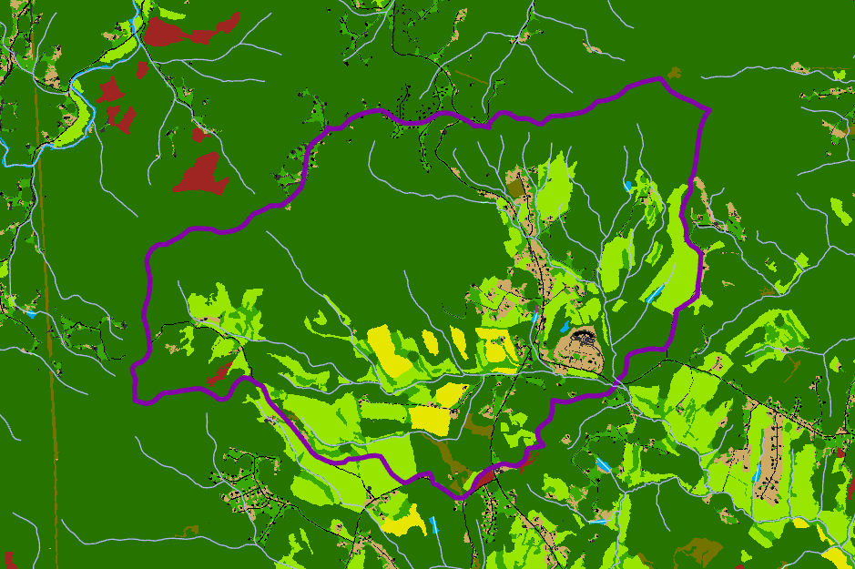
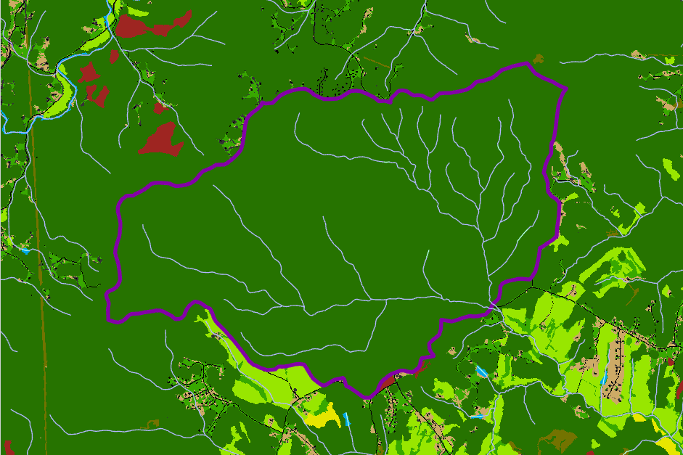
Developing a Pollutant Target: AllForX Methodology
Existing Sediment Load: 500,000 lb/yr vs. All Forested Sediment Load: 50,000 lb/yr
All-Forest Multiplier (AllForX) 500,000 / 50,000 = 10
If you are having technical difficulties, please call: 540-574-7872.

Slide 15
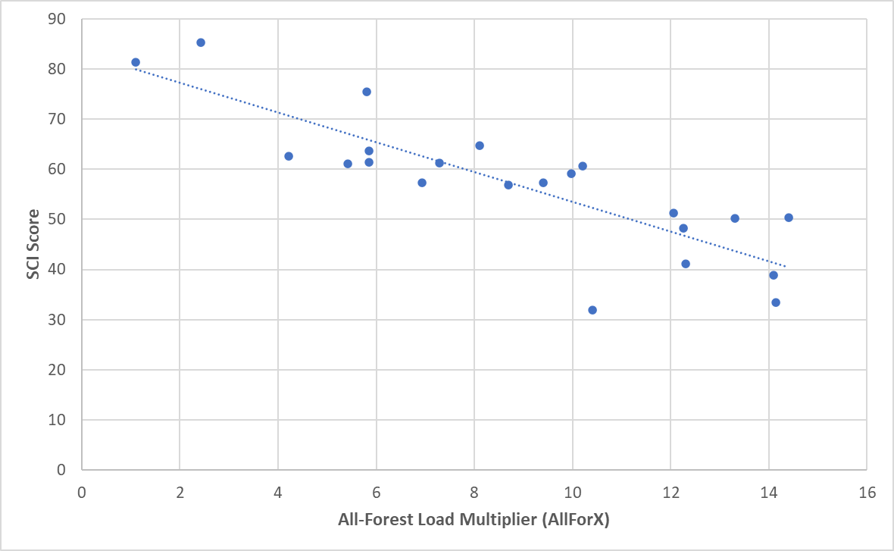
Developing a Pollutant Target: AllForX Methodology
Unimpaired Streams
Impaired Streams
If you are having technical difficulties, please call: 540-574-7872.

Slide 16
Developing a Pollutant Target: AllForX Methodology
Existing Sediment Load: 500,000 lb/yr
All Forested Sediment Load: 50,000 lb/yr
All-Forest Multiplier (AllForX) 500,000 / 50,000 = 10
Regression Results: VaSCI = 60 -> Threshold AllForX = 6.7
To Obtain Target Loading:
(All Forested Sediment Load) x (Threshold AllForX)
50,000 lb/yr x 6.7 = 335,000 lb/yr
Reduction needed: 500,000 – 335,000 = 165,000 lb/yr
If you are having technical difficulties, please call: 540-574-7872.
Notes:
6 yr sliding window, sampling every two years;
DEQ requires two consecutive years of meeting benthic health before can be delisted
So no more than a third of the samples can be below 60

Slide 17
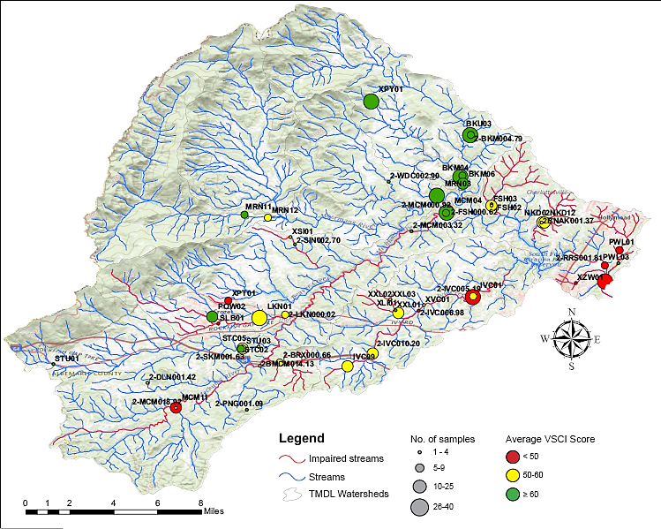
Map
If you are having technical difficulties, please call: 540-574-7872.

Slide 18
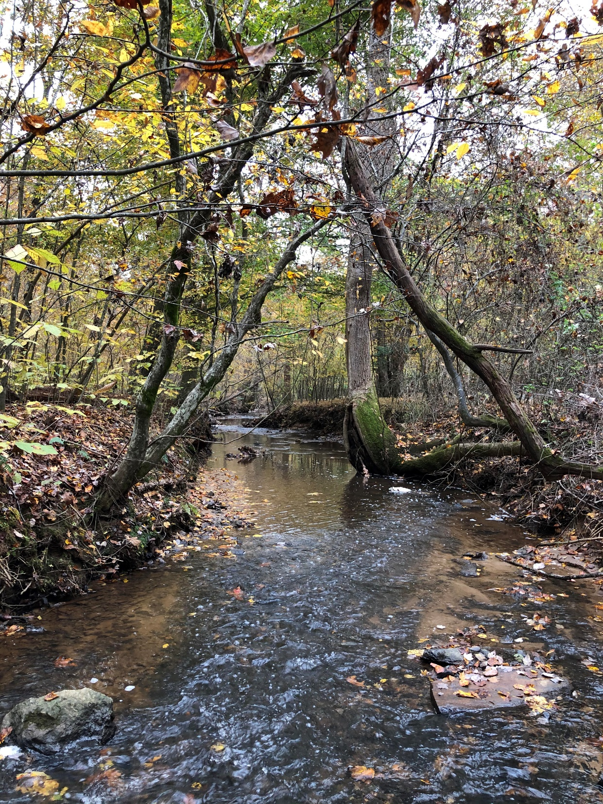
Q&A Session
Does the AllForX methodology make sense?
Do you have any suggested watersheds to add to the AllForX regression development?
If you are having technical difficulties, please call: 540-574-7872.

Slide 19
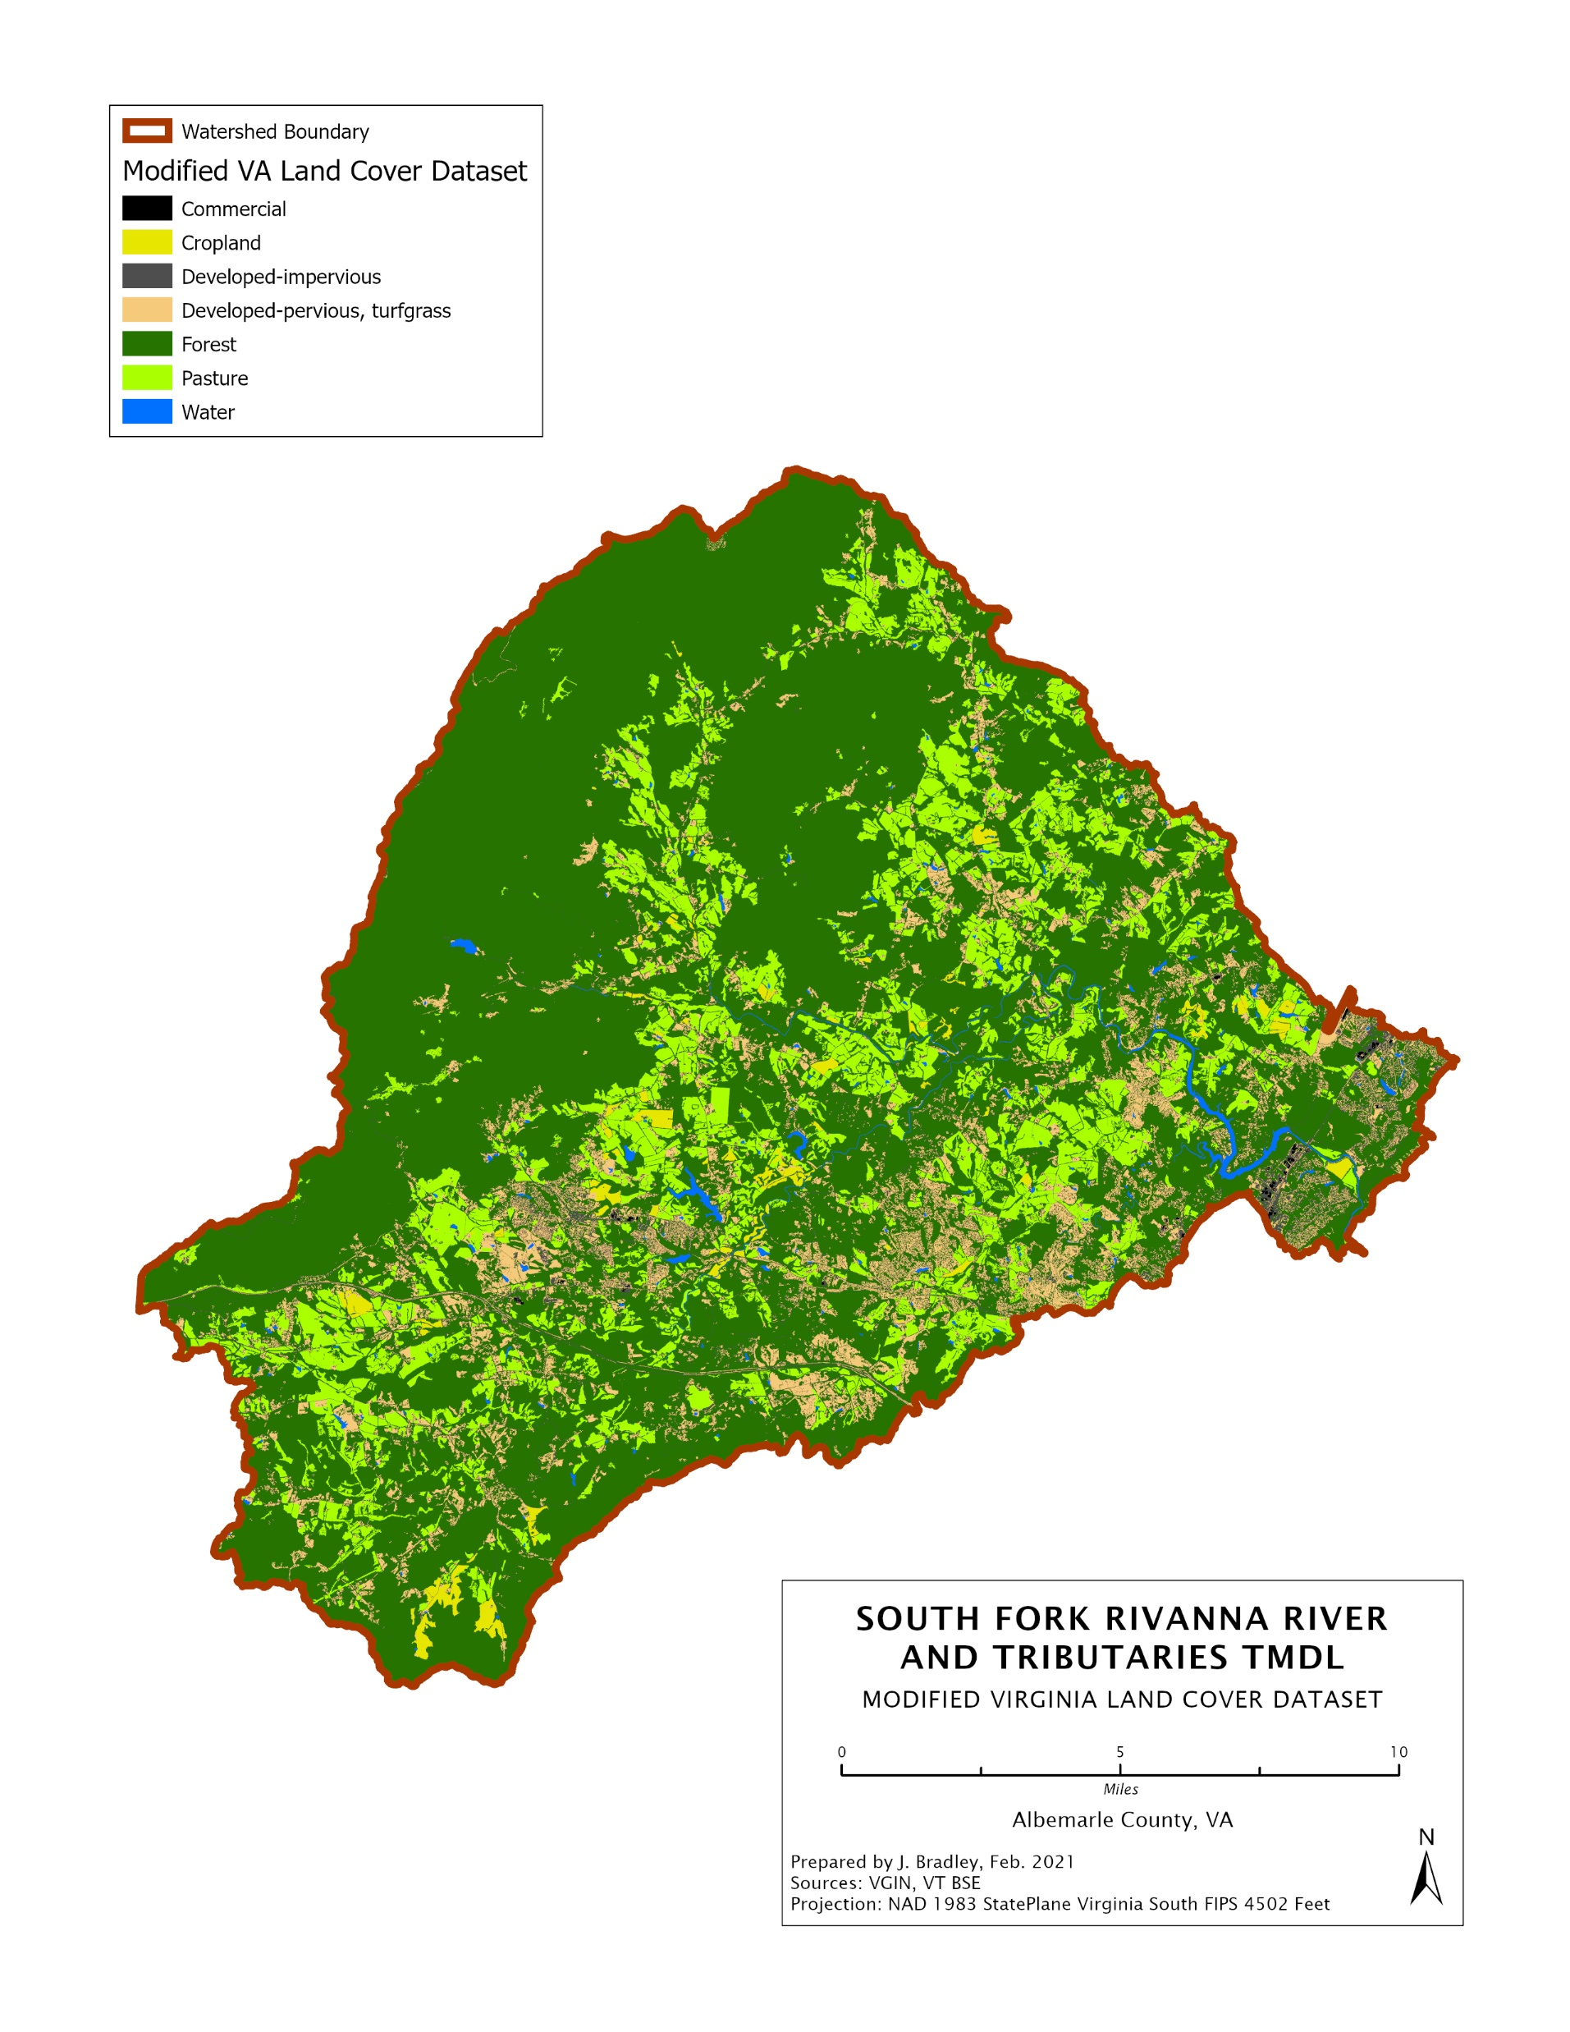

Virginia Tech Biological Systems Engineering (VT BSE) Department modified VA Land Cover Dataset
Virginia Tech Biological Systems Engineering (VT BSE) Department modified VA Land Cover Dataset
If you are having technical difficulties, please call: 540-574-7872.

Slide 20
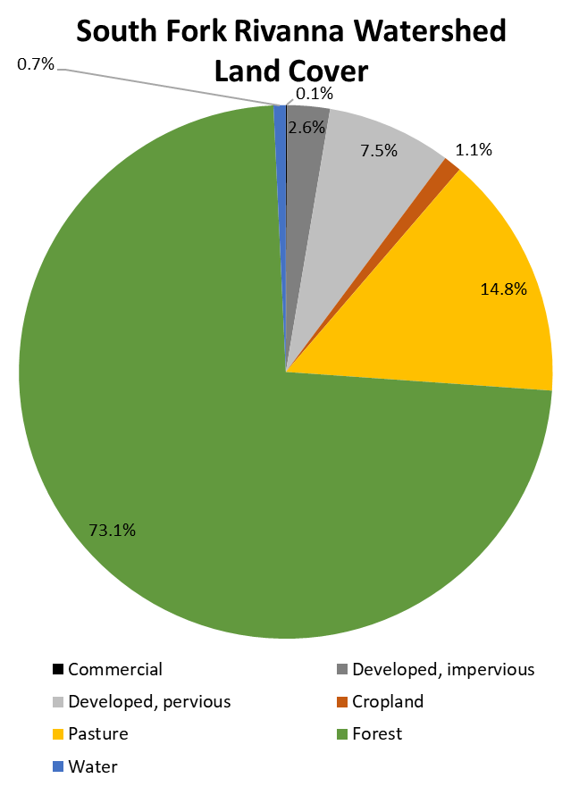

Modified VLCD Distribution
Land Cover Category | South Fork Rivanna River Watershed
 | Acres | %
Commercial | 140 | 0.1%
Developed, impervious | 4407 | 2.6%
Developed, pervious | 12885 | 7.5%
Cropland | 1875 | 1.1%
Pasture | 25341 | 14.8%
Forest | 125045 | 73.1%
Water | 1264 | 0.7%
Total | 170,957 | 100.0%
20
If you are having technical difficulties, please call: 540-574-7872.

Slide 21
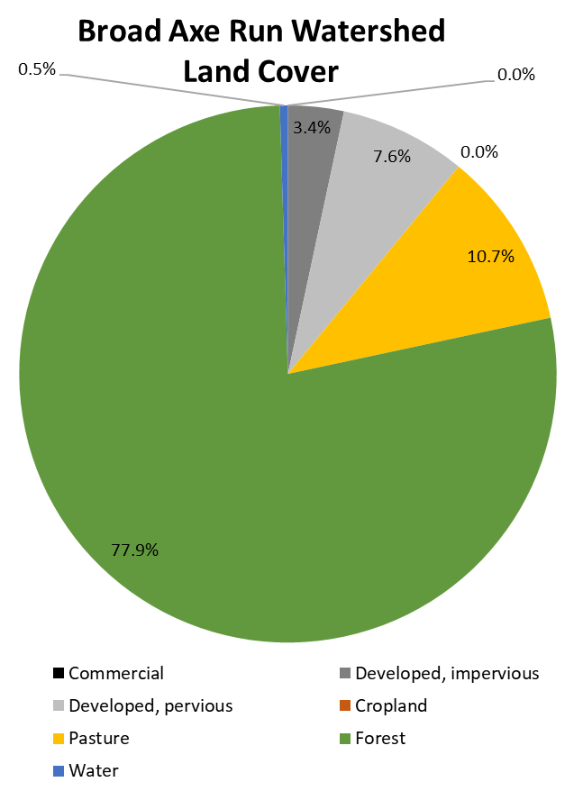

Modified VLCD Distribution
Land Cover Category | Broad Axe Run Watershed
 | Acres | %
Commercial | 0 | 0.0%
Developed, impervious | 67 | 3.4%
Developed, pervious | 151 | 7.6%
Cropland | 0 | 0.0%
Pasture | 212 | 10.7%
Forest | 1548 | 77.9%
Water | 10 | 0.5%
Total | 1,988 | 100.0%
21
If you are having technical difficulties, please call: 540-574-7872.

Slide 22
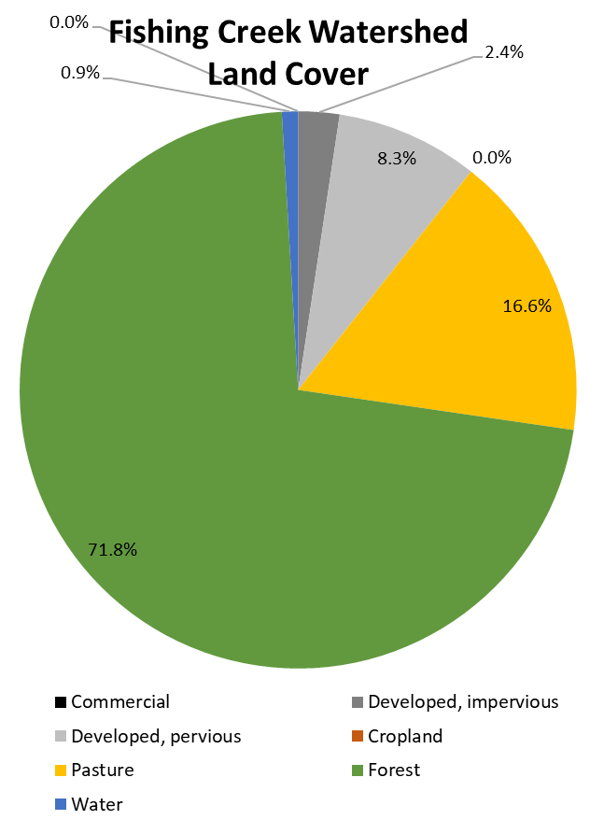

Modified VLCD Fishing Creek
Modified VLCD Distribution
Land Cover Category | Fishing Creek Watershed
 | Acres | %
Commercial | 0 | 0.0%
Developed, impervious | 72 | 2.4%
Developed, pervious | 250 | 8.3%
Cropland | 0 | 0.0%
Pasture | 504 | 16.6%
Forest | 2171 | 71.8%
Water | 28 | 0.9%
Total | 3,026 | 100.0%
22
If you are having technical difficulties, please call: 540-574-7872.

Slide 23
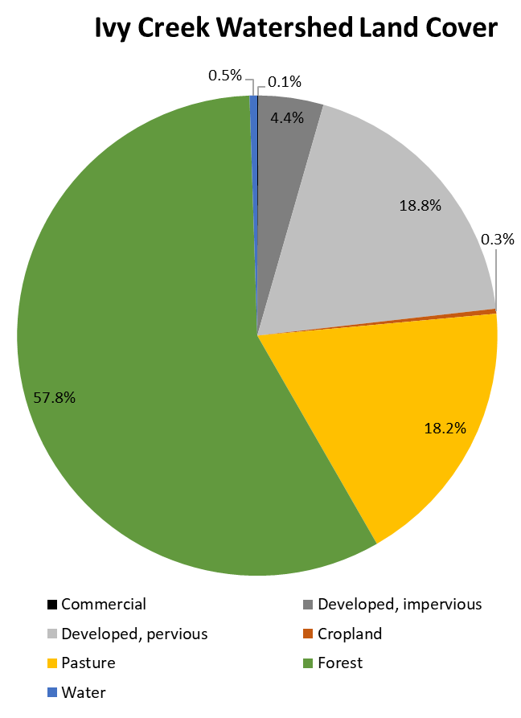
Modified VLCD Distribution
Land Cover Category | Ivy Creek Watershed
 | Acres | %
Commercial | 13 | 0.1%
Developed, impervious | 712 | 4.4%
Developed, pervious | 3058 | 18.8%
Cropland | 56 | 0.3%
Pasture | 2960 | 18.2%
Forest | 9419 | 57.8%
Water | 84 | 0.5%
Total | 16,302 | 100.0%
23
If you are having technical difficulties, please call: 540-574-7872.

Slide 24
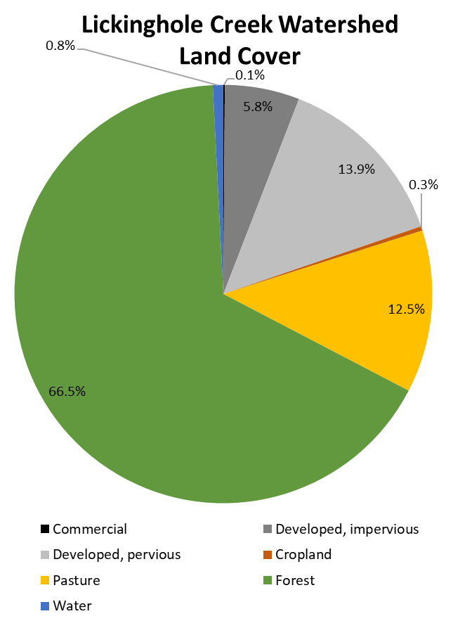

Modified VLCD Distribution
Land Cover Category | Lickinghole Creek Watershed
 | Acres | %
Commercial | 10 | 0.1%
Developed, impervious | 507 | 5.8%
Developed, pervious | 1216 | 13.9%
Cropland | 30 | 0.3%
Pasture | 1100 | 12.5%
Forest | 5835 | 66.5%
Water | 71 | 0.8%
Total | 8,769 | 100.0%
24
If you are having technical difficulties, please call: 540-574-7872.

Slide 25
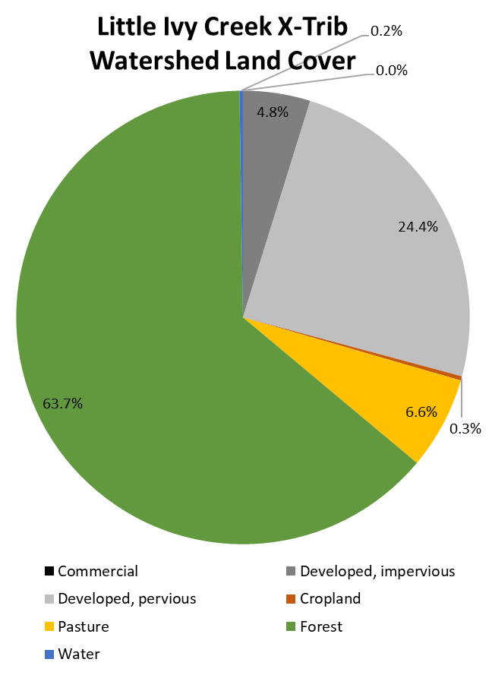

Modified VLCD Distribution
Land Cover Category | Little Ivy Creek X-Trib Watershed
 | Acres | %
Commercial | 0 | 0.0%
Developed, impervious | 60 | 4.8%
Developed, pervious | 308 | 24.4%
Cropland | 4 | 0.3%
Pasture | 83 | 6.6%
Forest | 803 | 63.7%
Water | 3 | 0.2%
Total | 1,261 | 100.0%
25
If you are having technical difficulties, please call: 540-574-7872.

Slide 26
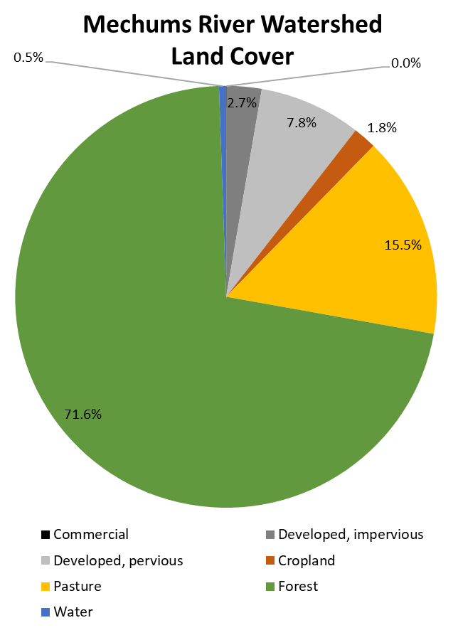

Modified VLCD Distribution
Land Cover Category | Mechums River Watershed
 | Acres | %
Commercial | 22 | 0.0%
Developed, impervious | 1669 | 2.7%
Developed, pervious | 4884 | 7.8%
Cropland | 1119 | 1.8%
Pasture | 9686 | 15.5%
Forest | 44760 | 71.6%
Water | 340 | 0.5%
Total | 62,479 | 100.0%
26
If you are having technical difficulties, please call: 540-574-7872.

Slide 27
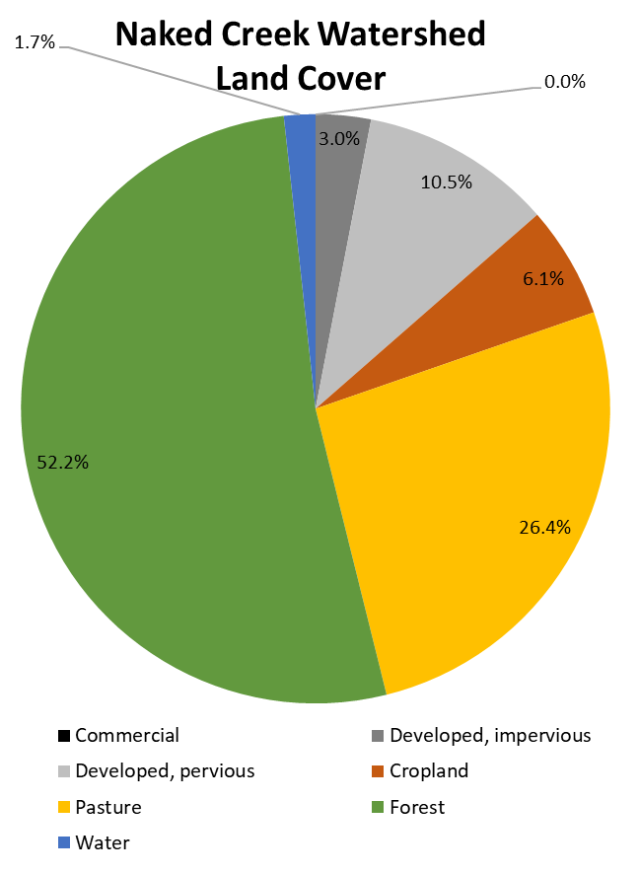

Modified VLCD Distribution
Land Cover Category | Naked Creek Watershed
 | Acres | %
Commercial | 0 | 0.0%
Developed, impervious | 64 | 3.0%
Developed, pervious | 222 | 10.5%
Cropland | 129 | 6.1%
Pasture | 558 | 26.4%
Forest | 1100 | 52.2%
Water | 36 | 1.7%
Total | 2,110 | 100.0%
27
If you are having technical difficulties, please call: 540-574-7872.

Slide 28
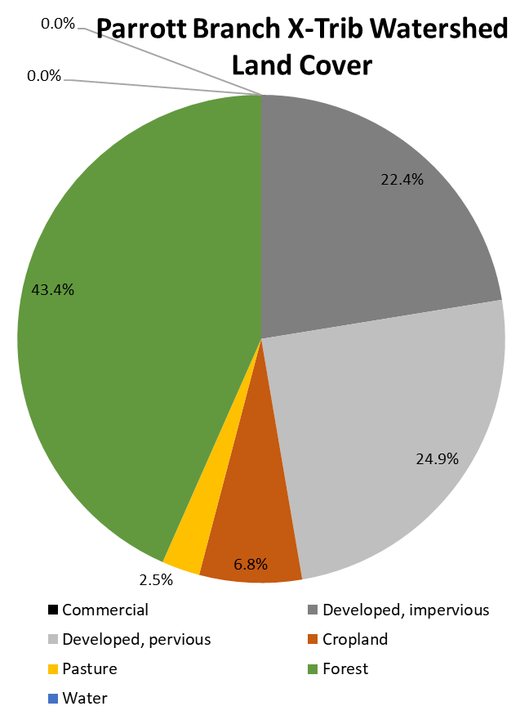

Modified VLCD Distribution
Land Cover Category | Parrott Branch X-Trib Watershed
 | Acres | %
Commercial | 0 | 0.0%
Developed, impervious | 28 | 22.4%
Developed, pervious | 31 | 24.9%
Cropland | 9 | 6.8%
Pasture | 3 | 2.5%
Forest | 55 | 43.4%
Water | 0 | 0.0%
Total | 126 | 100.0%
28
If you are having technical difficulties, please call: 540-574-7872.

Slide 29
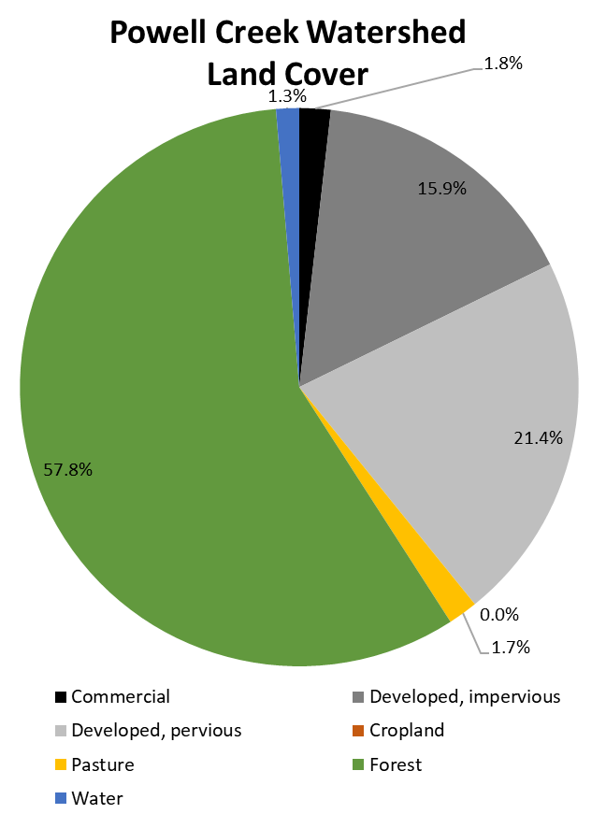

Modified VLCD Distribution
Land Cover Category | Powell Creek Watershed
 | Acres | %
Commercial | 44 | 1.8%
Developed, impervious | 385 | 15.9%
Developed, pervious | 518 | 21.4%
Cropland | 0 | 0.0%
Pasture | 41 | 1.7%
Forest | 1396 | 57.8%
Water | 32 | 1.3%
Total | 2,417 | 100.0%
29
If you are having technical difficulties, please call: 540-574-7872.

Slide 30
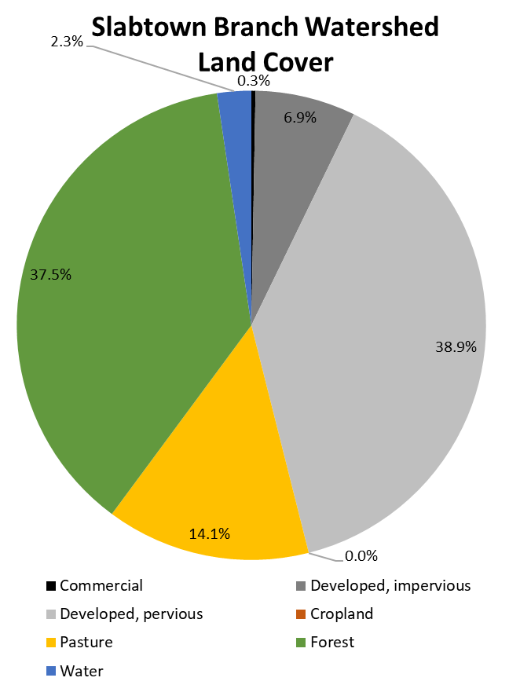

Modified VLCD Distribution
Land Cover Category | Slabtown Branch Watershed
 | Acres | %
Commercial | 2 | 0.3%
Developed, impervious | 57 | 6.9%
Developed, pervious | 319 | 38.9%
Cropland | 0 | 0.0%
Pasture | 116 | 14.1%
Forest | 308 | 37.5%
Water | 19 | 2.3%
Total | 821 | 100.0%
30
If you are having technical difficulties, please call: 540-574-7872.

Slide 31
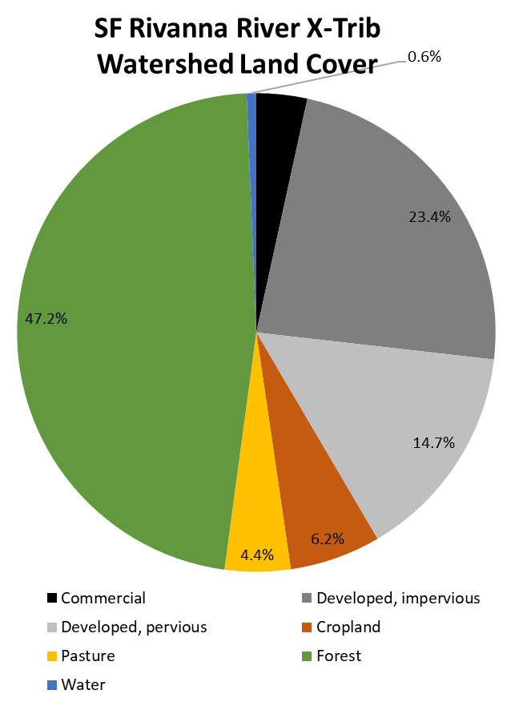

Modified VLCD Distribution
Land Cover Category | SF Rivanna River X-Trib Watershed
 | Acres | %
Commercial | 24 | 3.4%
Developed, impervious | 165 | 23.4%
Developed, pervious | 104 | 14.7%
Cropland | 44 | 6.2%
Pasture | 31 | 4.4%
Forest | 334 | 47.2%
Water | 5 | 0.6%
Total | 707 | 100.0%
31
If you are having technical difficulties, please call: 540-574-7872.

Slide 32
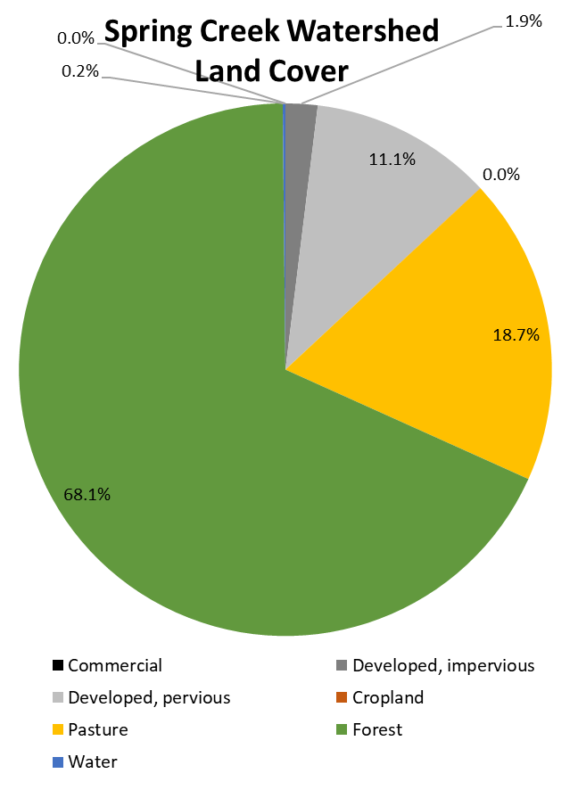
Modified VLCD Distribution
Land Cover Category | Spring Creek Watershed
 | Acres | %
Commercial | 0 | 0.0%
Developed, impervious | 25 | 1.9%
Developed, pervious | 145 | 11.1%
Cropland | 0 | 0.0%
Pasture | 244 | 18.7%
Forest | 889 | 68.1%
Water | 2 | 0.2%
Total | 1,306 | 100.0%
32
If you are having technical difficulties, please call: 540-574-7872.

Slide 33
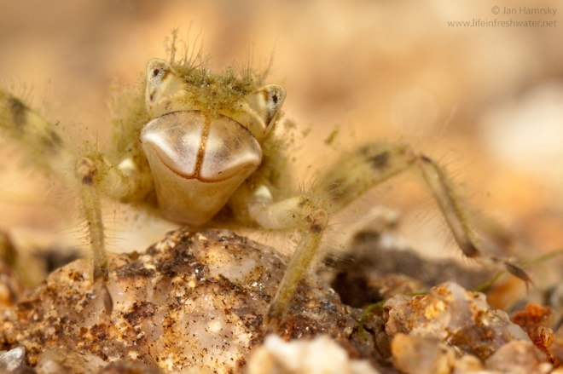
Q&A Session
Do the land use distributions presented match what you see on the ground?
Yes, these seem accurate
No, there’s something missing
I have a few questions…
Photo: Jan Hamrsky: lifeinfreshwater.net
If you are having technical difficulties, please call: 540-574-7872.

Slide 34
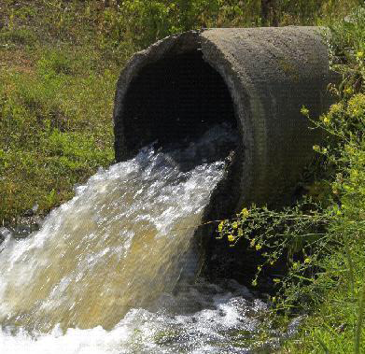
Identify point sources
Permitted Sources
2 VPDES Individual Permits
2 PWTP General Permits
4 ISW General Permits
4 Domestic Sewage General Permits
2 MS4 Permits
544.76 acres disturbed under Construction General Permits
1 Vehicle Wash General Permit
1 Nonmetallic Mineral Mining Permit
1 AFO Permit
If you are having technical difficulties, please call: 540-574-7872.
Notes:
Individual vs ISW
Understand that there is likely construction, just not at the scale that requires permits
Other way to estimate vs include in MOS/FL

Slide 35
Identify point sources
Virginia Pollutant Discharge Elimination System (VPDES) Individual Permits
Typical/existing loads based on discharge monitoring reports
Permitted/allocation loads based on permit language
Permit No | Facility Name | Receiving Stream
VA0027065 | Cooper Industries LLC | South Fork Rivanna River
VA0028398 | Charlottesville-Albemarle Airport Industrial Park | Naked Creek
If you are having technical difficulties, please call: 540-574-7872.
Notes:
Individual vs ISW
Understand that there is likely construction, just not at the scale that requires permits
Other way to estimate vs include in MOS/FL

Slide 36
Identify point sources
Potable Water Treatment Plant (PWTP) General Permits
Typical/existing loads based on discharge monitoring reports
Permitted/allocation loads based on permit language
Permit No | Facility Name | Receiving Stream | Estimated Maximum Discharge (MGD) | Permitted Concentration (mg/L TSS) | Permitted Load (lb/yr TSS)
VAG640097 | South Rivanna Water Treatment Plant | South Fork Rivanna River | 0.051 | 30 | 4,664
VAG640067 | Crozet Water Treatment Plant | South Fork Rivanna River | 0.063 | 30 | 5,761
If you are having technical difficulties, please call: 540-574-7872.
Notes:
Individual vs ISW
Understand that there is likely construction, just not at the scale that requires permits
Other way to estimate vs include in MOS/FL

Slide 37
Identify point sources
Industrial Stormwater (ISW) General Permits
Typical/existing loads based on model developed, impervious land cover
Permitted/allocation loads based on loading rates in the general permit
  440 lb/ac/yr TSS
  1.5 lb/ac/yr TP
Permit No | Facility Name | Receiving Stream
VAR050948 | R A Yancey Lumber Corporation | Mechums River
VAR050503 | Charlottesville-Albemarle Airport | Powell Creek
VAR052458 | Panorama Paydirt | South Fork Rivanna River and Naked Creek
VAR050973 | Ivy Materials Utilization Center | Broad Axe Run
If you are having technical difficulties, please call: 540-574-7872.
Notes:
Individual vs ISW
Understand that there is likely construction, just not at the scale that requires permits
Other way to estimate vs include in MOS/FL

Slide 38
Identify point sources
Domestic Sewage General Permits
Loading rates based on permitted flow and concentration
  91.44 lb/yr TSS
  7.61 lb/yr TP
Permit No | Receiving Stream
VAG408456 | South Fork Rivanna River
VAG408435 | Mechums River
VAG408493 | Mechums River
VAG408302 | South Fork Rivanna River
If you are having technical difficulties, please call: 540-574-7872.
Notes:
Individual vs ISW
Understand that there is likely construction, just not at the scale that requires permits
Other way to estimate vs include in MOS/FL

Slide 39
Identify point sources
Municipal Separate Storm Sewer (MS4) Permits
Loads based on area and land cover
Aggregated vs. disaggregated allocations
Permit Number | Permitted Entity
VAR040074 | Albemarle County
VA0092975 | Virginia Department of Transportation
If you are having technical difficulties, please call: 540-574-7872.
Notes:
Individual vs ISW
Understand that there is likely construction, just not at the scale that requires permits
Other way to estimate vs include in MOS/FL

Slide 40
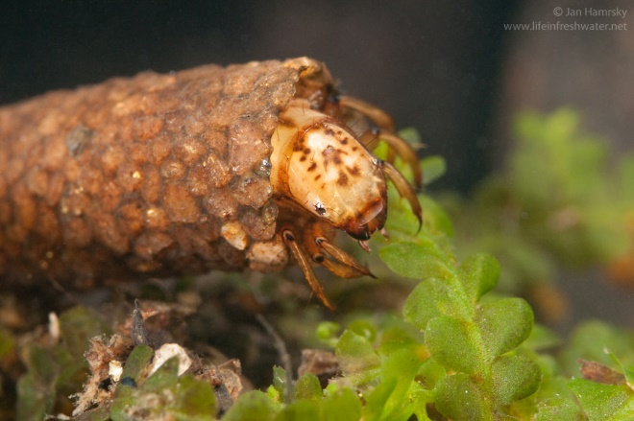
Q&A Session
Photo: Jan Hamrsky: lifeinfreshwater.net
Does it make more sense to handle the MS4 permits as aggregated or disaggregated?
If you are having technical difficulties, please call: 540-574-7872.

Slide 41
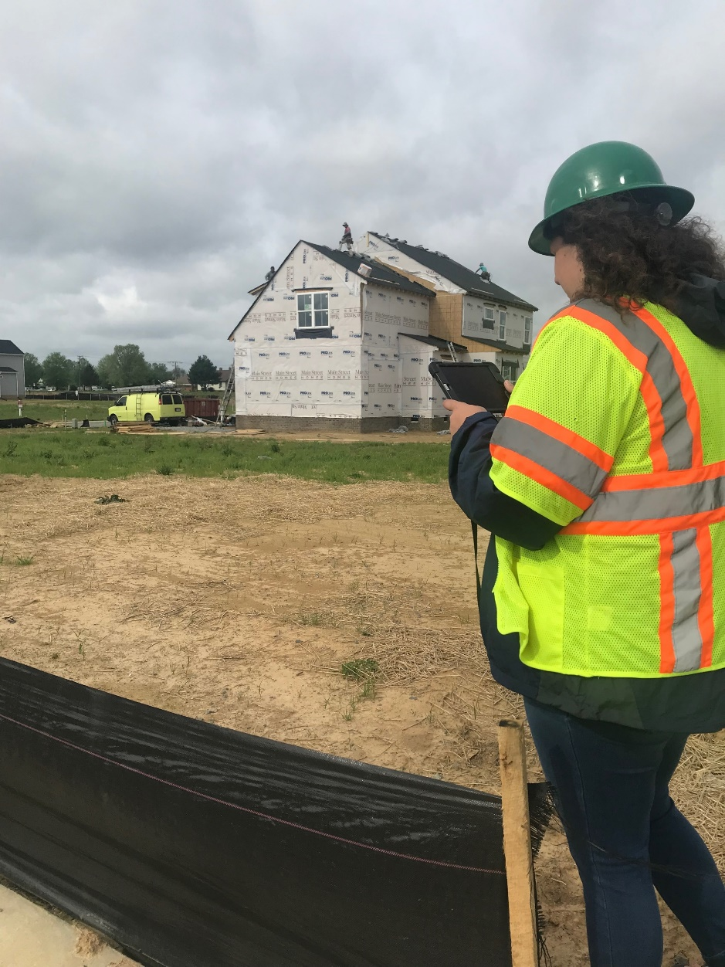
Identify point sources
Construction General Permits
WLA based on average disturbed area of active construction permits
Erosion and sediment control measures
  85% sediment removal
Receiving Stream | Estimated Potential Disturbed Area (ac)
Fishing Creek | 3
Ivy Creek | 7.7
Lickinghole Creek | 164.43
Powell Creek | 29.94
South Fork Rivanna River | 179.09
South Fork Rivanna River X-trib | 10.29
Slabtown Branch | 150.31
Total | 544.76
If you are having technical difficulties, please call: 540-574-7872.
Notes:
Individual vs ISW
Understand that there is likely construction, just not at the scale that requires permits
Other way to estimate vs include in MOS/FL

Slide 42
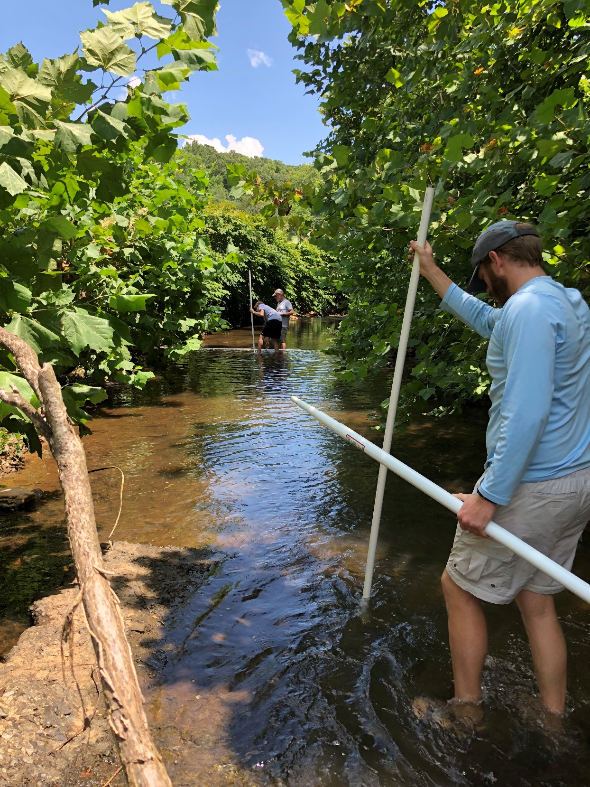
Q&A Session
Do the acreage estimates for construction related disturbance seem reasonable?
What level of ESC controls do you see implemented on construction sites within the watershed?
Controls on-site are spot-on
Controls are sometimes lacking
Sites are often out of compliance
If you are having technical difficulties, please call: 540-574-7872.

Slide 43
Identify point sources
Vehicle Wash General Permit
Permit No | Facility Name | Receiving Stream
VAG750045 | Albemarle County Schools Vehicle Maintenance Facility | Ivy Creek
Nonmetallic Mineral Mining General Permit
Permit No | Facility Name | Receiving Stream
VAG840204 | Luck Stone-Rivanna Plant | South Fork Rivanna River
Animal Feeding Operation (AFO) Permit
Permit No | Facility Name | Receiving Stream
VPG100217 | Early Dawn Dairy Inc | South Fork Rivanna River
If you are having technical difficulties, please call: 540-574-7872.
Notes:
Individual vs ISW
Understand that there is likely construction, just not at the scale that requires permits
Other way to estimate vs include in MOS/FL

Slide 44
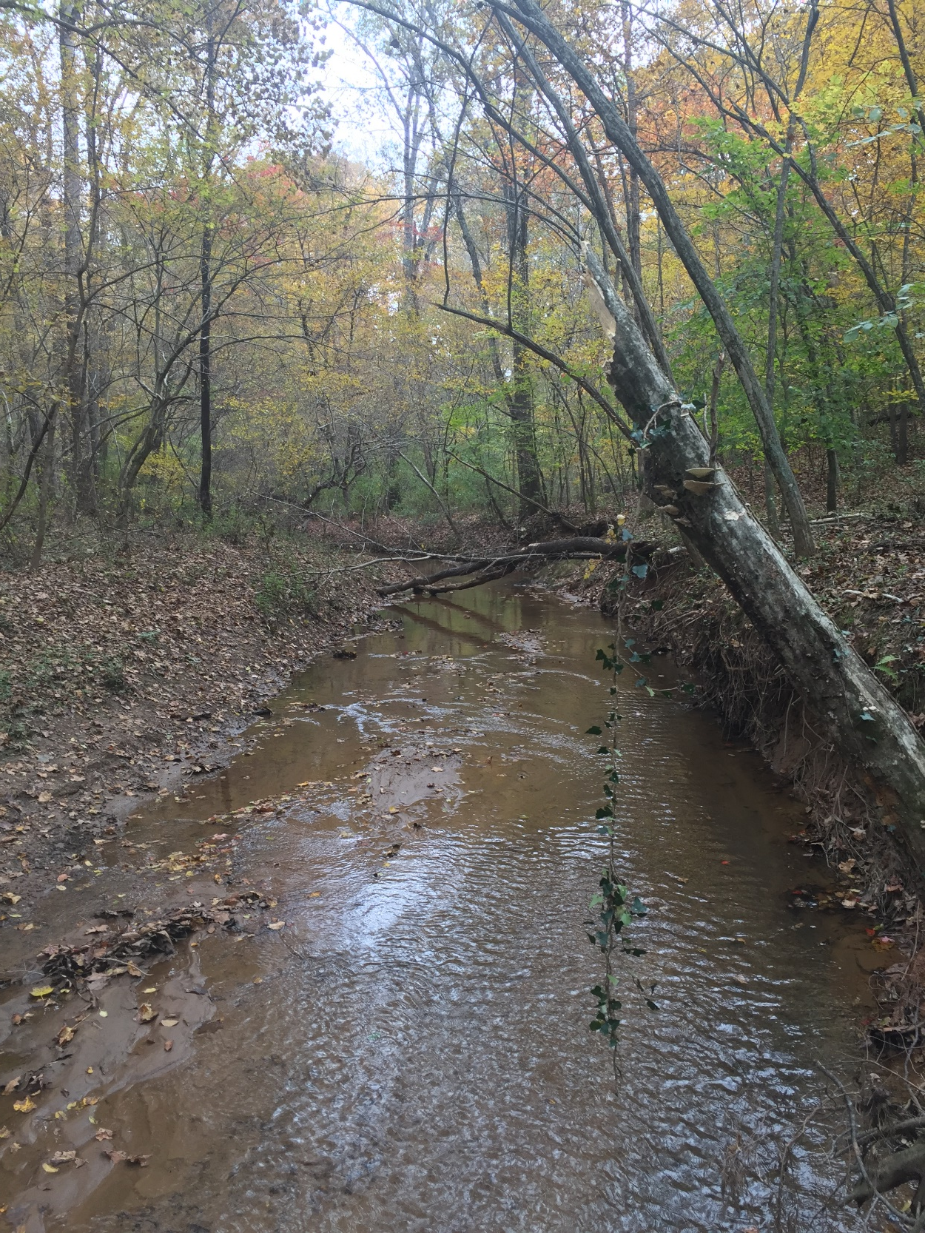
Q&A Session
Do you know of any permitted sources we may have missed?
Nope, you’ve got it covered
I think you’re missing at least one permit
Not permitted, but I think you are missing a pollutant source
If you are having technical difficulties, please call: 540-574-7872.

Slide 45
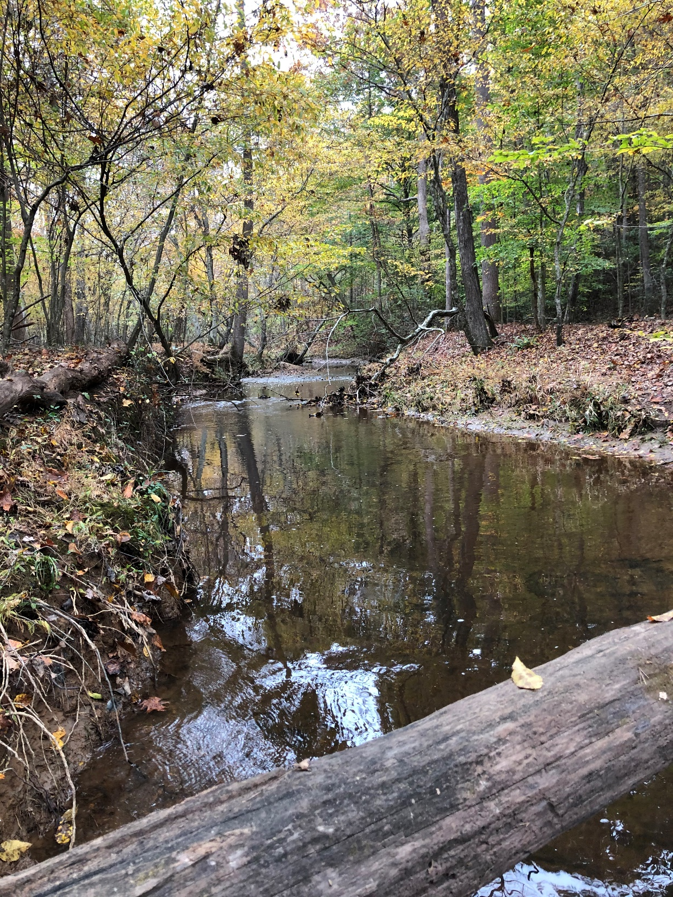
Next Steps
Development of watershed model
Allocation and reduction scenarios
Next Technical Advisory Committee meeting to be scheduled
45
If you are having technical difficulties, please call: 540-574-7872.

Slide 46
Please send all comments in writing to nesha.mcrae@deq.Virginia.gov or 4411 Early Road / PO Box 3000
Harrisonburg, VA 22801
The next TAC meeting will be scheduled to present preliminary modeling results.
To learn more about TMDLs, visit DEQ’s website: https://www.deq.virginia.gov/Programs/Water/WaterQualityInformationTMDLs/TMDL.aspx
If you are having technical difficulties, please call: 540-574-7872.

